Slide 1


REGIONAL
Committees on Trauma
RCOT Field Program Webinar Series
Copyright ©2025 American College of Surgeons. 633 N Saint Clair St, Chicago, IL 60611-3295

Slide 2
A Roadmap to RMOCC Implementation
©ACS

Slide 3
What are Regional Medical
Operations Coordinating Centers (RMOCCs) ?
Regional hubs that manage patient movement and resources by integrating emergency management, public health, EMS, and acute care systems.
They operate daily (e.g., trauma transfers, time-sensitive conditions) and can immediately surge for disasters or large-scale combat operations to balance casualties and capacity across hospitals—saving more lives and accelerating community recovery.
©ACS

Slide 4
Notes:
Replace with cleaned up graphic
Words are misspelled: Interoperability, Infrastructure
Should be 1000 casualties nationally per day

Slide 5








Initiating the RMOCC discussion in your region
©ACS

Slide 6
1
2
There are 6 Phases:
3
Preparation & Education
System Assessment
(“Lay of the Land”)
Administrative Setup
Fact Finding/Building the Team
Sustainability Planning
Building an RMOCC
4
5
6
©ACS

Slide 7
1
Phase
Preparation & Education
©ACS

Slide 8
1
2
3
4
5
6
Preparation & Education
Which key documents require my in-depth review and understanding?
©ACS

Slide 9
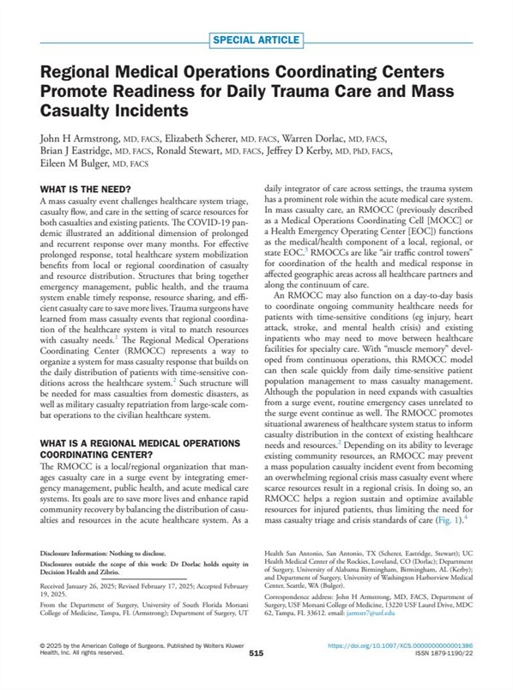
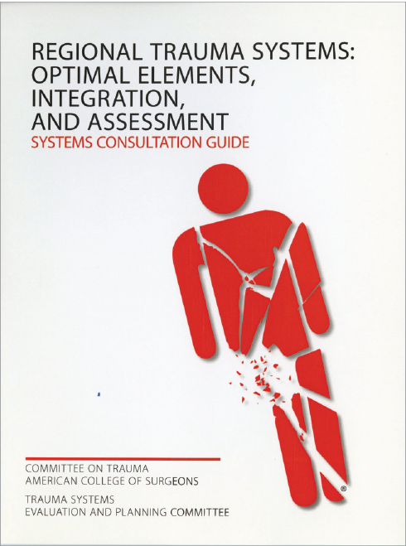
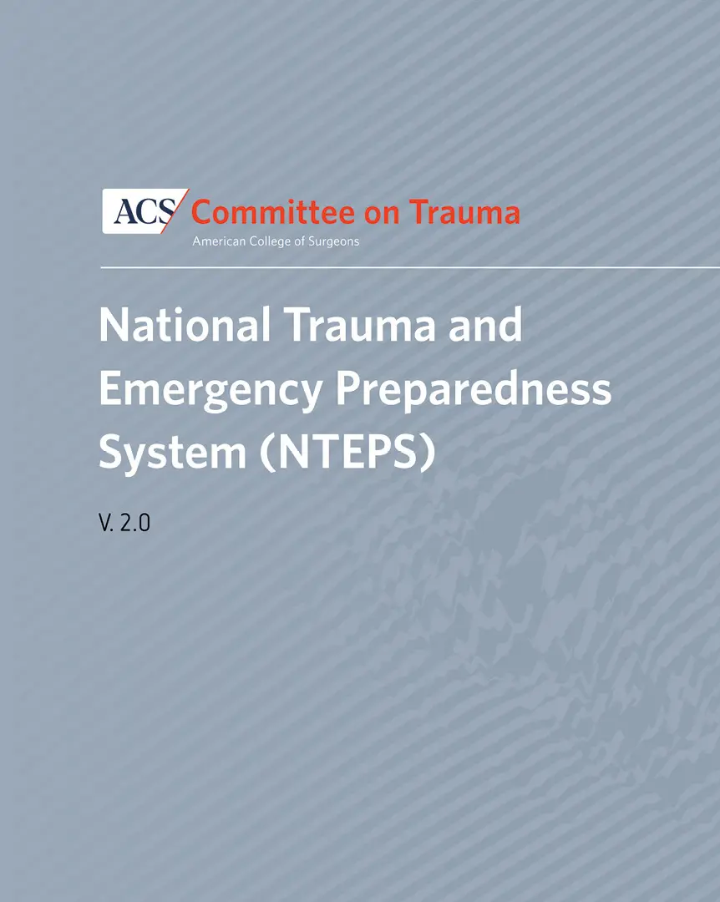

PHASE ONE
1
2
3
4
5
6
Preparation & Education
ACS COT White Book for Trauma Systems
COT’s NTEPS Version 2.0
JACS Paper on RMOCC
(Armstrong et al, Sept 2025)
©ACS

Slide 10


1
2
3
4
5
6
Preparation & Education
DRAFT
RMOCC Standards
coming in Spring 2026
ASPR TRACIE Version 3 Toolkit
Defense Health Board Report (Part 1 and Part 2)
ACS COT
RMOCC Standards
coming in Spring 2026
©ACS

Slide 11
1
2
3
4
5
6
Preparation & Education
Review Summaries from prior RCOT RMOCC Webinars
Introduction 2/11/2025 (Drs Jeff Kerby and John Armstrong)
STRAC 3/25/2025 (Eric Epley)
Standards 4/17/2025 (Dr Kristan Staudenmayer)
NDMS and Advocacy 7/29/2025 (Drs Staudenmayer and Joseph Sakran)
Washington State RMOCC 8/27/2025 (Dr Steven Mitchell)
Oregon State RMOCC and Tracking System 9/17/2025 (Dr David Lehrfeld)
NDMS Pilot Programs 11/12/2025 (Dr Jeff Freeman)
Go to www.facs.org/rmoccs to view all the available resources.
©ACS

Slide 12
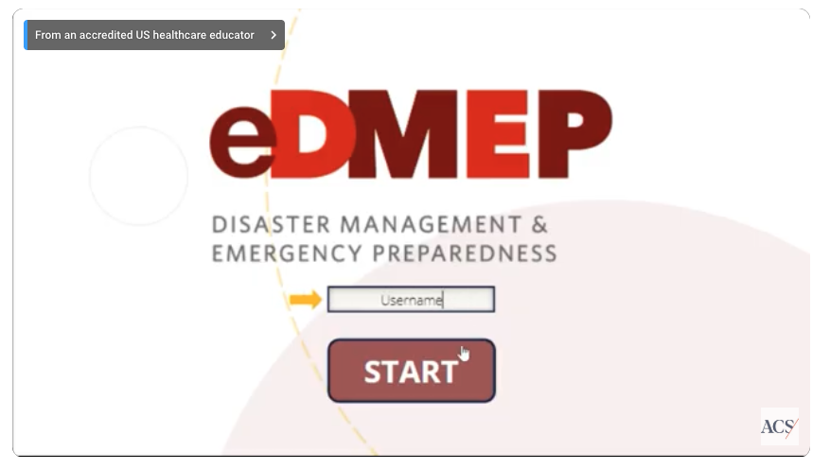
1
2
3
4
5
6
Preparation & Education
What course(s) should I participate in?
ACS COT eDMEP online course
©ACS

Slide 13
1
2
3
4
5
6
Preparation & Education
What are other states doing for trauma system development?
©ACS

Slide 14
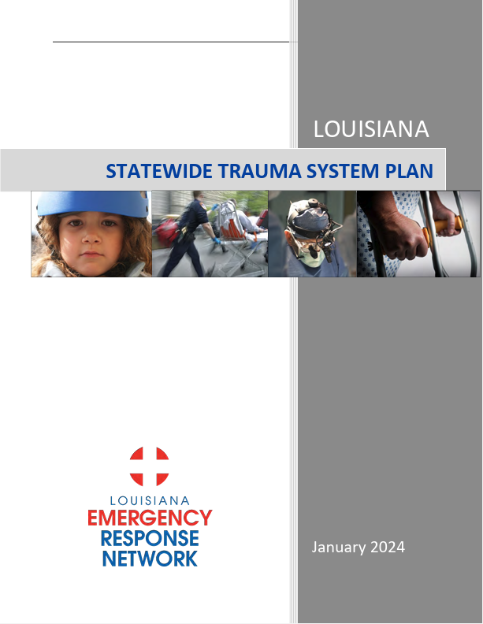
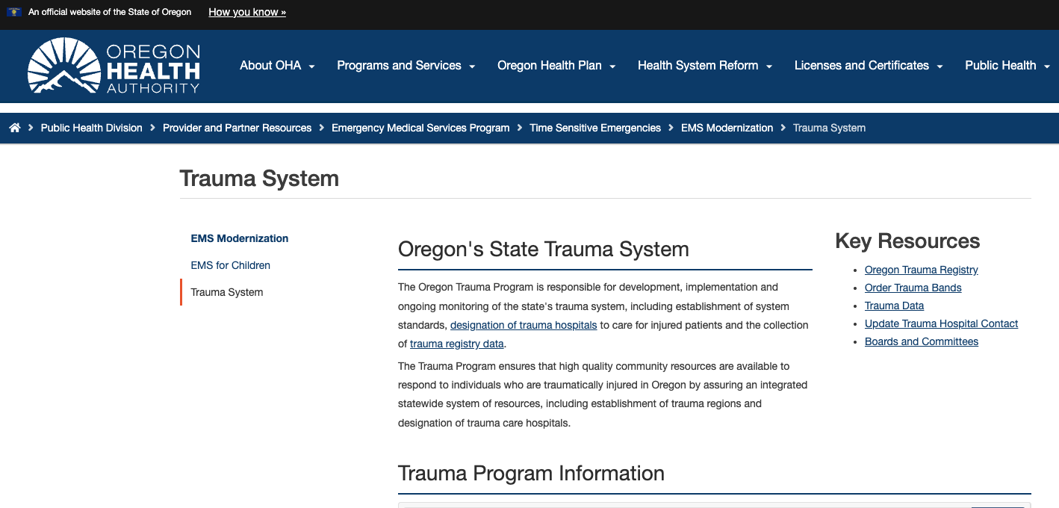
1
2
3
4
5
6
Preparation & Education
Review policies/procedures/functionality currently being used by: Alabama, Louisiana, Texas-STRAC, Washington state, Oregon, etc.
©ACS

Slide 15
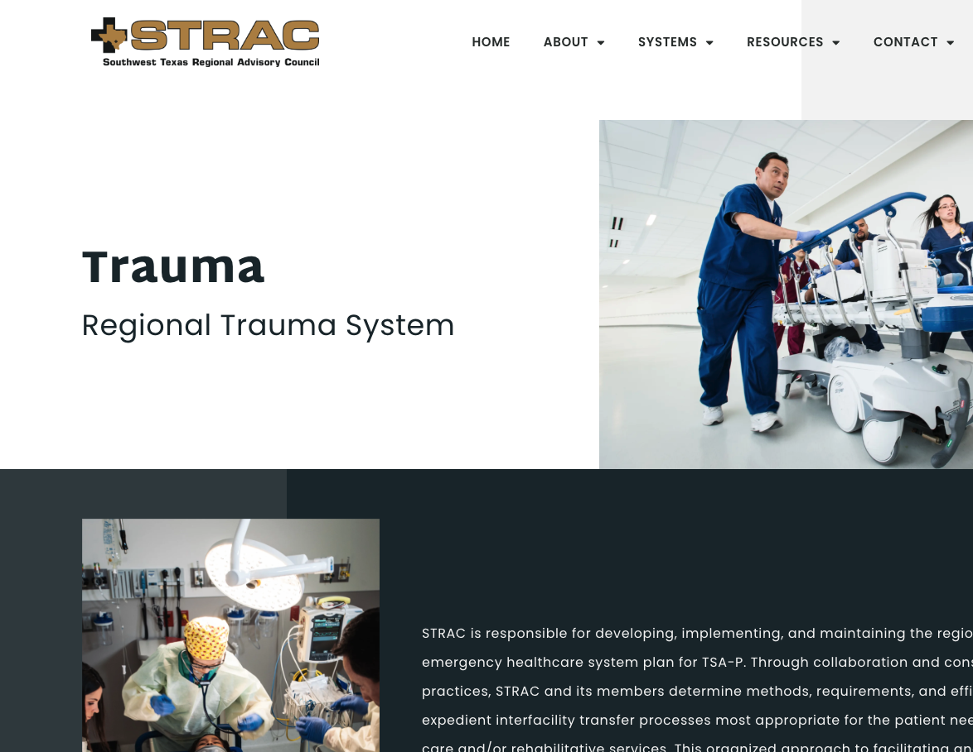

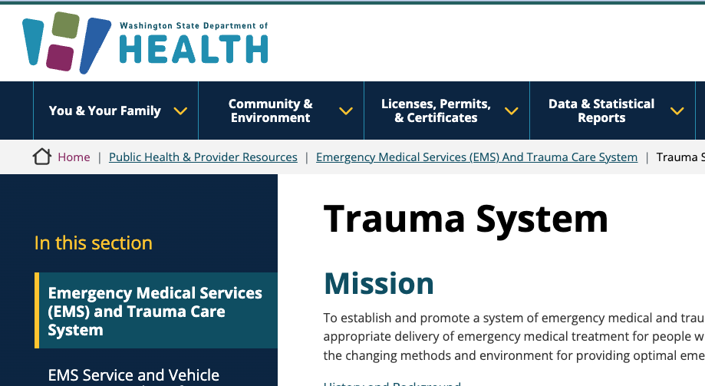

1
2
3
4
5
6
Preparation & Education
Review policies/procedures/functionality currently being used by: Alabama, Louisiana, Texas-STRAC, Washington state, Oregon, etc.
©ACS

Slide 16

1
2
3
4
5
6
Preparation & Education
Who do I need to connect with?
Participate in the monthly RCOT RMOCC working group webinars
©ACS

Slide 17
2
Phase
“Lay of the Land”
©ACS

Slide 18
Lay of the Land
1
2
3
4
5
6
How can I present the problem we are trying to address?
  Pose the question: If our nation were to receive 1,000 combat casualties per day for 30 or more days, how would we allocate those patients across the systems and what level of care should they be expected to provide?
  The system should be functional with day-to-day operations and be able
  to IMMEDIATELY surge for a disaster response or large-scale combat operation (LSCO).
  Focus on the Trauma and Disaster response first. Expansions into other areas of patient load balance including Psychiatry, STEMI and Stroke can be added later based on local/regional process and need.
©ACS

Slide 19
Lay of the Land
1
2
3
4
5
6
What resources or systems are already in place at the state/province level?
    Do we track facility capacity and capability?
    How do we prioritize patient transfers?
    Is there specialty consultation support?
    Can we perform patient load balancing in a crisis?
        If so, do we integrate with EMS?
        Who else participates?
    How do we coordinate transfers across jurisdictions or systems?
    Do we currently have telemedicine options?
    Are these functions supported currently?
©ACS

Slide 20
Lay of the Land
1
2
3
4
5
6
How are hospital beds tracked at the state/province level?
Determine which hospital-bed tracking system your state or province currently uses.
©ACS
Notes:
Oregon state has a beautiful system

Slide 21
Lay of the Land
1
2
3
4
5
6
How are patients tracked at the state/province level?
Determine if a patient tracking system is being used for patient movement.
If so, how is this funded and how is it linked to other regional systems?
©ACS

Slide 22
3
Phase
Administrative Setup
©ACS

Slide 23
Admin
1
2
3
4
5
6
Who needs to be involved?
Admin Support
Identify a solid administrative support person to facilitate meetings, contact lists
COT Work Group
Coordinate with your state/province chair on your involvement and develop a 1-3 person COT working group
Stakeholders
Build a stakeholder contact list as you progress through the tasks below (see RMOCC Checklist)
©ACS
Notes:
Potential candidate may be someone retired from clinical practice

Slide 24
Admin
1
2
3
4
5
6
What tools are needed?
Obtain and Modify the RCOT Field Program RMOCC Pitch Deck to meet your region’s needs
Go to www.facs.org/rmoccs to view all the available resources.
©ACS

Slide 25
4
Phase
Fact Finding / Building the Team
©ACS

Slide 26
Fact Finding/
Building the Team
1
2
3
4
5
6
Who are the stakeholders that need to be involved?
©ACS

Slide 27
Hospital System Leadership
Who will your point person be?
State/Regional Trauma Medical Directors
Reach out to Medical Directors throughout the state/region
State Hospital Preparedness Program
Learn about the Hospital Preparedness Program and
who is involved.
Learn how your system is structured to meet the different ESFs (e.g., transport, search and rescue, public health and medical support, etc.).
    Find out who is the leader of ESF-8.
    Determine if there is there funding to support your coalition.
State/Province Health Department’s Agency responsible for Disaster Response and Trauma Care
This is typically the Public Health Emergency Preparedness Director
State/Province Health Care Coalition Stakeholders
  Typically, the Hospital Association and State/Province Medical Associations
Determine who is the Preparedness representative
Emergency Operations Center Leadership
©ACS
Notes:
ESF=Emergency Support Function, ESF 8 refers to public health and medical services

Slide 28
EMS agencies’ Senior Leadership
  Colleagues from ACEP and NAEMSP
  RDHRS (ASPR) – Is your state already part of it, if so, how are they involved?
  Determine if your region has allocated funding.
State/Province Health Systems’ Leadership
(C-Suite)
  Determine who are the senior leaders that should be involved and if there are house supervisors at the trauma centers who may be key players and/or advocates
  Military Programs
Discover who is responsible for military integration in your state/province and establish contacts with ICMOP, FEMA, Mil-Civ partnerships, NDMS.
  NDMS pilot programs already include Capital Region, Omaha, San Antonio, Sacramento, Puget Sound, Oahu (HI), Denver, and Shreveport.
©ACS

Slide 29
Fact Finding/
Building the Team
1
2
3
4
5
6
How do I collaborate with the ACS COT Advocacy Team?
  In concert with the ACS COT Advocacy team, meet with the
  following groups:
    State legislators who sit on Health Affairs Committee
    State legislators with a military or medical background
    Federal congressional members
        Discuss the importance of federal funding for the trauma system RMOCC.
        Discuss the importance of funding being tied to specific requirements
        (PAHPA reauthorization, Mission Zero funding).
Your ACS COT
Advocacy Contacts:
Federal – Emma Zimmerman ezimmerman@facs.org
State – Catherine Hendricks chendricks@facs.org
General – Joseph Sakran, MD, MPH, MPA, FACS jsakran1@jhmi.edu
©ACS

Slide 30
Fact Finding/
Building the Team
1
2
3
4
5
6
What data will be needed?
  Determine how many RMOCCs will be needed in your state/region.
©ACS

Slide 31
Fact Finding/
Building the Team
1
2
3
4
5
6
What are the deliverable for this phase?
Build a coalition working group (if not already meeting regularly) or ask for your team to participate (if these meetings are already occurring).
Build an RMOCC Steering Committee.
Encourage the State/Province Dept of Health to seek out a COT Trauma Systems consultation (if not done in the past 2-3 years).
©ACS

Slide 32
5
Phase
Sustainability
©ACS

Slide 33
Sustainability
4
1
2
3
5
6
What are the deliverables for this phase?
Identify where your state/province federal disaster money is going.
Work on a creative funding solution for your RMOCC.
  Potential avenues include: ASPR, NDMS, State (under hospital preparedness program HPP), Hospital Association, Health Care Coalitions (funding under ASPR), individual hospital systems, DoW, State initiatives: increase in vehicle tag fees by the State, etc.
Consider creating a nonprofit organization to run your coalition (i.e., STRAC 501-6c status).
©ACS
Notes:
DoW= Dept of War (Prior Dept of Defense)

Slide 34
6
Phase
Build an RMOCC
©ACS

Slide 35
Build an RMOCC
6
1
2
3
4
5
What is the core issue the day-to-day RMOCC is trying to solve?
Define the goals and objectives for the RMOCC.
Identify which patients are served.
Identify which systems/centers/units participate.
©ACS

Slide 36
Build an RMOCC
6
1
2
3
4
5
What is the operational sustainability plan?
Identify a centralized communication center.
Identify the method of communication/software package for tracking.
Create a long-term oversight/leadership team.
Define the return on investment.
Integrate the RMOCC into the existing infrastructure (e.g., disaster, transfer, telehealth, etc.).
Identify sustainable funding.
©ACS

Slide 37
Build an RMOCC
6
1
2
3
4
5
How is the plan scalable for regional and national disasters?
Work with your regional and state COT chair to integrate into the national RMOCC network.
©ACS

Slide 38
To recap:
There are 6 Phases:
Preparation & Education
System Assessment (“Lay of the Land”)
Administrative Setup
Fact finding/Building the Team
Sustainability Planning
Building an RMOCC
©ACS

Slide 39
Quick Reference Graphic
©ACS

Slide 40

Questions?

Slide 41

Thank You.
©ACS

