Slide 1


REGIONAL
Committees on Trauma
RCOT Field Program Webinar Series
The History of Pediatric Readiness and Survey Process
Copyright ©2025 American College of Surgeons. 633 N Saint Clair St, Chicago, IL 60611-3295

Slide 2

REGIONAL
Committees on Trauma
MARY E. FALLAT MD, FACS, FAAP
PROFESSOR OF SURGERY
UNIVERSITY OF LOUISVILLE
mefall01@louisville.edu
©ACS

Slide 3


You can adjust the horizontal length of the light blue and dark blue triangles to fit whatever you need.
Disclosure
Dr. Fallat receives grant support from the Health Resources & Services Administration (HRSA) for Kentucky EMSC as Principal Investigator and the Pediatric Pandemic Network grant as a sub-Principal Investigator.
The contents are solely the responsibility of the author and do not necessarily represent the official views of ASPR, HRSA or the Department of Health and Human Services.
©ACS

Slide 4
Objectives
At conclusion of this program,
the participant will be able to:
Provide historical context and foundational knowledge of Pediatric Readiness systems and surveys.
Describe how the National Pediatric Readiness Program helped to shape the national standards.
Advocate effectively within their trauma systems and partner with other organizations and hospital emergency departments to improve pediatric readiness.
©ACS

Slide 5
History of
Pediatric Readiness within the
EMS System

Slide 6

THE FEDERAL EMS FOR CHILDREN PROGRAM (HRSA, MCHB)
EMS Systems Act approved by Congress & provided resources to state/local govt to develop comprehensive EMS systems
1973-81
1975-9
State EMS systems improve the outcomes for adults but not children
Calvin Sia, MD, Hawaii Medical Association President, urges AAP to develop “multi-facted EMS programs” to decrease disability and death in children
1979
1983-4
Senator Daniel Inouye (D-HI) joins Dr. Sia after learning about emergency care provided to a senior staff member’s daughter. Senators Orrin Hatch (R-UT) and Lowell Weicker (R-CT), backed by staff with similarly disturbing experiences, join Sen. Inouye in sponsoring successful legislation to create the EMSC Program in 1984
Notes:
The EMS Systems Act of 1973 provided grants for studying, planning, establishing, and improving emergency medical services, and research in emergency medical techniques. More than $300 million in federal grants had been distributed to establish 300 EMS and trauma systems across the U.S. In 1981, the Omnibus Budget Reconciliation Act withdrew federal funding dedicated to EMS and trauma systems. The Act consolidated funding into a broader state preventive health block grant, shifting the responsibility to state governments to decide whether and how to fund their trauma systems. The federal government does not consistently fund EMS, unlike police and fire services, which receive support from federal sources like the Department of Justice.
In 1979, Calvin Sia, MD, then-president of the Hawaii Medical Association, requested that the members of the AAP develop EMS programs designed to decrease disability and death in children. Soon after, Senator Daniel Inouye responded to this request by introducing a legislative vehicle in the United States Senate. His staff assistant and chief of staff Patrick DeLeo’s daughter was hospitalized with meningitis. The girl's treatment demonstrated the shortcomings of an average emergency department when treating a critically ill child. Other legislators were Senators Orrin Hatch (R-UT) and Lowell Weicker (R-CT).

Slide 7
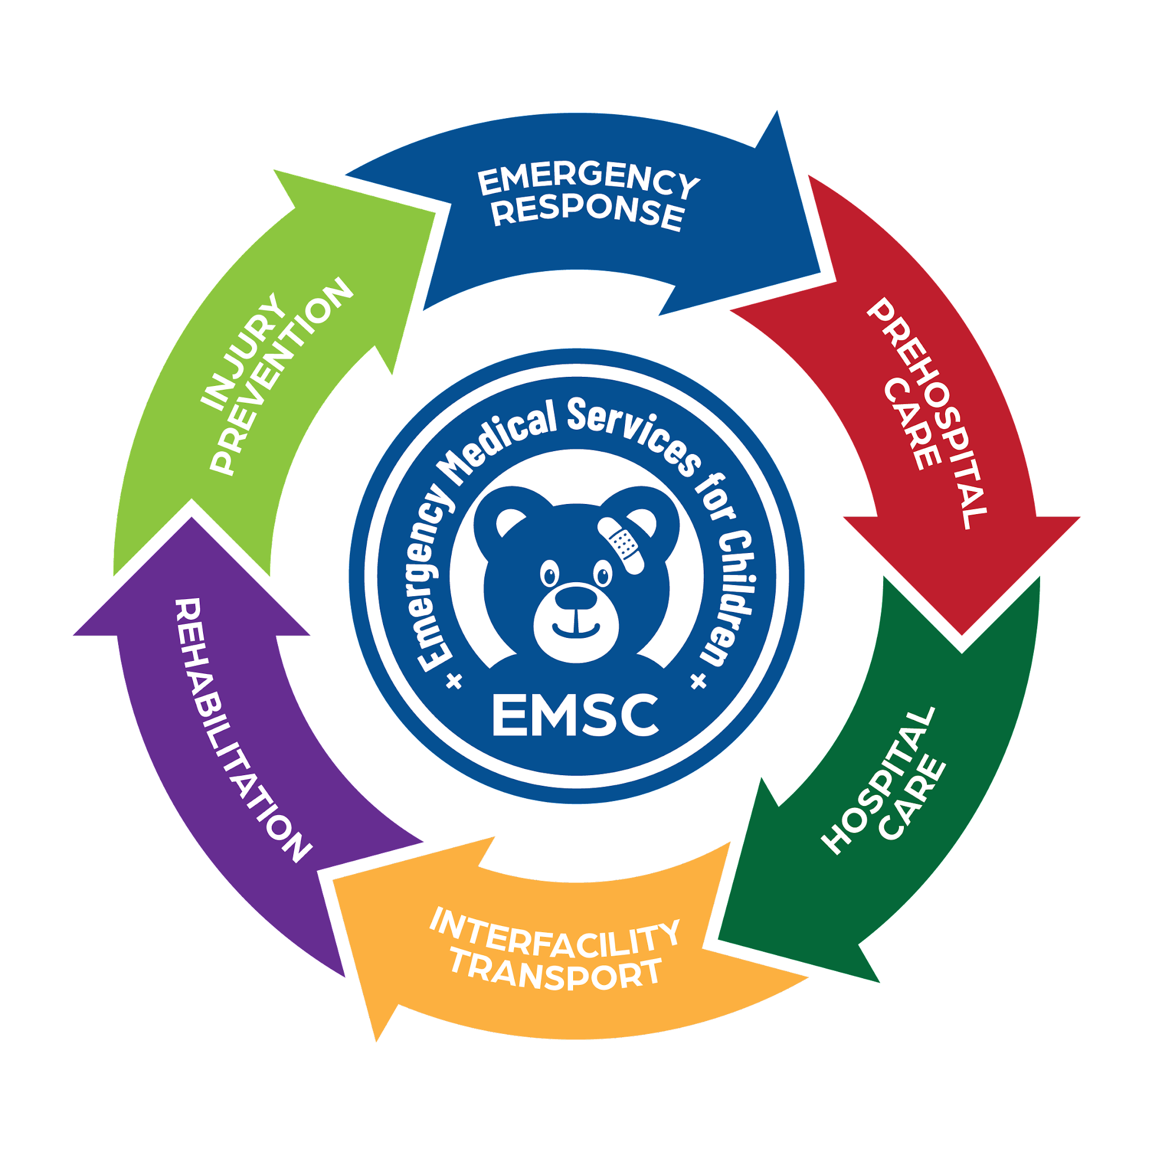
The EMS for Children Program (1984-5)
Designed to reduce childhood death and disability due to severe illness or injury
Enhance the pediatric capability of existing emergency care systems designed for adults

Slide 8
THE FEDERAL EMS FOR CHILDREN PROGRAM (HRSA, MCHB)
1984
Initial legislation passed
1986
First grants to 4 states: AL, NY, CA, OR
1991-2
Targeted Issues Grants
Congress appropriated 2 million dollars in 1984.
EMSC Targeted Issues (TI) Grants support projects
that develop and implement timely, practical
strategies to address high-priority, unmet gaps
in pediatric emergency care.

Slide 9
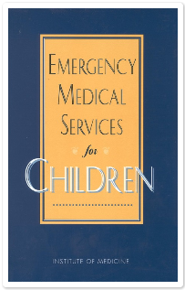



JACOB ALEXANDER HALLER, JR
MARTY EICHELBERGER
JOE TEPAS
1993
Joe Tepas
National Pediatric Trauma Registry
Pediatric Trauma Score Development
Emergency Medical Services For Children
Jacob Alexander Haller, Jr
First Pediatric Trauma System
Emergency Medical Services For Children
Marty Eichelberger
National Safe Kids Campaign 1988
Emergency Medical Services for Children
Continuum of Care
Notes:
3/19 on the panel
Susan McHenry: Director, Emergency Medical Services, Office of
Emergency Medical Services, Virginia Department of Health, Richmond,
Virginia
Calvin Sia
Administrators, Hospital officials, Community Officials, EMS

Slide 10
THE FEDERAL EMS FOR CHILDREN PROGRAM (HRSA, MCHB)
EMSC Partnership Grant Program
First State recognition program - IL
1997-8
1999
First model of standards for EDAPs CA
2000
State-by-State Trauma System Needs Survey
(NHTSA, FORHP)
1993
2001
Care of Children in the ED Guidelines – AAP, ACEP
2001
Emergency Medical Services for Children Program
Trauma/EMS System Supplement
2001
Pecarn
First federally-funded, multi-institutional network for research in Pediatric Emergency Medicine
Pediatric Emergency Care Applied Research Network
By 2005, program funding was $20 million
Notes:
Care of Children in the ED was the predecessor of “pediatric readiness”.
In 2001 - EMSC, NHTSA, and the Office of Rural Health Policy conducted a state-by-state trauma systems needs survey to characterize the current structure and viability of state trauma systems. The survey led to the development of a national group on trauma and EMS systems, inclusive of rural communities. Briefly, HRSA funded trauma system grants, initially as a supplement to EMSC in each state. This was followed by an RFP for a 3 year grant cycle offering $120,000 per grantee. Unfortunately, funding was withdrawn within a year after these awards.

Slide 11
2003: First National Assessment of EDs
55/100 median score
29% (1489) response rate
Paper survey,
Mailed
<60% aware of national guidelines
Notes:
First National Assessment of EDs Conducted in 2003
Under a grant from the EMSC Program, an assessment is conducted to determine U.S. hospitals’ adherence to AAP and ACEP’s 2001 guidelines. Results reveal that most hospitals are unaware of the national guidelines and few hospitals have all the equipment and essential care policies listed.

Slide 12
THE FUTURE OF EMERGENCY
CARE IN THE UNITED STATES
HEALTH SYSTEM
June 2004-2006
Bill Schwab
Brent Eastman
Mary Fallat
Notes:
In June 2004, the Institute of Medicine formed 3 subcommittees, in addition to a main committee, to examine the crisis in emergency care in this country. The crisis was multifaceted, impacting every aspect of emergency care from prehospital EMS to hospital-based emergency and trauma care. Several members of the trauma community were selected to participate, including Bill Schwab on the main committee and the Hospital-based subcommittee, Brent Eastman on the Prehospital EMS Subcommittee, and myself on the Pediatric Subcommittee.

Slide 13
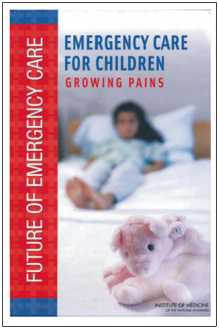
2006 IOM REPORT
Variation in preparedness described as UNEVEN
Only 6% of EDs in the US had all the supplies deemed essential for managing pediatric emergencies
  Only half of hospitals had at least 85% of those supplies
Lack of care coordination
Geographic disparities in access
Pediatric treatment patterns varied widely among emergency care providers
  Many providers undertreated children
  Many failed to recognize cases of child abuse
Recommended that “hospitals should appoint 2 pediatric emergency coordinators—one a physician—to provide pediatric leadership for the organization.”
Notes:
A year later, the IOM report was released. The report showed: variation in preparedness to care for children. Using the word “uneven” the report addressed supplies in the ED, lack of care coordination, geographic disparities, undertreatment and failure to recognize abuse. Similar to other areas of the 2006 report, many of the gaps remain today.

Slide 14
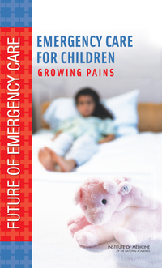





If there were one word to describe the state of emergency care for children, it is “uneven.”
EMSC Performance Measures (2006, 2009)
Expand our team (ENA)
Educational resources
Enhance communication efforts
2001: Joint Policy Statement “Care of Children in the Emergency Department: Guidelines for Preparedness” (AAP, ACEP)
2003: Baseline assessment based on 2001 Joint Policy Statement
Institute of Medicine Committee on the Future of Emergency Care in the U.S. Health System. Washington, DC: National Academies Press; 2006.
Notes:
AHRQ PDSA Cycle
EMSC PM (2006): operational capacity to provide pediatric emergency care (aim statement)
The 2001 joint policy statement was updated in 2009. Authored by AAP, ACEP, and the ENA, the statement was endorsed by 22 organizations, including ACS, NAEMSP, NAEMT, and NASEMSO. The statement offers recommendations for essential equipment, medications, personnel training, and key policies necessary for optimal pediatric emergency care.

Slide 15
“Pediatric Readiness”
Pediatric Readiness is ensuring that every EMS agency and emergency department has the pediatric-specific champions, competencies, policies, equipment, and other resources needed to provide high-quality emergency care for all children.

Slide 16
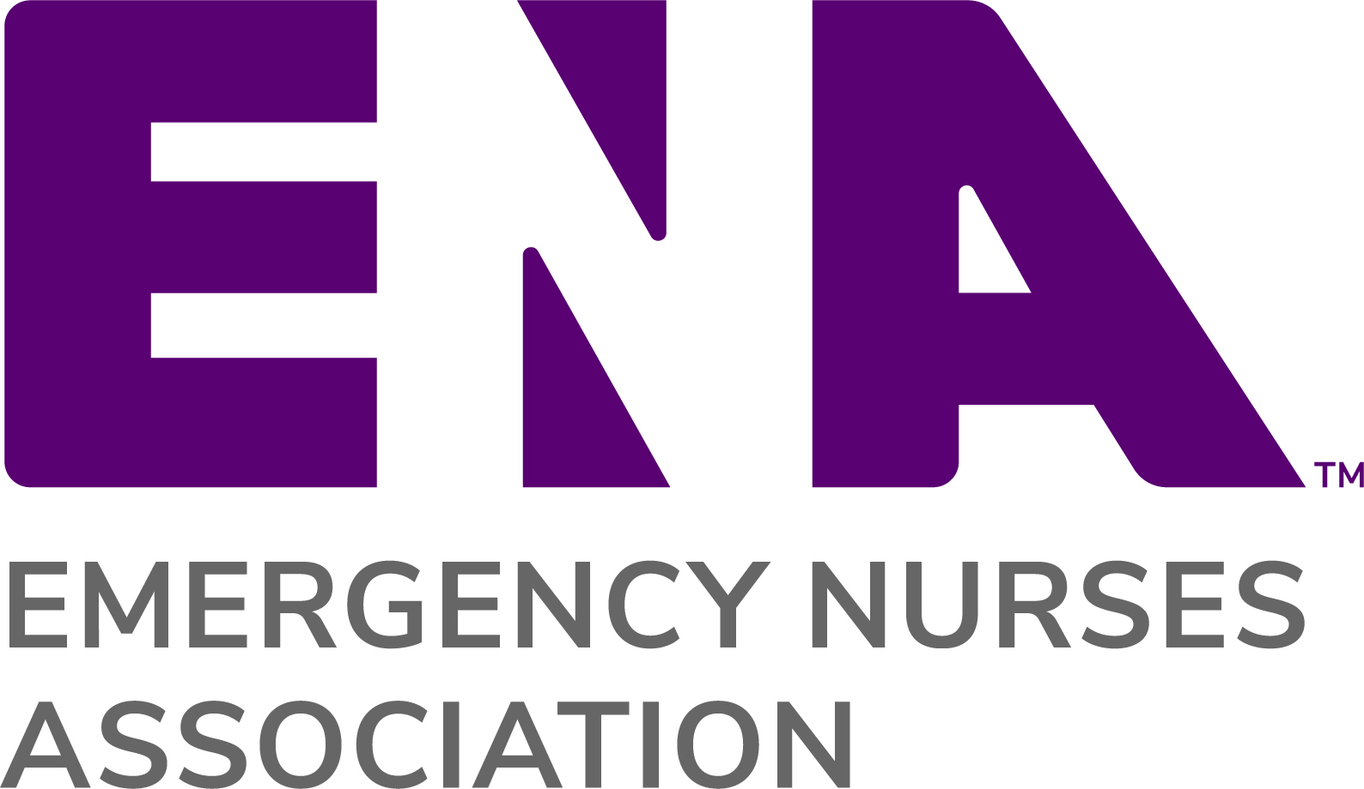



2012
Notes:
2012: In partnership with AAP, ACEP, and ENA, the EMSC Program established the NPRP, a multiphase quality improvement (QI) initiative to ensure all EDs are prepared to care for children. Following a pilot assessment in California, the first phase of the NPRP was a national assessment of EDs based on the 2009 policy statement.

Slide 17
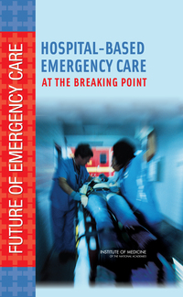
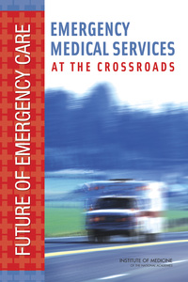

Development of Systems of care
2001
Pediatric Readiness Guidelines published
2009
Pediatric Readiness Guidelines published
Presidential Commission on Heart Disease, Cancer, and Stroke
Trauma Systems Planning and Development Act
Trauma Care Systems Planning and Development Act
1st Trauma Systems Criteria
1976
Development of Stroke Systems
proposed
Increased focus on clinical practice guidelines and quality improvement
1966
National Highway Traffic Safety Act
1970
1973
EMS
Systems Development Act
1976
1985
EMS
for Children Program established
1990
1999
IOM Report
To Err is Human
2005
1965
2012
“Mission Critical” STEMI Centers
ACCIDENTAL DEATH AND DISABILITY:
THE NEGLECTED DISEASE OF
MODERN SOCIETY
DIVISION OF MEDICAL SCIENCES
NATIONAL ACADEMY OF SCIENCES NATIONAL RESEARCH COUNCIL
Institute of Medicine Committee on the Future of Emergency Care in the U.S. Health System. Washington, DC: National Academies Press; 2006.

Slide 18
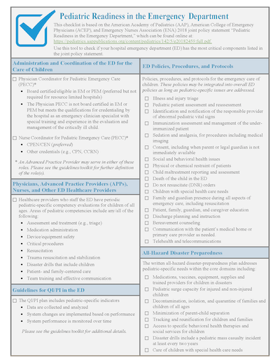
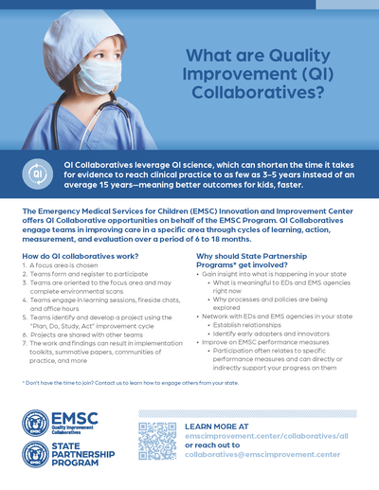


EMSC Performance Measures Revised (2017)
QI collaboratives
Toolkits and reference guides
Expanding evidence
Enhanced communications
Education Kits
2009: Joint Policy Statement
2012: “National Pediatric Readiness Project” formalized
2013: Re-Assessment based on 2009 Joint Policy Statement (AAP, ACEP, ENA)

Slide 19
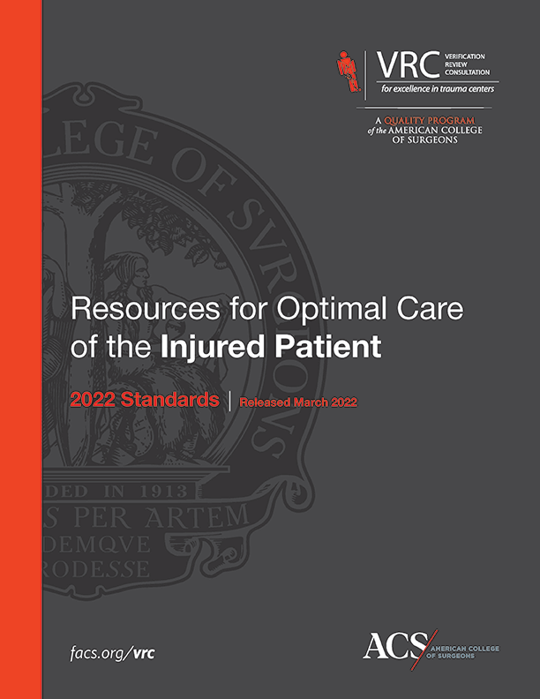



EMSC Performance Measures Revised (2023)
Expand our team (PPN, ACS-COT)
Expanding evidence
Leverage new technologies
QI collaboratives
New policies (ACS trauma centers)
… New Regulations?
2018: Joint Policy Statement
2021: Re-Assessment based on 2018 Joint Policy Statement (AAP, ACEP, ENA)

Slide 20



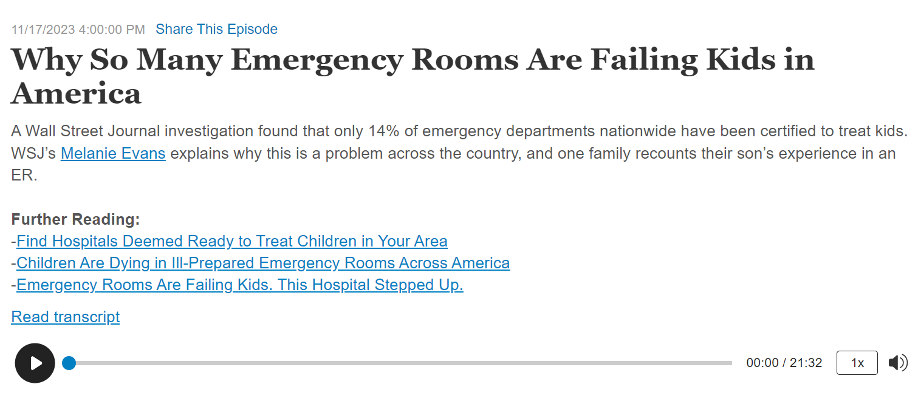


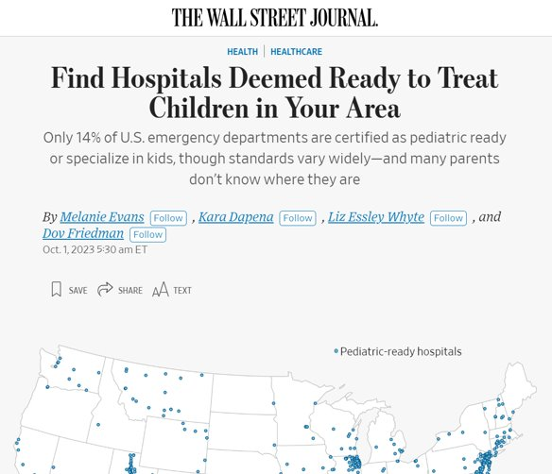



response to lack of pediatric readiness
“It is unreasonable to expect every ED to have the pediatric expertise of a state-of-the-art children’s hospital.”
Many EDs lack pediatric-specific protocols​
Many EDs lack immediate access to a pediatric crash cart or critical equipment​
Many parents are unable to make informed decisions​
Pediatric emergency care is under-funded; under-incentivized
Joint Commission lacks pediatric-specific standards​

Slide 21


2018: Pediatric Readiness in the Emergency Department
A perfect score is 100, national average is 70 and hasn’t changed much in a decade
Administration and Coordination
Physicians, Nurses, and Other Healthcare Providers
Quality Improvement
Policies, Procedures, and Protocols
Patient and Medication Safety
Support Services
Equipment, Supplies, and Medications
Notes:
.

Slide 22
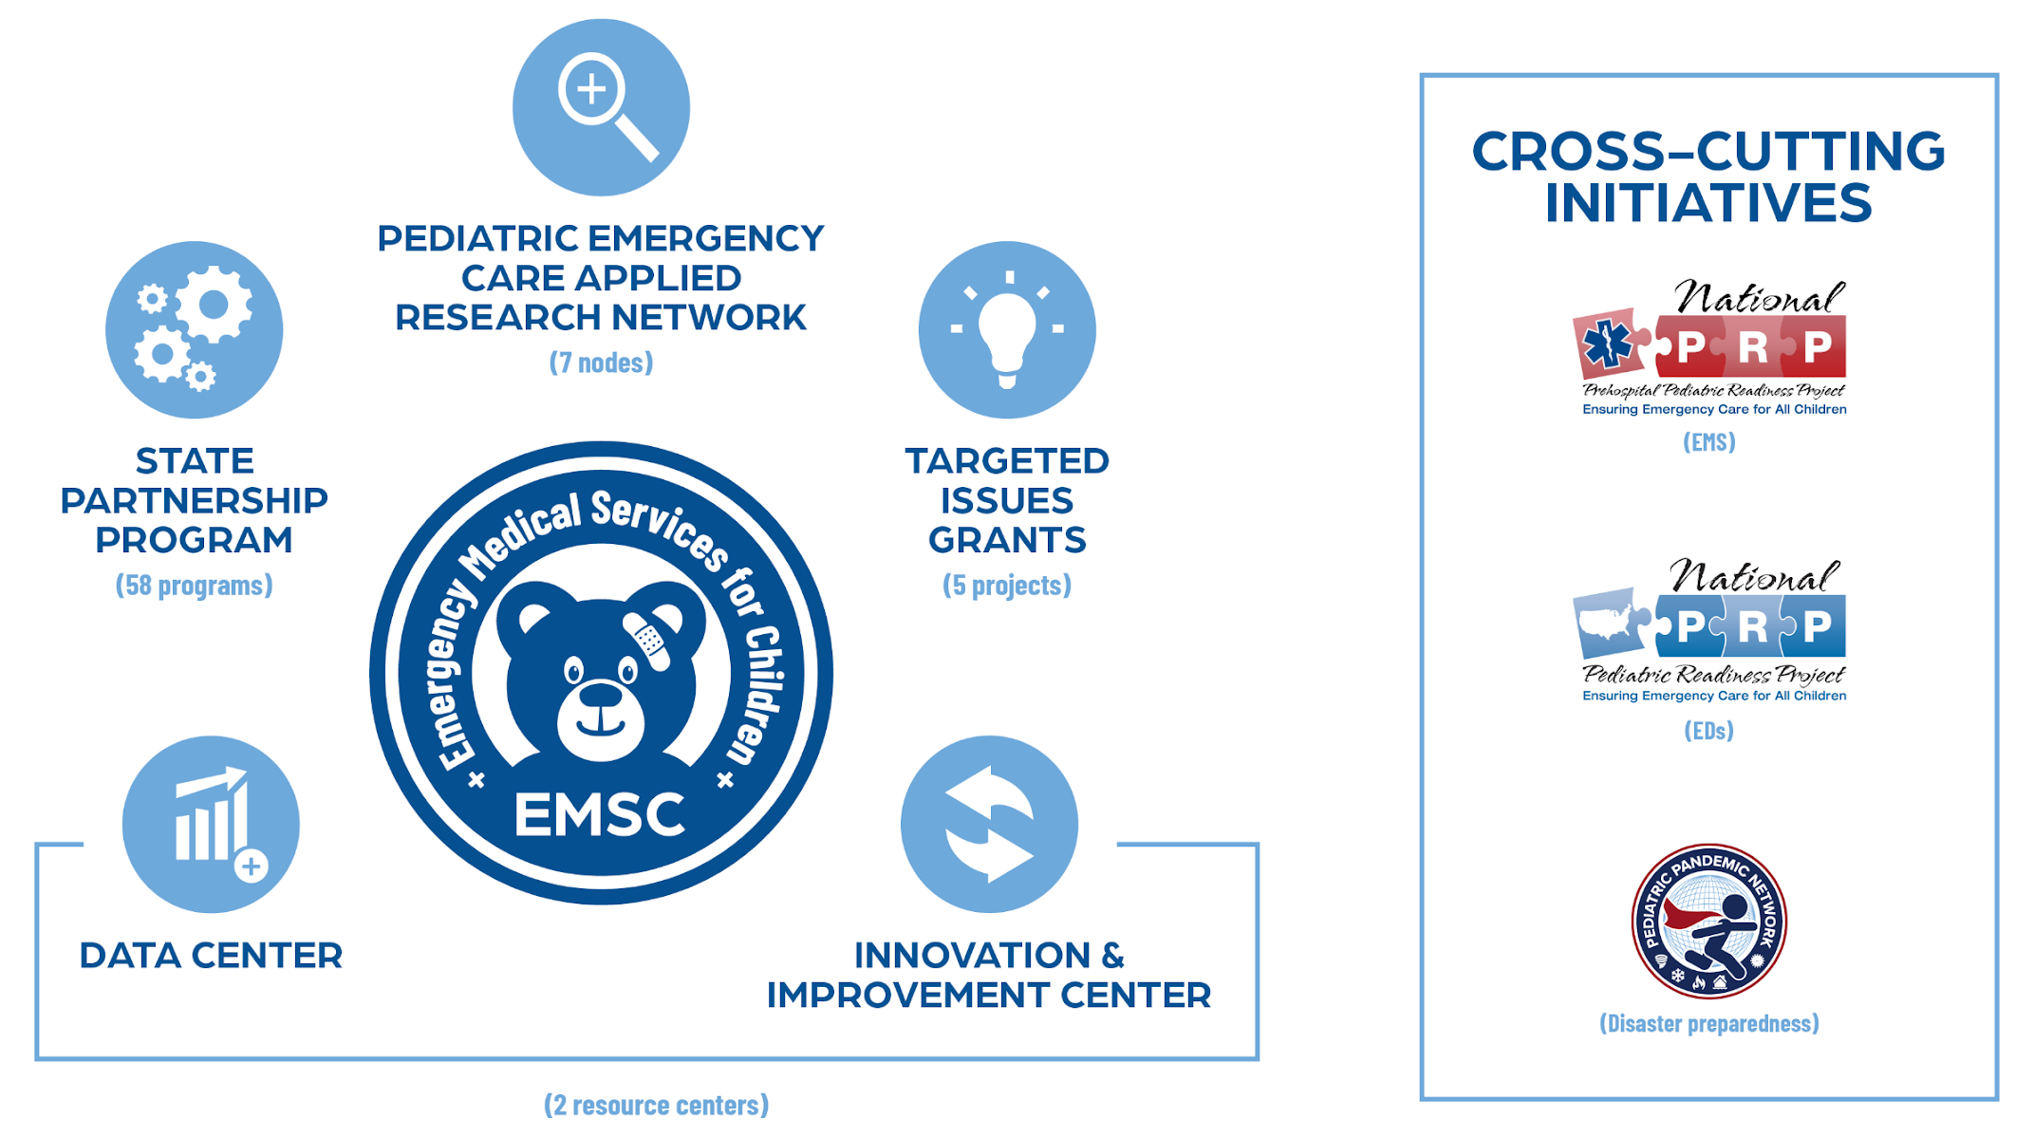
Emergency Medical Services for Children Family of Programs
Notes:
Targeted issues 2013-6

Slide 23
Pediatric Readiness Originated in the HRSA programs
2001
2016
2021
Emergency Medical Services for Children (EMSC) | EMSC Innovation and Improvement Center (EIIC) | Pediatric Pandemic Network (PPN)
improves emergency care for kids by helping first responders and hospital emergency departments be “pediatric ready” to provide the best care possible. | uses research to develop strategies to help medical professionals understand how to take better care of children who need emergency care. | collaborates across the country with children's hospitals and their communities to provide the best care possible to children in emergencies, disasters and pandemics.

Slide 24
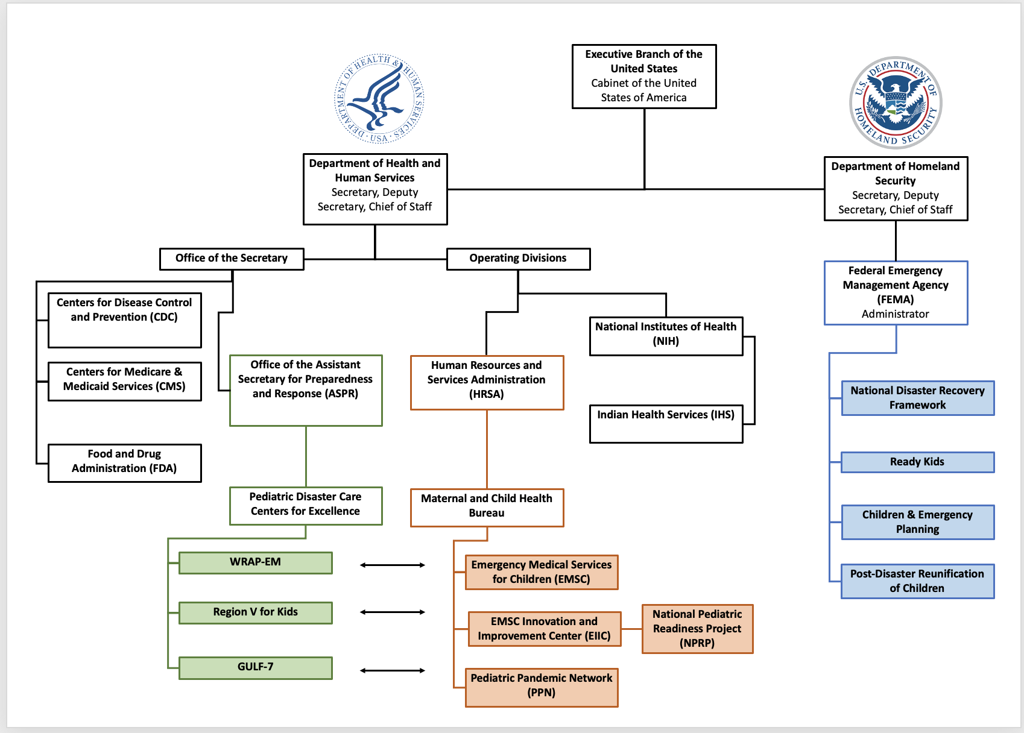
Notes:
Executive Branch of the US
Dept of HHS (ASPR and HRSA) and Dept of Homeland Security

Slide 25


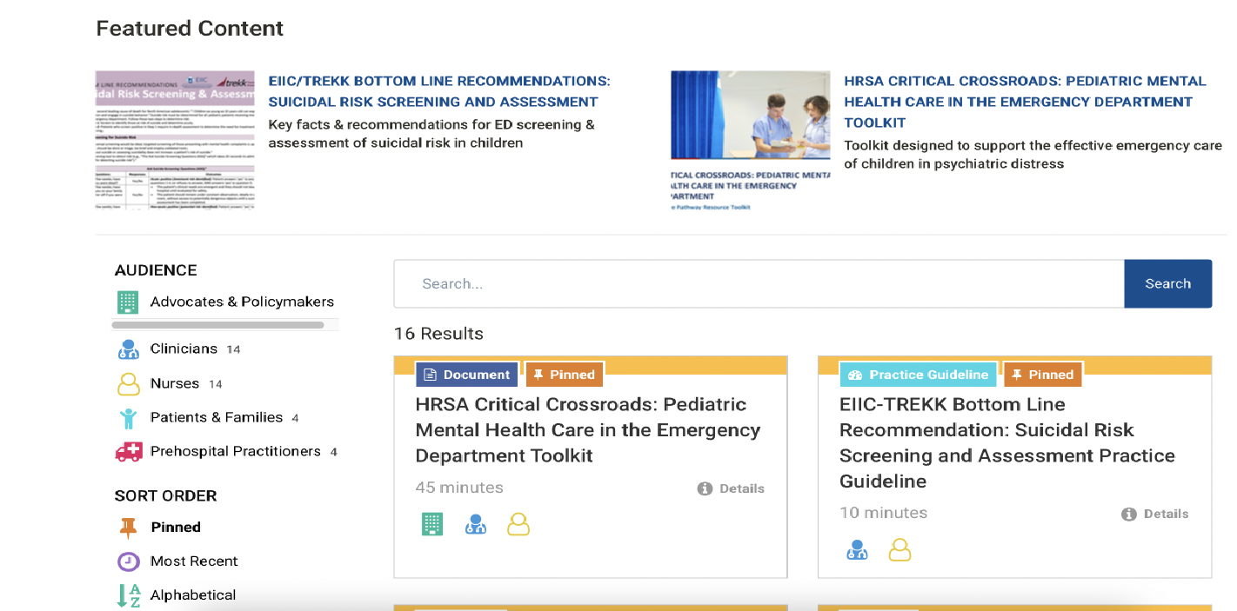


Resources to Facilitate Pediatric Readiness
If there were one word to describe the state of emergency care for children, it is “uneven.”
https://emscimprovement.center

Slide 26
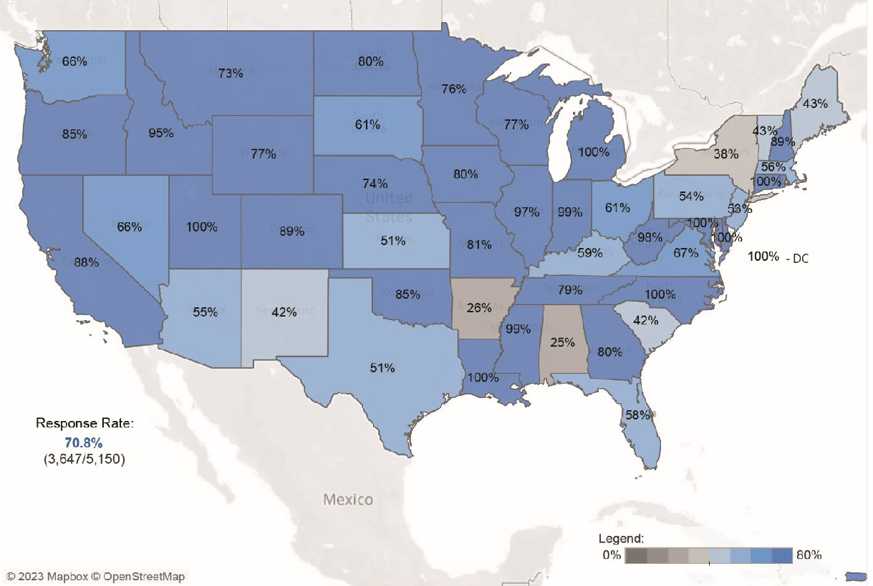
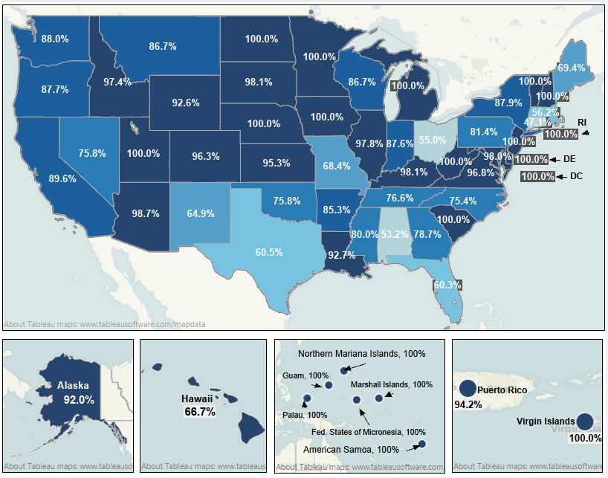


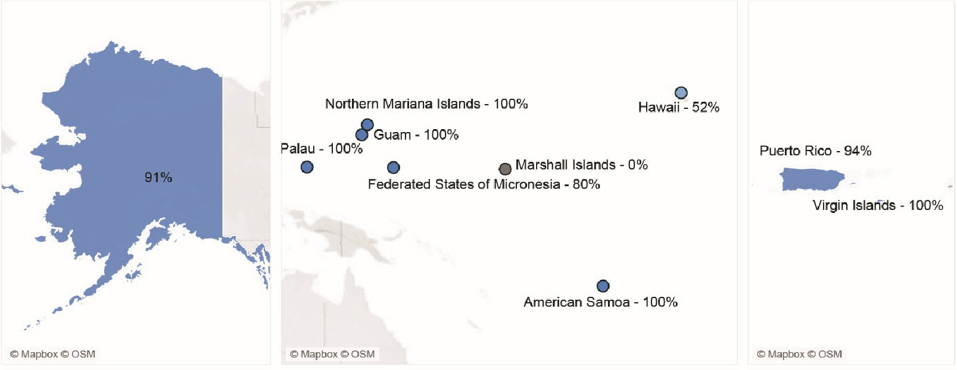

Slide 27
NPRP Assessments
2003
2013
2021
55/100
69/100
70/100
29% (1489) response rate
82% (4149) response rate
71% (3647) response rate
Paper survey,
Mail-out survey
<60% aware of national guidelines

Slide 28



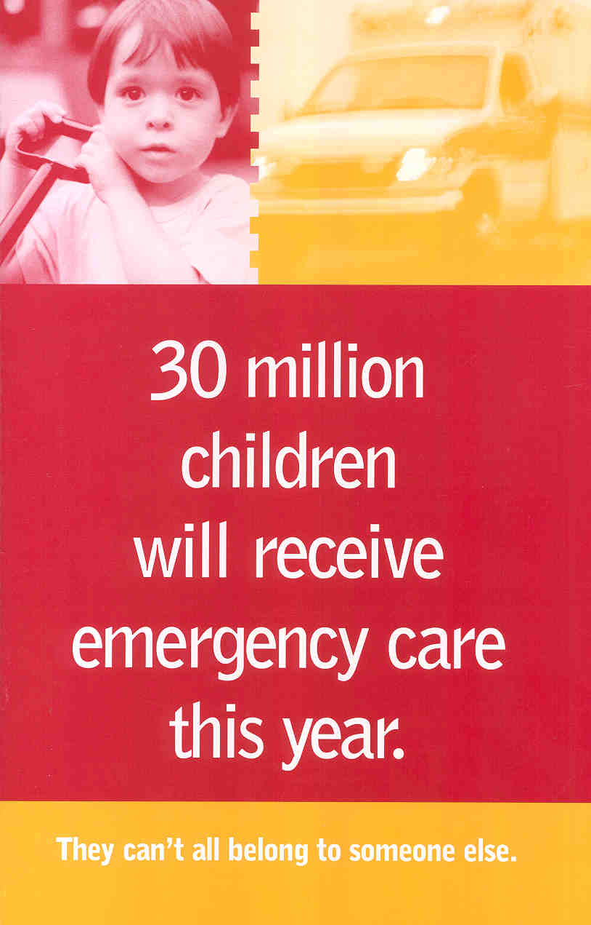
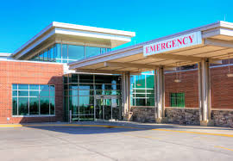
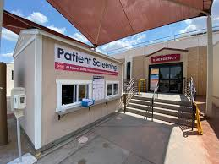
Where do children seek care for emergencies?
Community ED
Rural ED
>80-90% of children (30M/yr) are seen in general EDs that see
fewer than 10-15 children per day
Critical Access Hospital ED
Gausche-Hill, et al. JAMA Peds. 2015

Slide 29
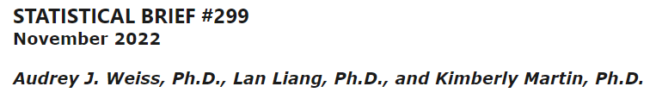
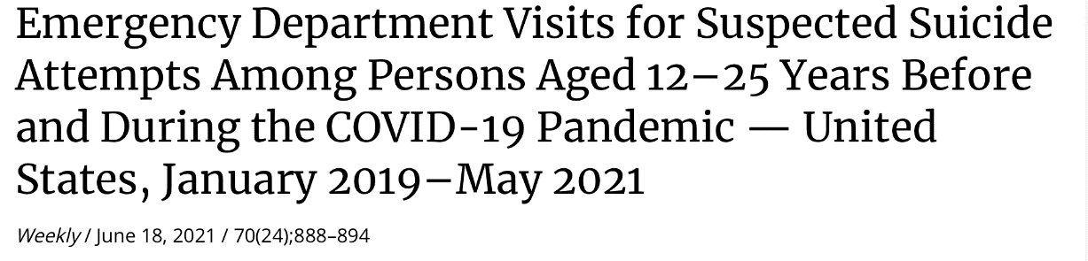
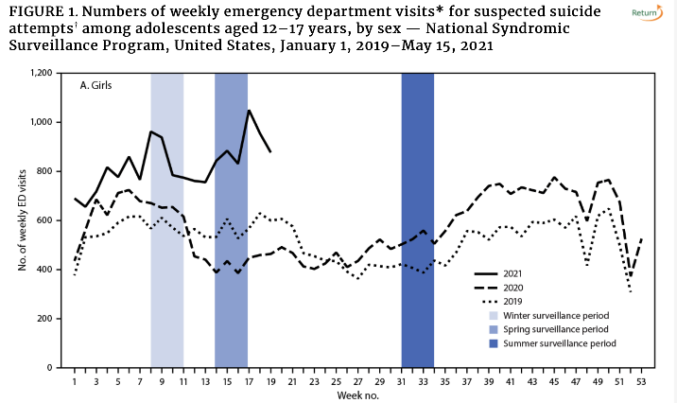
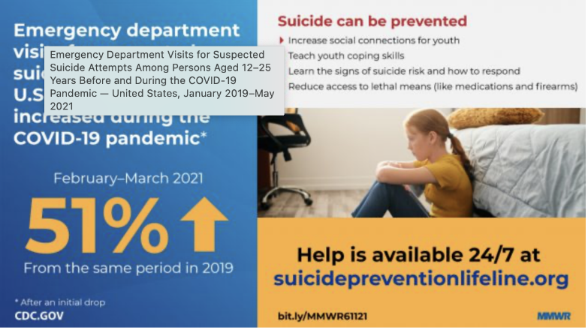

What brings children to emergency departments?
Overview of Hospital Stays Among Children and Adolescents, 2019
#1 cause of hospitalization <10yrs: Respiratory
#1 cause of hospitalization >10yrs: Depression/Suicide
https://www.cdc.gov/mmwr/volumes/70/wr/mm7024e1.htm#F2_down

Slide 30
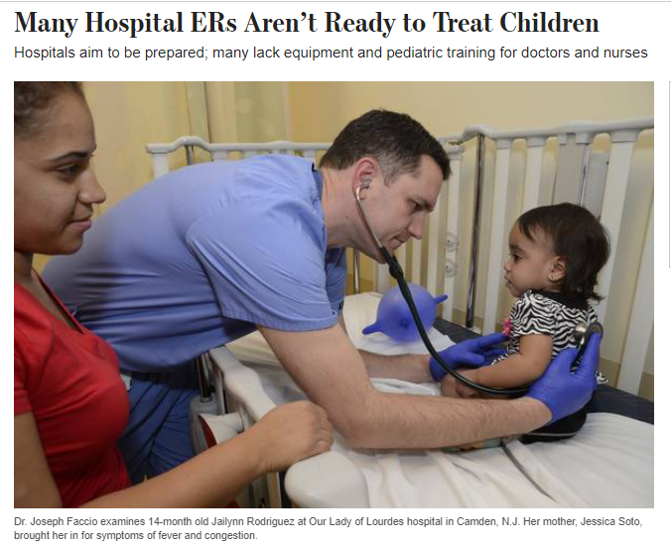
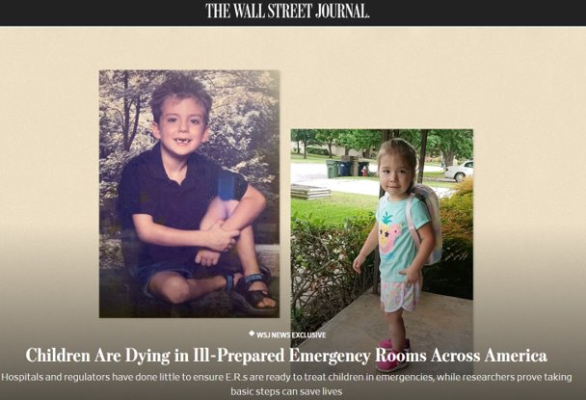
Why is A Focus on Pediatric Readiness Needed?
94% of children <30min to any ED
  55% within 30min to high peds ready ED
  90% live closer to non-peds ready ED
No universal licensing requirements, variable readiness to meet the needs of children
  Median pediatric readiness score = 69.5/100
Variability in pediatric emergency care, <50% with QI plans
Notes:
HRSA does not own NPRP – equal partnership with AAP, ACEP, ENA – number we can reach is much greater due to partners and efficiency/timing is easier to push out.

Slide 31
1-19yr of age

Slide 32
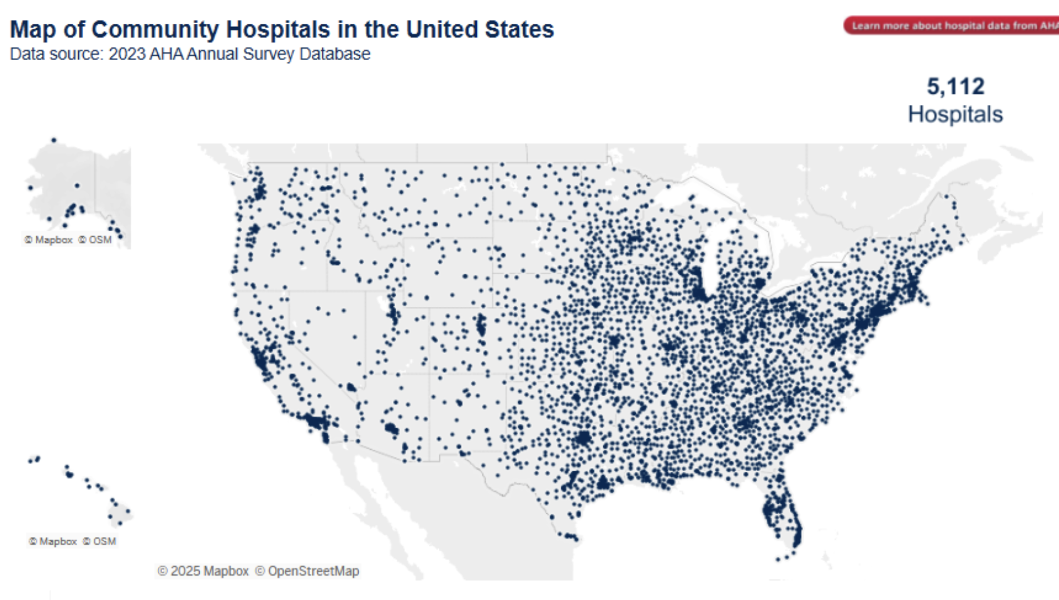
Total Number of All U.S. Hospitals 2025
6,093
Number of U.S. Community ¹ Hospitals
5,139 (2020) to 5,112
Number of Rural Community Hospitals
1,796 (35%)
Number of Urban Community Hospitals
3,316 (65%)
Children’s Hospitals 200 (CHA)
Trauma centers 2000+
Pediatric trauma centers 184
Notes:
Total Number of All U.S. Hospitals 2022
6,093
Number of U.S. Community ¹ Hospitals
5,139
Number of Rural Community Hospitals
1,796
Number of Urban Community Hospitals
3,316
1. Community hospitals are defined as all nonfederal, short-term general, and other special hospitals. Other special hospitals include obstetrics and gynecology; eye, ear, nose, and throat; long term acute-care; rehabilitation; orthopedic; and other individually described specialty services. Community hospitals include academic medical centers or other teaching hospitals if they are nonfederal short-term hospitals. Excluded are hospitals not accessible by the general public, such as prison hospitals or college infirmaries.

Slide 33
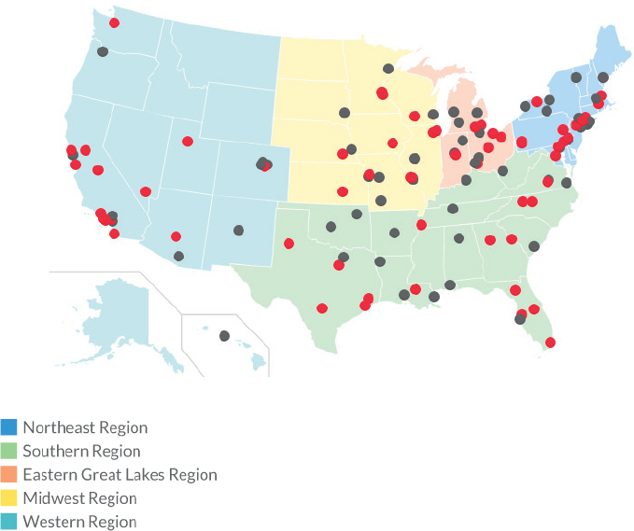
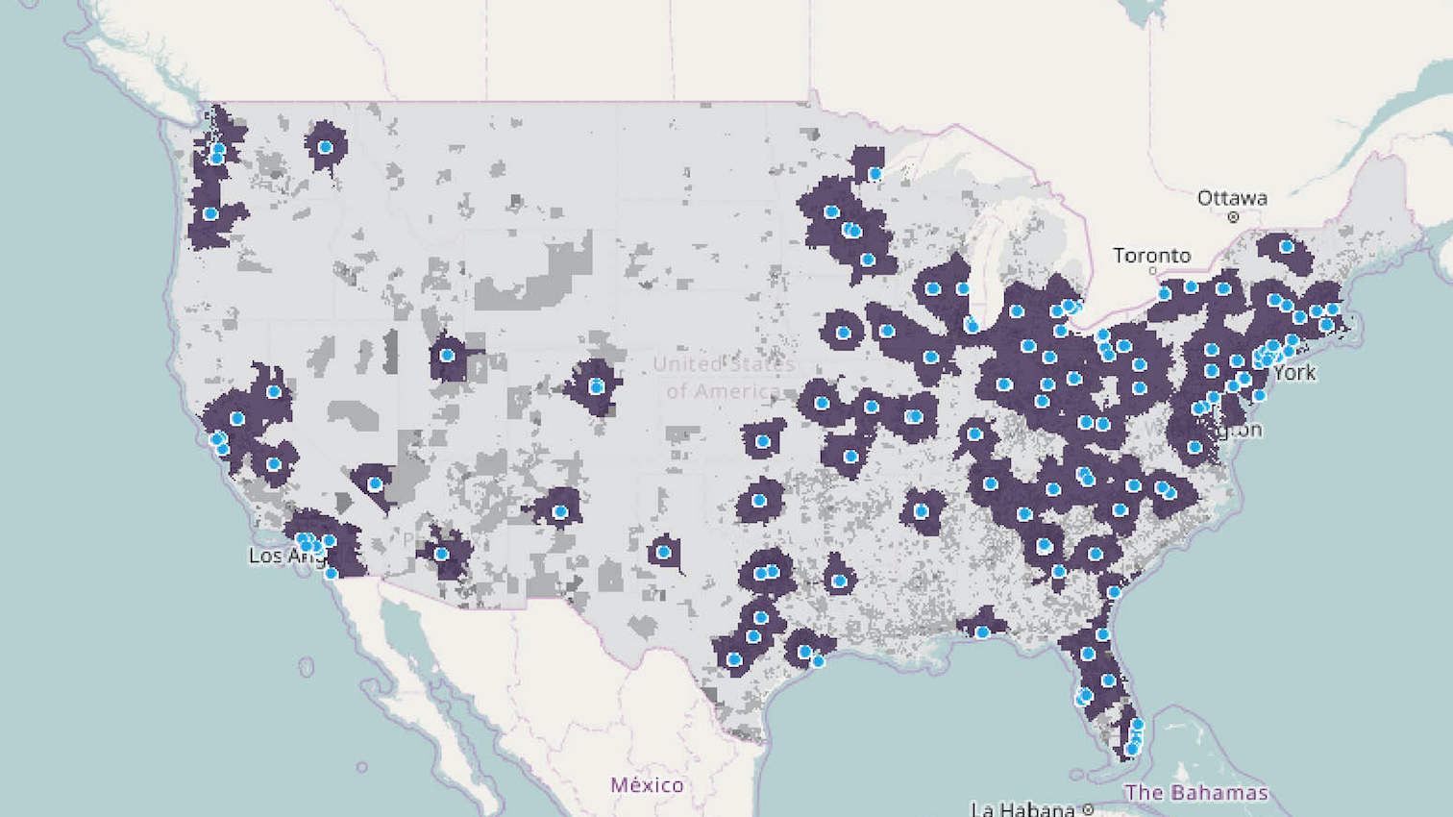
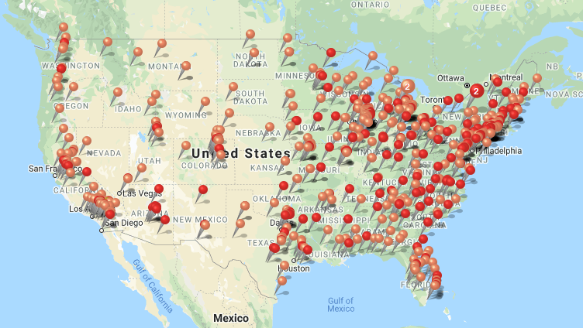
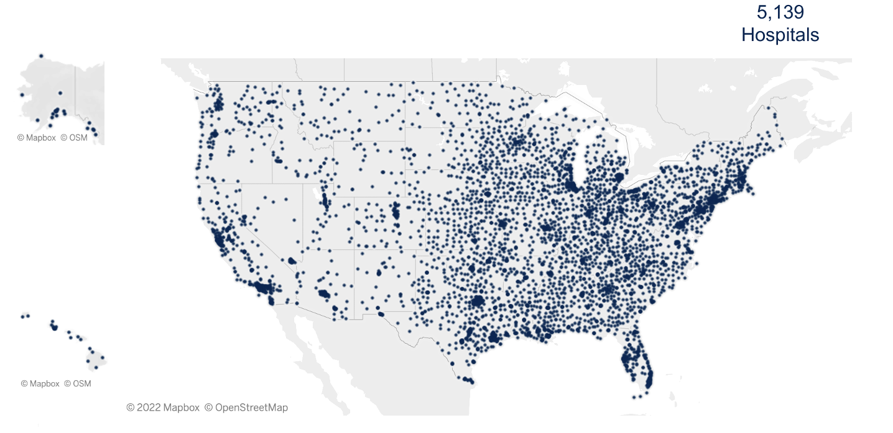
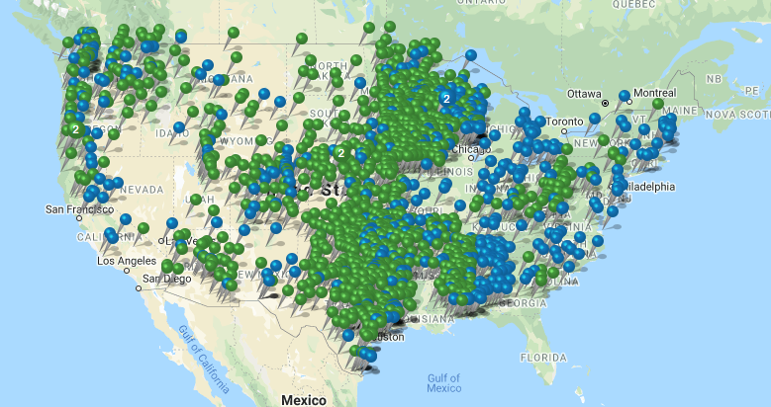
Level I, II
PTC (169; 184)
Burn Centers
ABA directory lists 135 burn centers, only 76 are currently verified
2294 Trauma
Centers in US including all levels
https://www.definitivehc.com/resources/healthcare-insights/number-us-trauma-centers-by-level
Level I, II A&PTC
(766)
Level III, IV
A&PTC
(1416)
All Hospitals

Slide 34
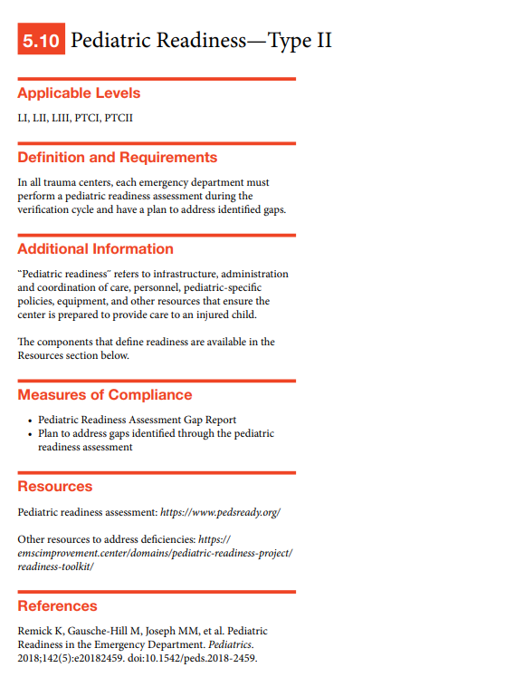
Resources for Optimal Care of the Injured Patient
(2022 Standards)
Effective for visits starting in September 2023
Standard 5.10 - Pediatric Readiness
  The NPRP assessment must be conducted once during the Verification cycle.
  One cycle is defined as the thirty-six (36) month period preceding the expiration date of the current Verification status

Slide 35
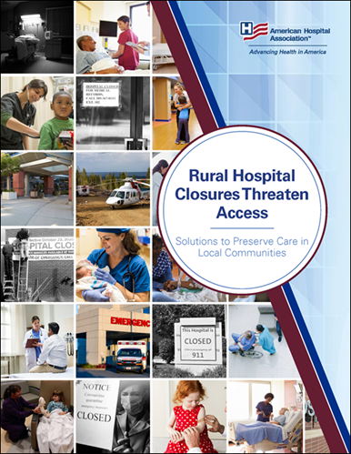
2013 vs 2021: Healthcare Landscape
17% fewer hospitals report availability of pediatric inpatient wards
The loss of critical access hospitals over the prior decade (N=136), pales in comparison to the loss of pediatric inpatient units.
JAMA Peds Remick, 2023

Slide 36
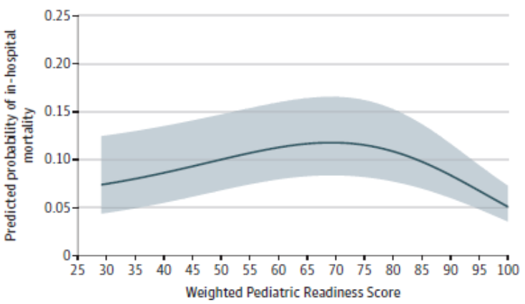
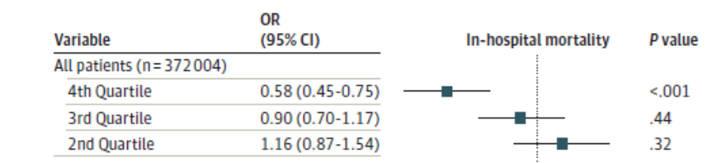
Published June 7, 2021
If high pediatric readiness (wPRS>93), risk of death decreased by ~50%
Newgard, et al. JAMA Peds. 2021

Slide 37
Impact of Individual Components of Emergency Department Pediatric Readiness on Pediatric Mortality in US Trauma Centers
Among 555 trauma centers, the O/E mortality ratios ranged from 0.07 to 4.17 (IQR 0.93, 1.14).
Unadjusted analyses of 23 components of ED pediatric readiness - trauma centers with better-than-expected survival have:
a validated pediatric triage tool,
comprehensive quality improvement processes,
a pediatric-specific disaster plan, and
critical airway and resuscitation equipment (all p < 0.03)
Remick et al. J Trauma Acute Care Surg. 2023 March 01; 94(3): 417–424.

Slide 38
The Association Between Pediatric Readiness and Mortality for Injured Children at US Trauma Centers
Pediatric centers show an improvement in adjusted mortality for wPRS > 94
Melhado et al, Ann Surg, 2023

Slide 39
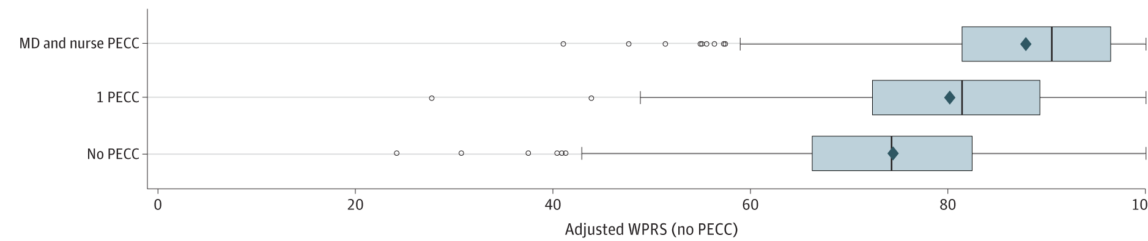
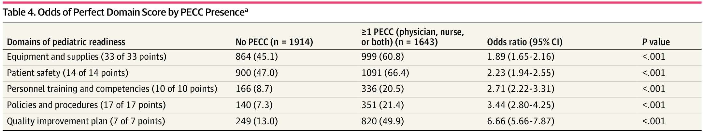
Impact of PECCs on wPRS
  2021 Stats:
  Physician PECC - 37% of EDs (76% with protected time)
  Nurse PECC – 37% of EDs
  (81% with protected time)
The presence of the nurse-physician PECC dyad = average 16pt increase in adjusted wPRS compared to no PECC
  28.5% of EDs have both a physician and nurse PECC
JAMA Netw Open. 2023;6(7):e2321707. doi:10.1001/jamanetworkopen.2023.21707

Slide 40

Impact of QI plans on wPRS
The presence of a full QI plan = average 26pt increase in adjusted wPRS compared to no QI plan
Shift from lowest to top quartile of readiness
  2021 Stats:
  Peds QI Plan – 50% of EDs
  Among those – 60% complete

Slide 41
What have been the barriers to engaging in pediatric QI?
Low pediatric patient volumes relative to adults
Lack of relevant measures and performance standards
Lack of access to data visualization tools or platforms
No designated individual or organizational structure
Lack of access to data collection tools
No financial incentives

Slide 42
Opportunities and Challenges
NPRQI
Team Building with the ED
PECCs
Rural Emergency Departments
©ACS

Slide 43
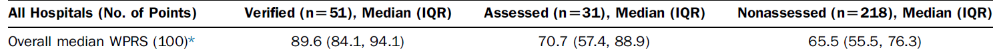
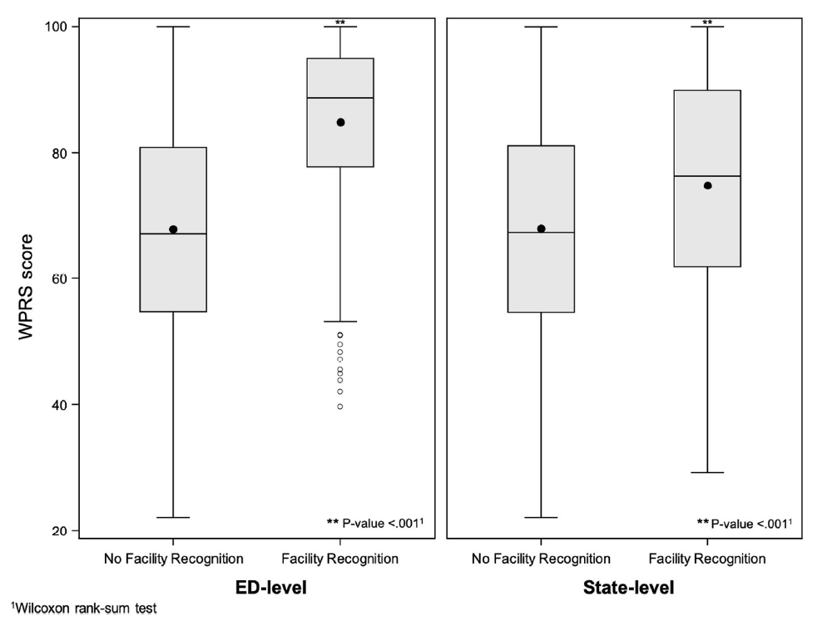
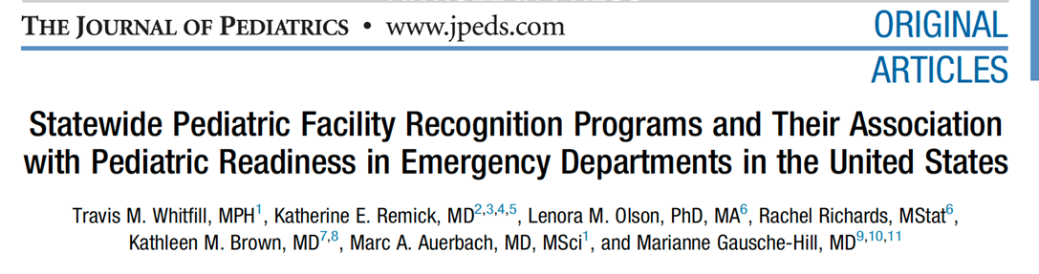
Pediatric Readiness Recognition Programs and Association with Pediatric Readiness
Remick, et al. Ann Emerg Med 2016. Whitfill, et al. J Pediatr 2019.

Slide 44
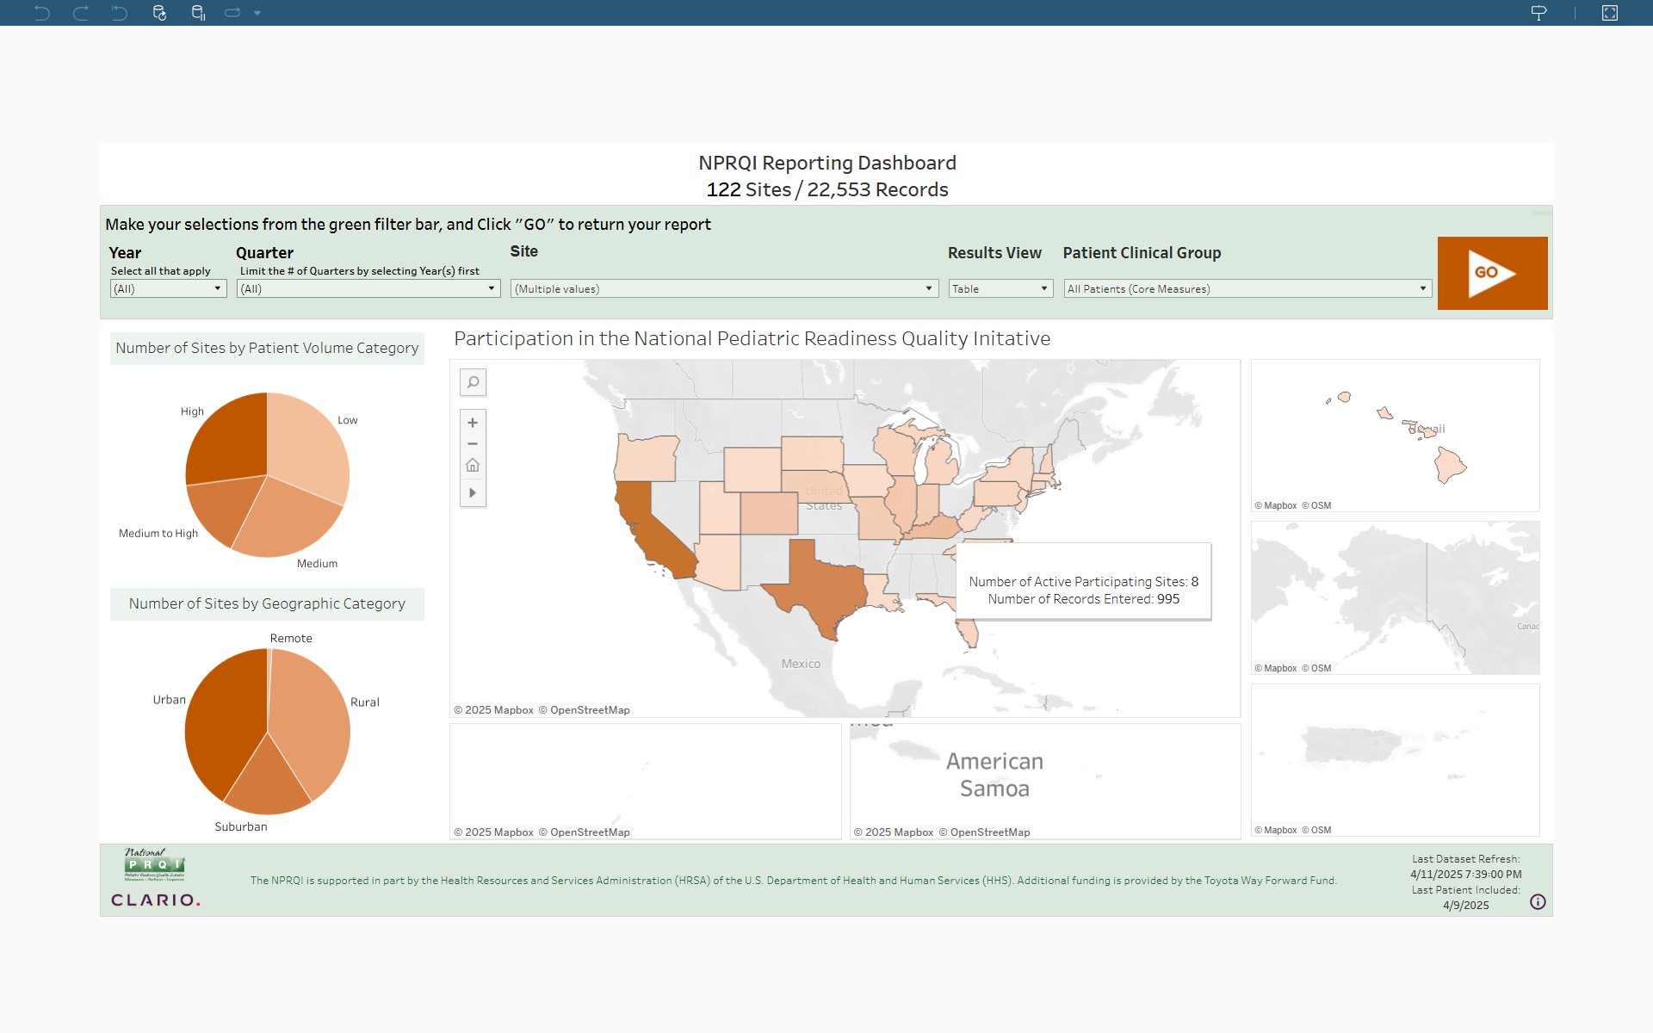

Slide 45
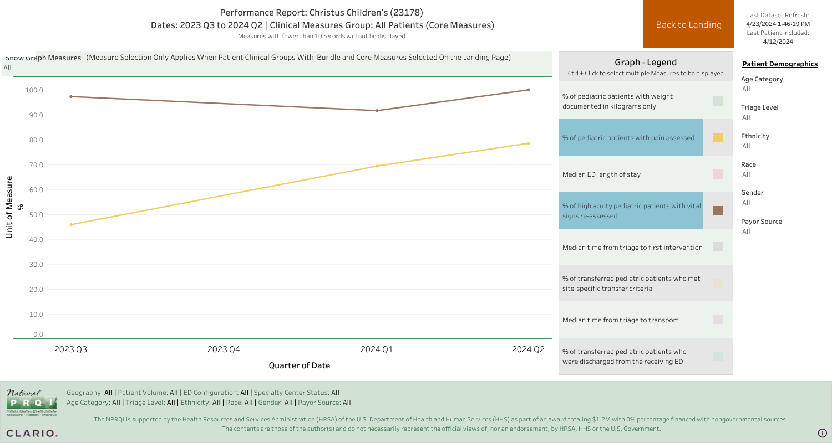
NPRQI Site Dashboard – Graph View

Slide 46
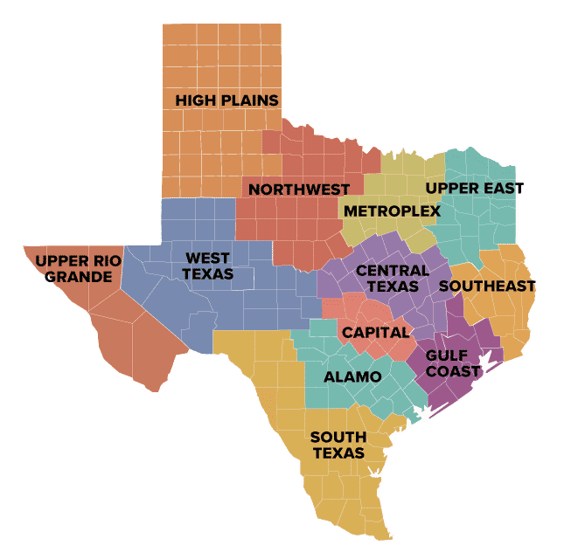
New TX trauma rules: 11/2024
Texas Trauma Rules:
Pediatric simulations (semiannual)
Pediatric competencies for staff
Pediatric equipment and supplies
Annual NPRP assessment
Assessments include GCS; complete vital signs
Serial vital signs, GCS, and pain assessments in shock and trauma
Pediatric imaging guidelines
302 Trauma Centers

Slide 47
Burke LG, Beaute JI, Michelson KA. Saving Children’s Lives Through Universal Pediatric Readiness Is a Wise Investment. JAMA Netw Open. 2024;7(11):e2442139. doi:10.1001/jamanetworkopen.2024.42139
Newgard CD, Lin A, Goldhaber-Fiebert JD, et al. State and National Estimates of the Cost of Emergency Department Pediatric Readiness and Lives Saved. JAMA Netw Open. 2024;7(11):e2442154. doi:10.1001/jamanetworkopen.2024.42154
In this cohort study of 4840 EDs across the US, 842 (17.4%) had high pediatric readiness and the annual cost to reach high pediatric readiness was $207 335 302, ranging from $0 to $11.84 per child by state. An estimated 2143 pediatric lives may be saved each year through universal high ED pediatric readiness.
The authors estimated the cost of bringing all US EDs to high pediatric readiness at $207 million, which is less than 0.005% of the $4.5 trillion in US health care spending in 2022

Slide 48
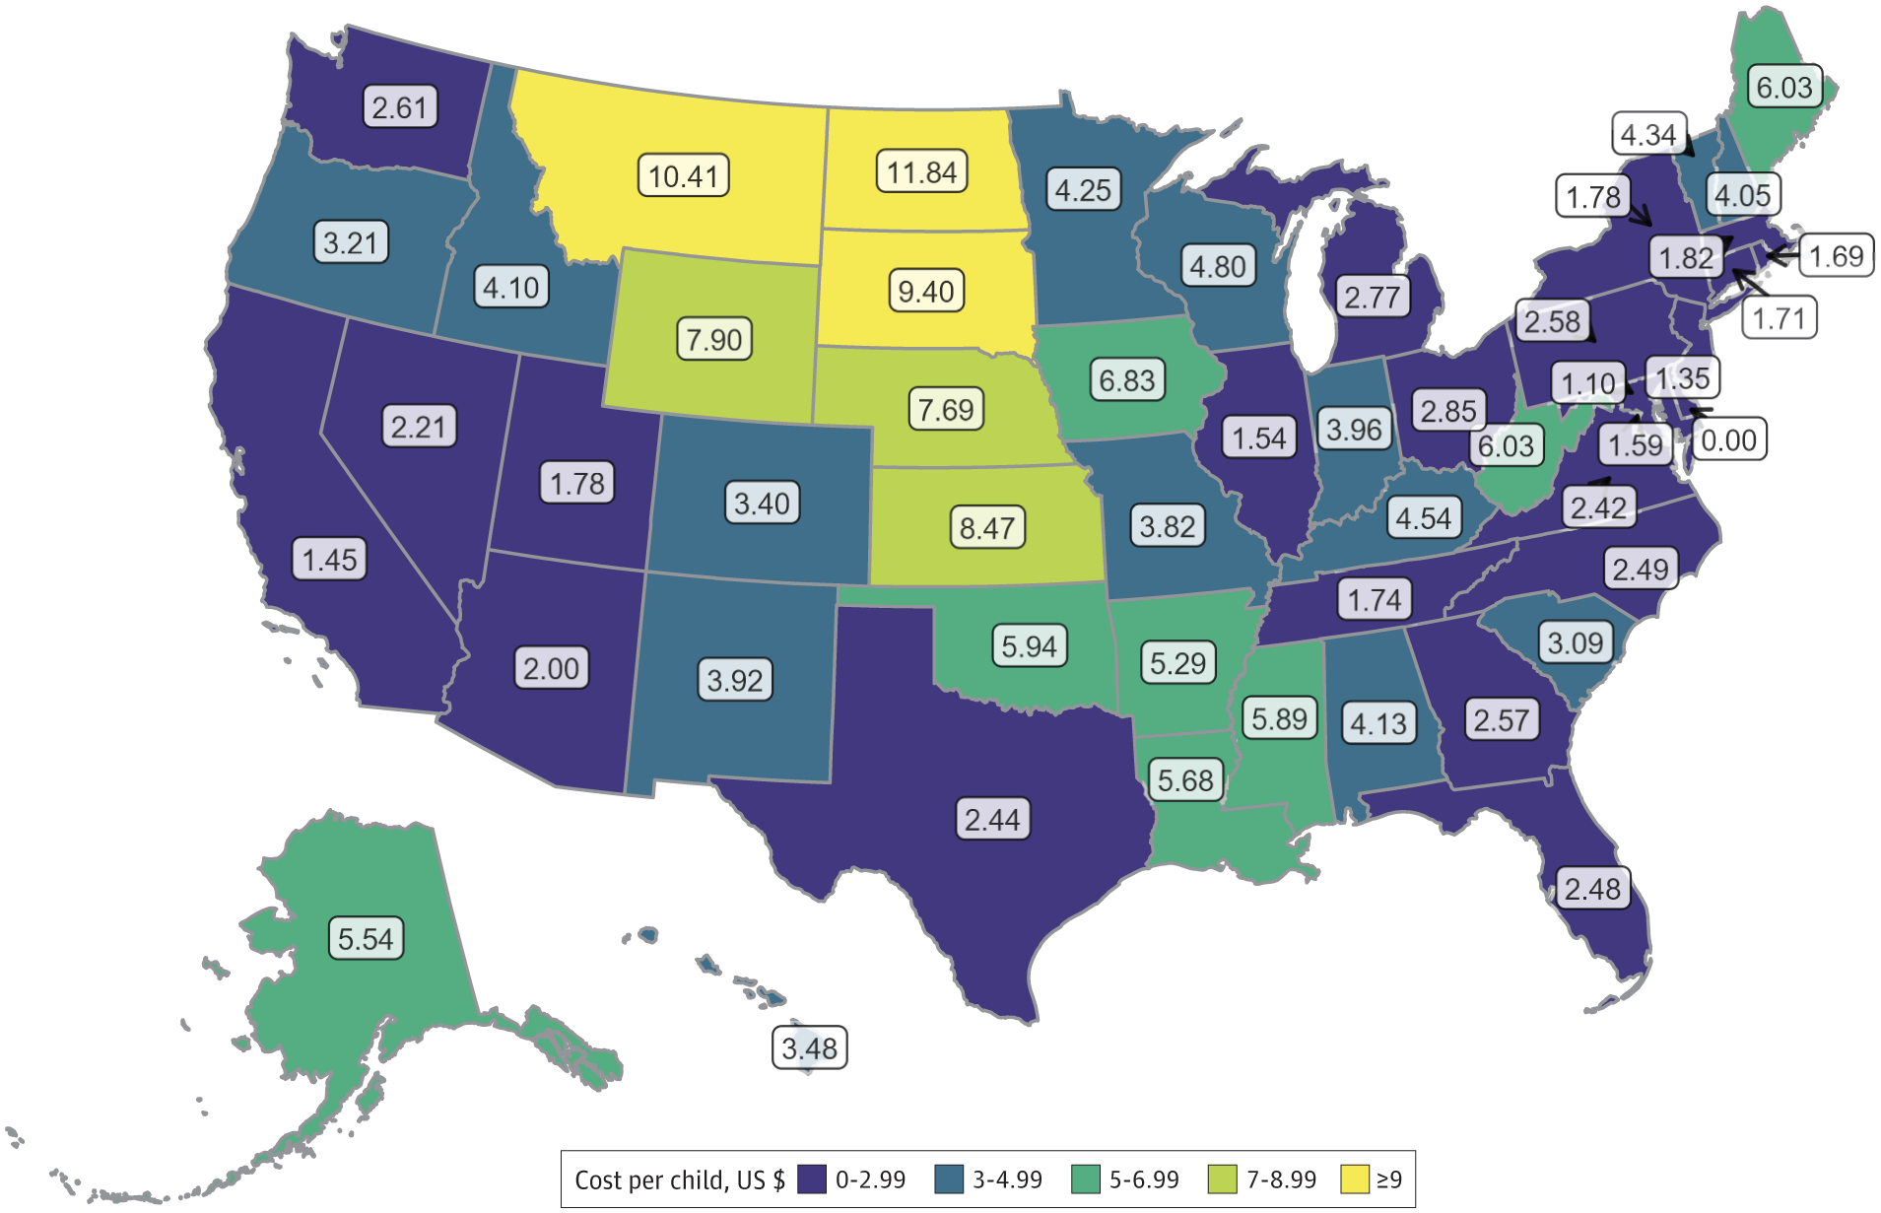
Annual Cost per Child Resident to Reach Universal High ED Pediatric Readiness by State

Slide 49
American College of Emergency Physicians
Emergency Department Accreditation Criteria
August 2025
Level I-III and Federally Designated Rural and Emergency Hospital and Critical Access Hospital
QI Plan (all hospitals): The ED must review its pediatric readiness status at least every two years, including participation
in the National Pediatric Readiness Assessment (www.pedsready.org ). The ED must document their gap analysis and develop action plans to address any identified deficiencies.
Policies: A hospital disaster plan that includes a plan for adult and pediatric patient surge to the ED.
©ACS

Slide 50
American College of Emergency Physicians
Emergency Department Accreditation Criteria
August 2025
Federally Designated Rural and Emergency Hospital and Critical Access Hospital
Staffing/Supervision:
There is a physician on site 24/7/365 in the ED. The physician can be a qualified emergency physician or an American Board of Medical Specialties (ABMS) BC/BE physician. Patients may be seen by a NP or PA who will consult a physician as needed.
The Medical Director of the ED must be a qualified emergency physician.
©ACS

Slide 51
States Seeking Laws for ED
Coverage by Physicians
Passed Laws Requiring 24/7/365 Coverage
Indiana & Virginia
Approximately 1 in 13 US EDs lacks 24/7 attending physician coverage. The absence of 24/7 attending physician coverage was more common in low-volume EDs and CAHs.
Lack of 24/7 Attending Physician Coverage in US Emergency Departments, 2022. JACEP Open
Volume 6, Issue 2, April 2025, 100050
©ACS

Slide 52
Establishing PR in the Absence of an MD
2015/2023: The presence of physician and nurse PECCs was associated with a higher adjusted median WPRS across all pediatric volume categories
Many EDs only have one PECC (usually a nurse) or none
In rural areas, the sharing of the PECC position across hospitals or across departments within a hospital is common
A dyad could be a nurse or paramedic who works in an ED and a NP/PA
©ACS

Slide 53
Simulation Program Overview and Challenges
Majority of our trauma centers have participated or are on the list to participate
Every hospital that has participated has a PECC
MD participation is low; a surgeon has never participated
Course is 4-5hr in center’s ED; 2 case scenarios including 1 trauma/burn/child abuse; table-top disaster drill; check equipment and skills; scavenger hunt with PR check list
©ACS

Slide 54
Next Steps
Develop list of all trauma center listserv of TC medical directors and program managers
Reach out to your EMSC State Program Manager to see which trauma centers took the 2021 survey
  The next national survey starts in March 2026, and he/she may be starting to develop the list of hospital ED contacts
  This individual will likely have a list of PECCs in state hospitals
Encourage a partnership between the TMD and TPM with the ED regarding the pediatric readiness program (team approach)
Encourage participation in the QI of trauma and acute care surgical pediatric patients that are cared for in TC EDs and invite the PE to Trauma QI if pediatric patients are discussed
©ACS

Slide 55

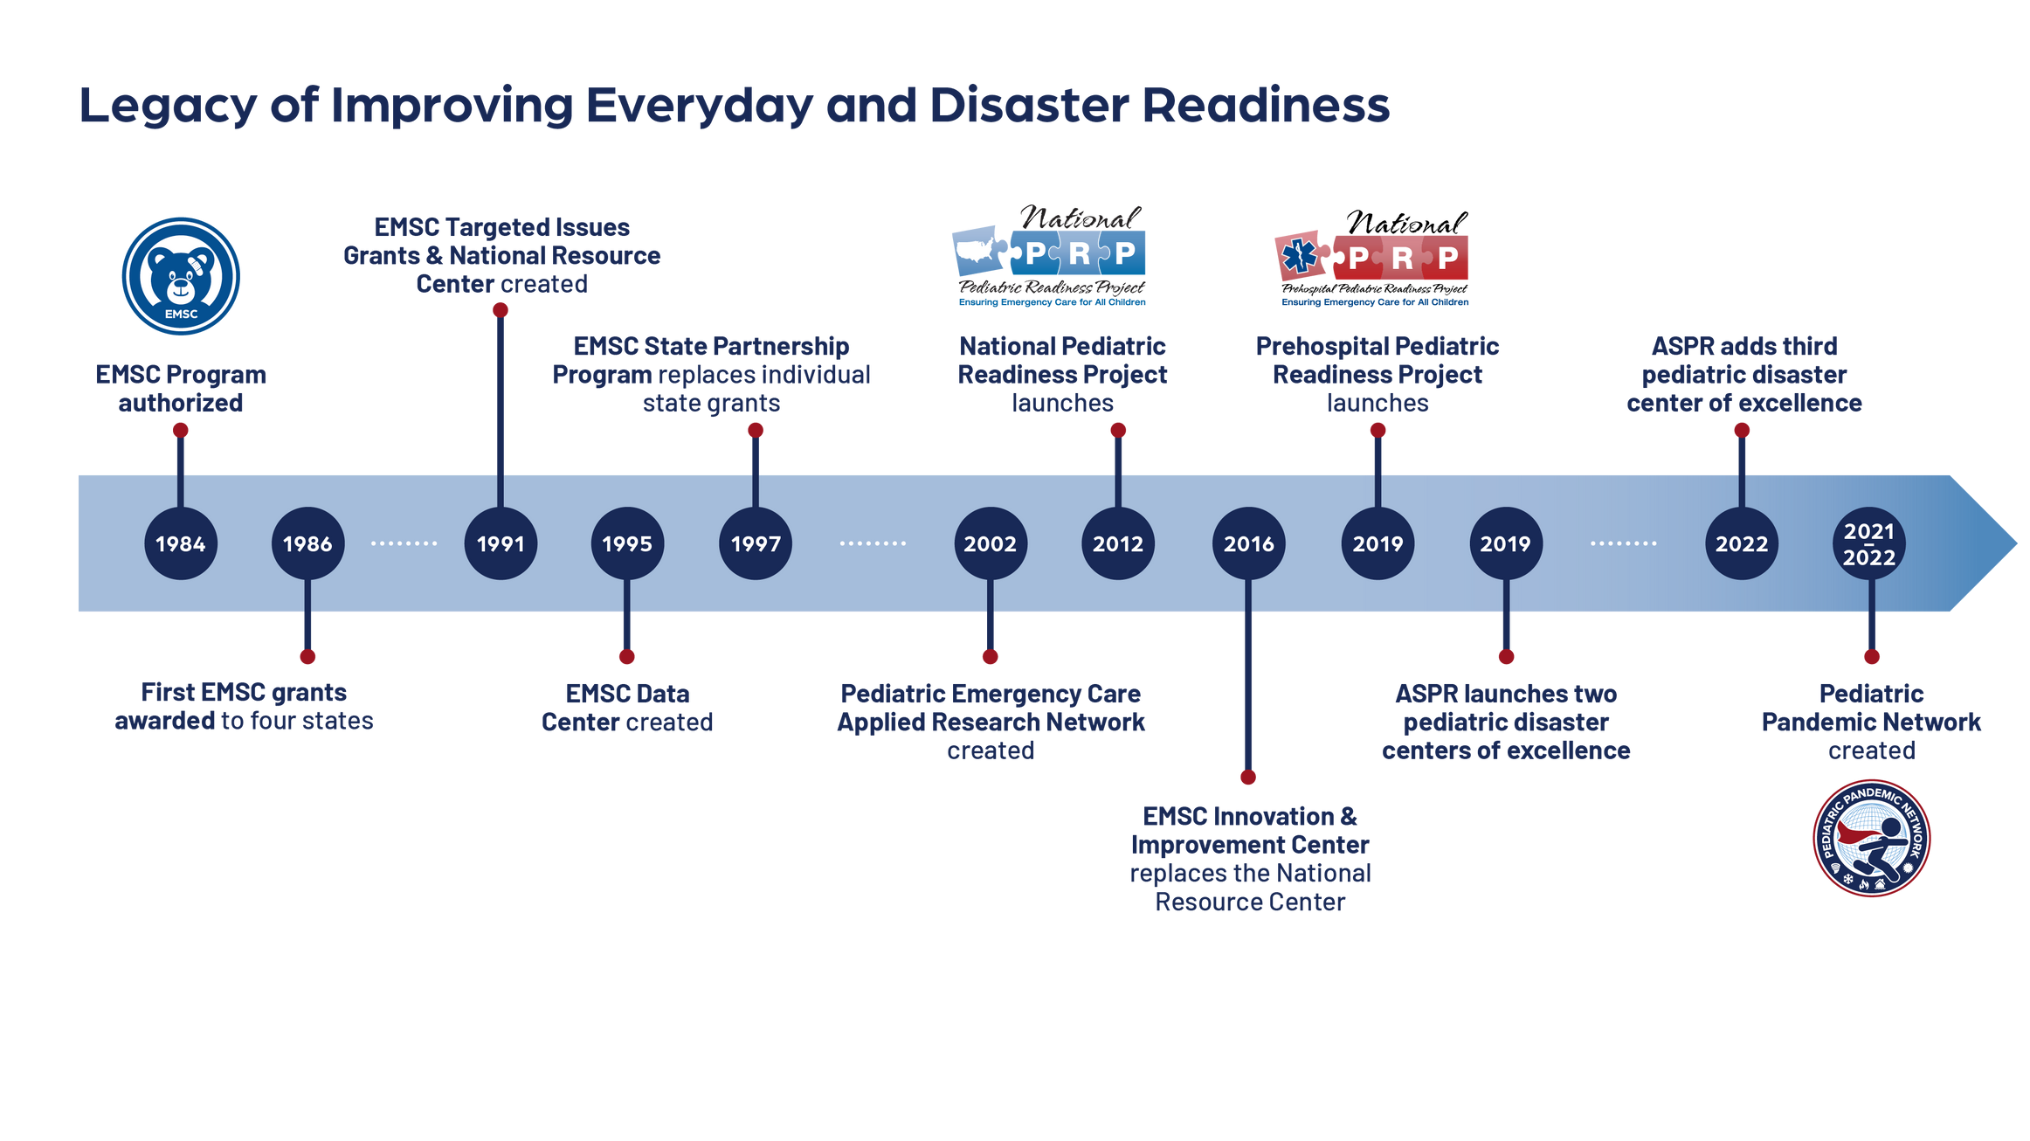



2₂0₀2₂1₂-
Regional Pediatric Disaster Centers
Network of Children’s Hospital Hubs

Slide 56
Pediatric Readiness in a disaster presumes Pediatric Readiness everyday
Pediatric Readiness (PR) as a stretch goal is to ensure that every EMS agency and emergency department in the US has all pediatric-specific requirements and resources needed to provide high-quality emergency care for children
PR Research: 70 + articles provide evidence that it decreases all cause pediatric mortality including trauma
BUT the PR score must be around 94 to achieve a mortality reduction

Slide 57

MARY E. FALLAT MD
PROFESSOR OF SURGERY
UNIVERSITY OF LOUISVILLE
mefall01@louisville.edu
Thank You.
©ACS

