Slide 1


REGIONAL
Committees on Trauma
RCOT Field Program:
Building a National Trauma and Emergency Preparedness System
The Role of Regional Medical Operations Coordinating Centers (RMOCC)
Copyright ©2025 American College of Surgeons. 633 N Saint Clair St, Chicago, IL 60611-3295
Notes:
NOTE: extra materials- use as needed depending on your audience

Slide 2
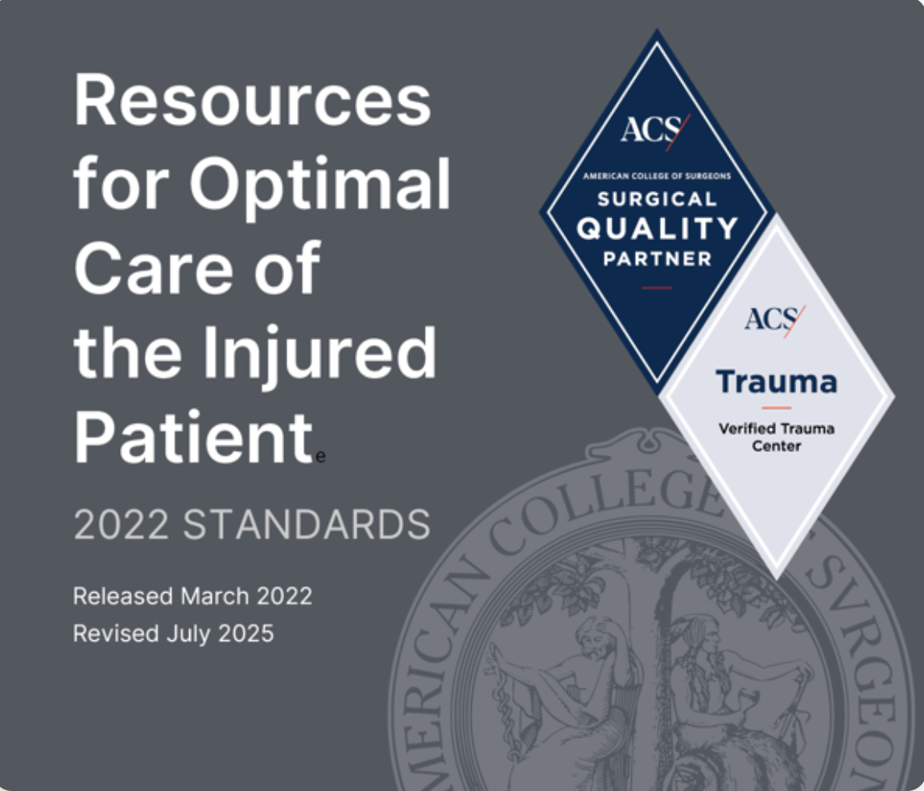
Trauma Care in the US
State and Regional Level
Trauma Center Level of Care
  ACS and State Verified Centers
  Classified as Level I-V
State and Regional Trauma Systems
  Revolve around Level I & II Centers
    Support Urban and Rural Trauma Needs
  Presence of smaller Level III & IV Centers
Regional EMS Systems/Air Transport
Emergency Care Coordination/Disaster Plans
©ACS
Notes:
Trauma Care in the United States is provided at different levels of trauma centers with our systems revolving around Level I and II centers (our largest and most robust centers)
EMS which is not an essential service in most US states (only 13 and DC as of 2023), they are often voluntary local services or funded locally, yet they are critical for the prehospital care component.
(Major funding gaps, inconsistent standards, etc)
Emergency care coordination is also very variable depending on which state or region involved.

Slide 3
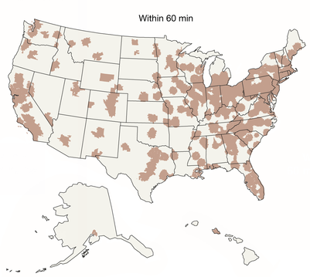
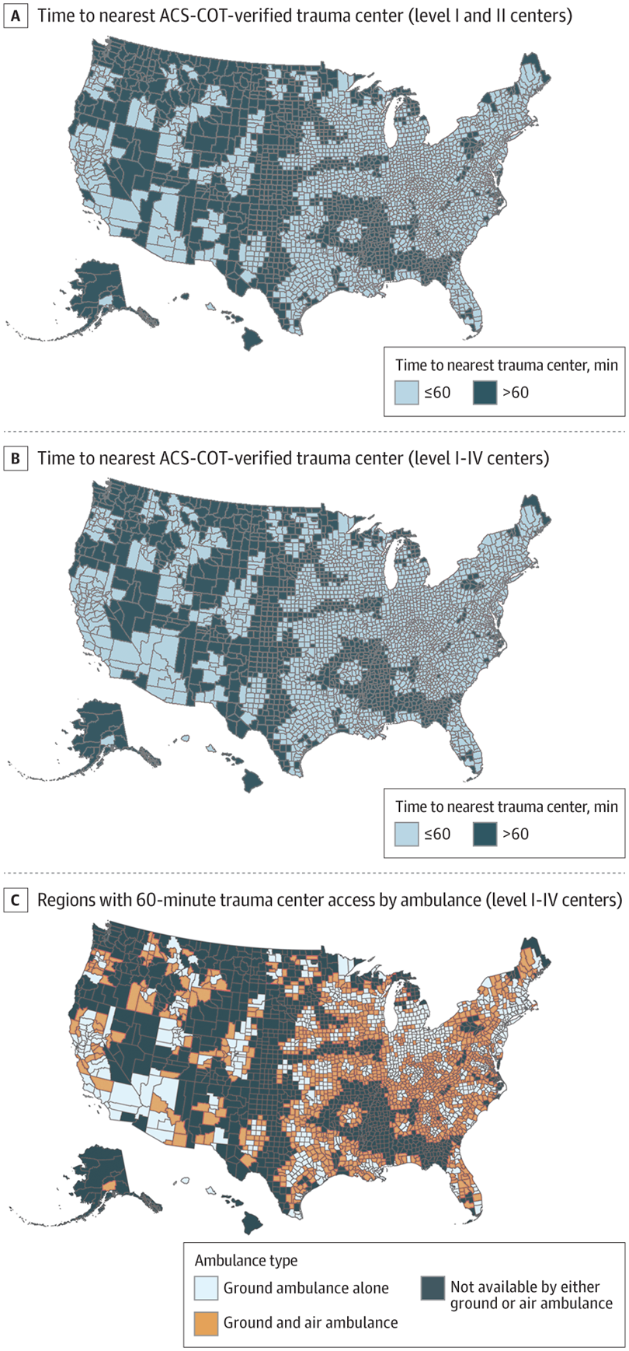
Gaps in Access to Trauma Care
Access to Level I or II Center within 60 min
Branas et al 2005 JAMA
by Ambulance or Helicopter
Choi et al 2022 JAMA
by Ambulance or Helicopter
©ACS
Notes:
Large gaps in high level trauma care still exist across much of the USA (although improvements are being made)
1. Access to Trauma Centers in the United States
Charles C. Branas, PhD; Ellen J. MacKenzie, PhD; Justin C. Williams, PhD
JAMA Published Online: June 1, 2005
2005;293;(21):2626-2633. doi:10.1001/jama.293.21.2626
Context Previous studies have reported that the number and distribution of trauma centers are uneven across states, suggesting large differences in access to trauma center care.
Objective To estimate the proportion of US residents having access to trauma centers within 45 and 60 minutes by Ambulance or Helicopter.
Design and Setting Cross-sectional study using data from 2 national databases as part of the Trauma Resource Allocation Model for Ambulances and Hospitals (TRAMAH) project. Trauma centers, base helipads, and block group population were counted for all 50 states and the District of Columbia as of January 2005.
Main Outcome Measures Percentages of national, regional, and state populations having access to all 703 level I, II, and III trauma centers in the United States by either ground ambulance or helicopter within 45 and 60 minutes.
Results An estimated 69.2% and 84.1% of all US residents had access to a level I or II trauma center within 45 and 60 minutes, respectively. The 46.7 million Americans who had no access within an hour lived mostly in rural areas, whereas the 42.8 million Americans who had access to 20 or more level I or II trauma centers within an hour lived mostly in urban areas. Within 45 and 60 minutes, respectively, 26.7% and 27.7% of US residents had access to level I or II trauma centers by helicopter only and 1.9% and 3.1% of US residents had access to level I or II centers only from trauma centers or base helipads outside their home states.
Conclusion Selecting trauma centers based on geographic need, appropriately locating medical helicopter bases, and establishing formal agreements for sharing trauma care resources across states should be considered to improve access to trauma care in the United States.
2. Access to American College of Surgeons Committee on Trauma–Verified Trauma Centers in the US, 2013-2019
Jeff Choi, MD, MSc¹; Sarah Karr, MS²; Arjun Jain²
JAMA Published Online: July 26, 2022
2022;328;(4):391-393. doi:10.1001/jama.2022.8097
This study uses data from the American Trauma Society’s Trauma Information Exchange Program to evaluate trends in nationwide 60-minute access to American College of Surgeons Committee on Trauma–verified level I-IV trauma centers between 2013 and 2019.
Compared with 78% in 2013, 91% of US residents had 60-minute access to a trauma center in 2019 ,a statistically significant trend (P = .002). In 2019, 89% of US residents had 60-minute access to a level I/II center; level III/IV centers provided 60-minute trauma center access to an additional 1% of residents. Compared with 68% of US residents with 60-minute trauma center access by ground ambulance transport alone, air ambulance transport expanded 60-minute trauma center access to an additional 23% in 2019 (total, 91%)

Slide 4
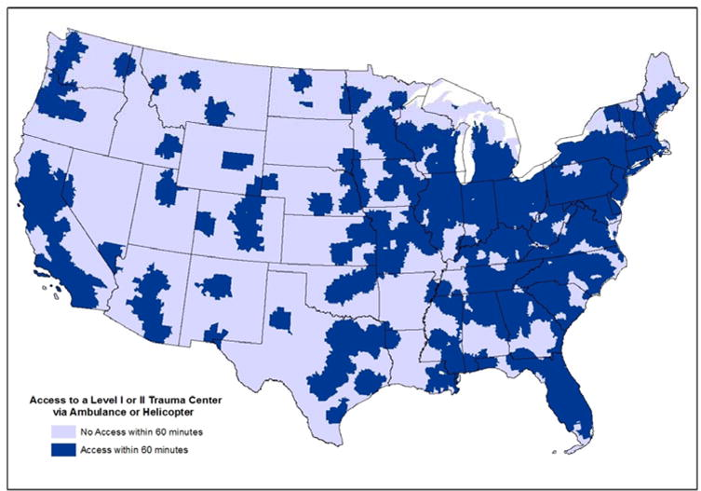
The US Does Not Have a Trauma System
Islands of excellence
in a sea of chaos
Where you live determines if you live!
Carr et al, “Disparities in Access to Trauma Care in the US”
Injury 48(2):332 – 338, 2017
©ACS
Notes:
Unfortunately, The US trauma system is incomplete. We have many excellent centers but Where you live or where you are injured, decides in a large part what your outcome will be.

Slide 5
The US Does Not Have a Trauma System
What we DO have
Trauma Centers
  Committed hospitals
  Committed healthcare professionals
Committed Organizations
Some Committed Regions/States
Challenges
Uneven Access to Timely Care
  Trauma care deserts
  Limited capability
  EMS resources
Financial Challenges
Difficulties with System Collaboration
©ACS
Notes:
There is uneven access to quality trauma care across the system. In many states and regions, care is concentrated in the urban areas and access to specialty and coordinated care can be challenging in many rural areas. Due to manpower shortages, many critical access hospitals are being managed by APPs, sometimes without physician backup and with limited trauma experience. In addition, EMS systems are often not robust in rural areas and not fully integrated into the trauma system. EMS in not recognized as an essential service in 74% (n=37) of states in the US [Hassanein 2023] and is thus frequently underfunded, understaffed, and overworked.
According to the American Hospital Association, approximately 48% of rural hospitals operated at a financial loss in 2023 [analysis of RAND hospital cost report data].
There are frequently difficulties across different hospital systems, often financially driven, to disincentivize cross-collaboration.

Slide 6
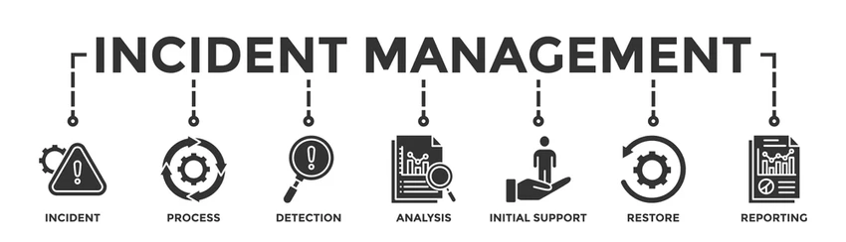




?
©ACS
Notes:
When there is a disaster or multi-casualty even, there is an established process for development of incident command by police and fire. There is deployment of emergency services including fire, police, and EMS to the scene with communication regarding scene safety and patient transport. There is often, however, a lack of information regarding hospital bed capacity as these patients are distributed.

Slide 7
RMOCC
Regional Medical Operations Coordinating Center
“A construct for regional patient distribution to avoid or mitigate crisis conditions by equitably deploying health care resources across a state, territory, or region”
©ACS
Notes:
To help with this care coordination to the medical facilities, the RMOCC was created as a tool to facilitate equitable health care distribution across a region.

Slide 8
RMOCC
Regional Medical Operations Coordinating Center
Centralized command center that coordinates real-time
communication and resource management across a region
  Situational awareness of healthcare resources
  Coordination of patient tracking and distribution
  Real-time evaluation of capacity and capability
  Workforce and supply sharing
©ACS
Notes:
What the RMOCC provides is
Centralized command center that coordinates real-time communication and resource management across a region and provides:
Situational awareness of healthcare resources
Coordination of patient tracking and distribution
Real-time evaluation of capacity and capability
Workforce and supply sharing

Slide 9
RMOCC
Regional Medical Operations Coordinating Center
Key Functions
  Multi-disciplinary collaboration between hospitals, EMS, public health
  departments, emergency management agencies, and military
  Supports access to healthcare assets consistently across a region
  Coordinates patient movement day-to-day with surge capability
  Acts as an adjunct and does not affect patient movement and process within
  existing hospital systems
©ACS
Notes:
The RMOCC serves many Key Functions to include:
Multi-disciplinary collaboration between hospitals, EMS, public health departments, emergency management agencies, and military
Support access to healthcare assets consistently across a region
Coordinates patient movement day-to-day with surge capability
Acts as an adjunct and does not affect patient movement and process within existing hospital systems

Slide 10
RMOCC
Potential Other Initiatives
Coordinate care in rural areas and resource deserts
Coordinate transfer of patients to higher level of care
Support regionalization of specialty services
Support telemedicine networks
Facilitate regional best practice, education, quality improvement
Load balance across the system day-to day or at times of surge
Communication for multiple casualty incident (MCI) and disaster
©ACS
Notes:
NOTE: extra materials- use as needed depending on your audience
RMOCC can do even more than those key functions and there are many locations that have other initiates or activities linked to their RMOCC:
Coordinate care in rural areas and resource deserts
Coordinate transfer of patients to higher level of care
Support regionalization of specialty services
Support telemedicine networks
Facilitate regional best practice, education, quality improvement
Load balance across the system day-to day or at times of surge
Communication for multiple casualty incident (MCI) and disaster

Slide 11

Network of RMOCCs
Basis for National Trauma and Emergency Preparedness System
©ACS
Notes:
What happens if the “event” or MCI exceeds your region’s capabilities and you need to go beyond your regional medical operations coordinating center?
The basic building block for a NTEPS is a network of RMOCCs so that a region could be easily linked in with other RMOCCs for additional resources.

Slide 12

National Trauma and Emergency Preparedness System (NTEPS)
Based on network of Regional Medical Operations Coordinating Centers (RMOCCs)
Vision
  Timely & high-quality trauma care
  Equitable access for all injured
  Focus on entire continuum of care, from prevention to long-term outcomes
  Coordinated care for individual injuries to mass population events
Mission
  Oversee coordination of resource & patient/casualty distribution in daily and mass population events
  Develop system standards & benchmark regional system performance
  Synthesize & disseminate knowledge
  Promote uniform community outreach for prevention & resiliency
“Daily coordination of trauma care keeps the engine
of disaster response warm and running….”
©ACS
Notes:
Although we do not have a national trauma system, A series of linked RMOCCs would be the basis for a national system.
The Vision of a National Trauma and Emergency Preparedness System (NTEPS)
Provides Timely & high-quality trauma care
Allows for Equitable access for all injured
A true system would Focus on the entire continuum of care (from prevention to long-term outcomes)
And provide- Coordinated care for individual injuries to mass population events
Mission of NTEPS:
Oversee coordination of resource & patient/casualty distribution in daily and mass population events
Develop system standards & benchmark regional system performance
Synthesize & disseminate knowledge across the country
And, Promote uniform community outreach for prevention & resiliency
Ideally this provides “Daily coordination of trauma care and keeps the “engine of disaster response” warm and running….”
Time and lives are lost if you try to stand up a system once the disaster occurs. Best to have it up and running where it can easily surge for the response to a “no notice” event.

Slide 13

National Trauma and Emergency Preparedness System (NTEPS)
RMOCCs as “Unit of Action”
Rapid movement of patients across facilities
Response for daily time sensitive conditions
Readiness to scale for mass population events
Builds on existing strengths of regional trauma systems
Coordination of trauma care across military and civilian systems
©ACS
Notes:
The QR code links to Version 2, there is a version 3 coming soon.
Again- RMOCC would be the unit of action of a national system and provides all of these roles:
Rapid movement of patients across facilities
Response for daily time sensitive conditions
Readiness to scale up for mass population events
Builds on existing strengths of regional trauma systems
Coordination of care across military and civilian systems

Slide 14
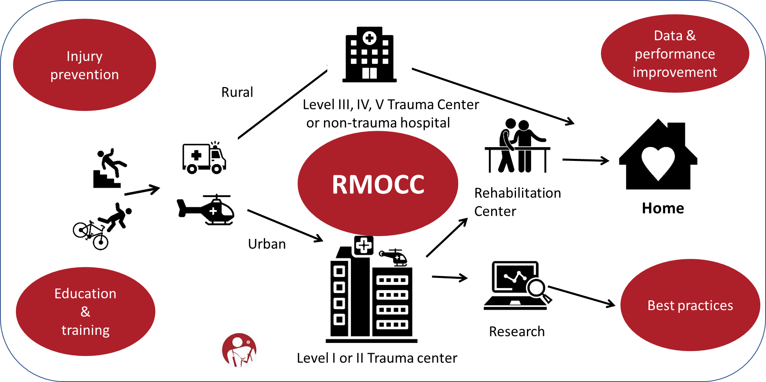
Daily RMOCC Use for Coordination of Emergency Care
©ACS
Notes:
At the regional level, you can see from this diagram how the RMOCC can be used for day-to-day operations and be the coordinating center for most of the regional activities to ensure linkage.

Slide 15

COVID-19 Pandemic
State and Regional Care Coordination
Nationwide Hospital Surge
  Lack of coordinated effort to load balance critically ill patients
  Estimated 1 in 4 early COVID deaths were potentially preventable
Lessons Learned
  Development of regional coordinating centers saved lives
  Flow-sizing of critical care resources
  Load balancing strategies to offload rural hospitals
  A need for collaboration and communication across hospitals, emergency care providers, and healthcare systems
©ACS
Notes:
Many centers were stood up specifically, to address the many coordinating concerns that came out of the COVID pandemic.
These Regions now had a way of distributing patients and load balancing – “pop up” MOCC
Three states that did this were:
Washington State
Georgia
Colorado

Slide 16
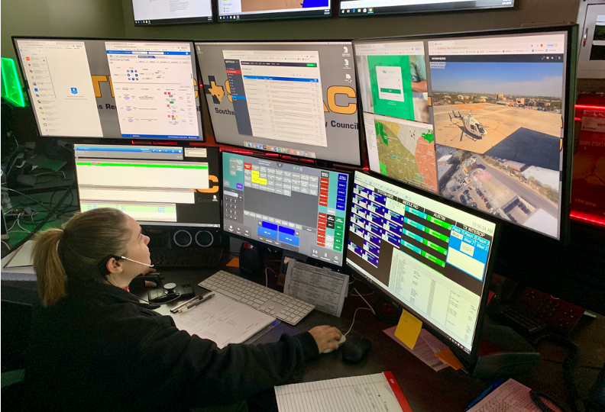


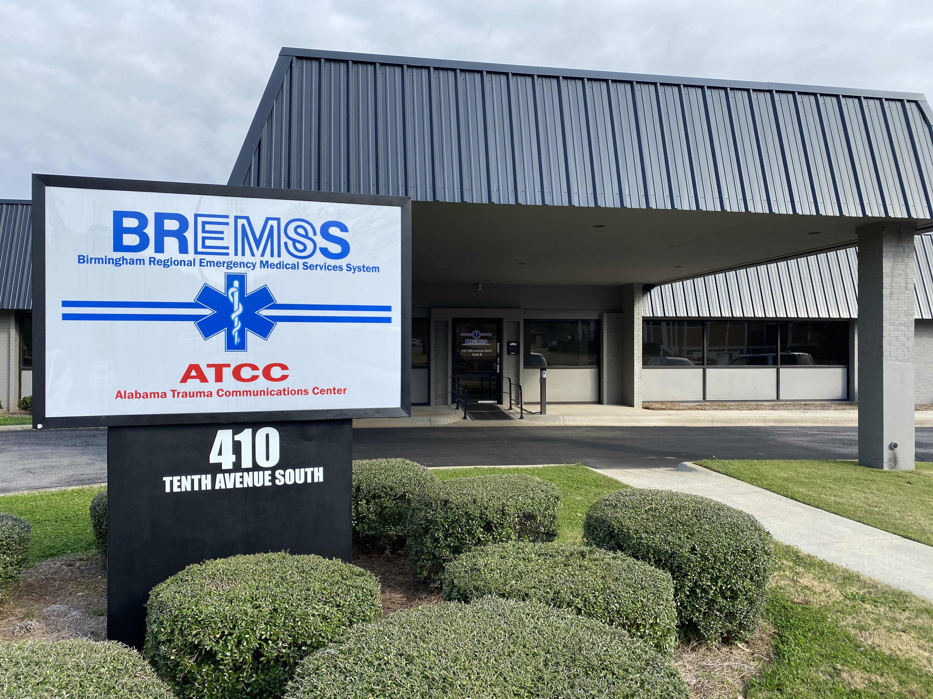
Regional Medical Operation Coordinating Centers
RMOCCs
©ACS
Notes:
A few other states or regions already had something in place such as STRAC in Southwest Texas and Alabama with their trauma coordinating center

Slide 17
Scalability of the RMOCC Concept
Scalable RMOCC
Potential Scenario
NATIONAL
COVID, International Conflict
MULTIPLE REGIONS/STATE
Hurricane, Earthquake
LOCAL/REGIONAL
Active Shooter, Bridge Collapse
DAY TO DAY
Prehospital Care Coordination; Trauma Transfer Process
©ACS
Notes:
The national trauma system needs to be in place for large scale disaster, however, it is also necessary for it to function on a day to day. This is an upside-down wedding cake model, courtesy of Eric Epley. Something that can be quickly scaled up based on the level of the event.

Slide 18
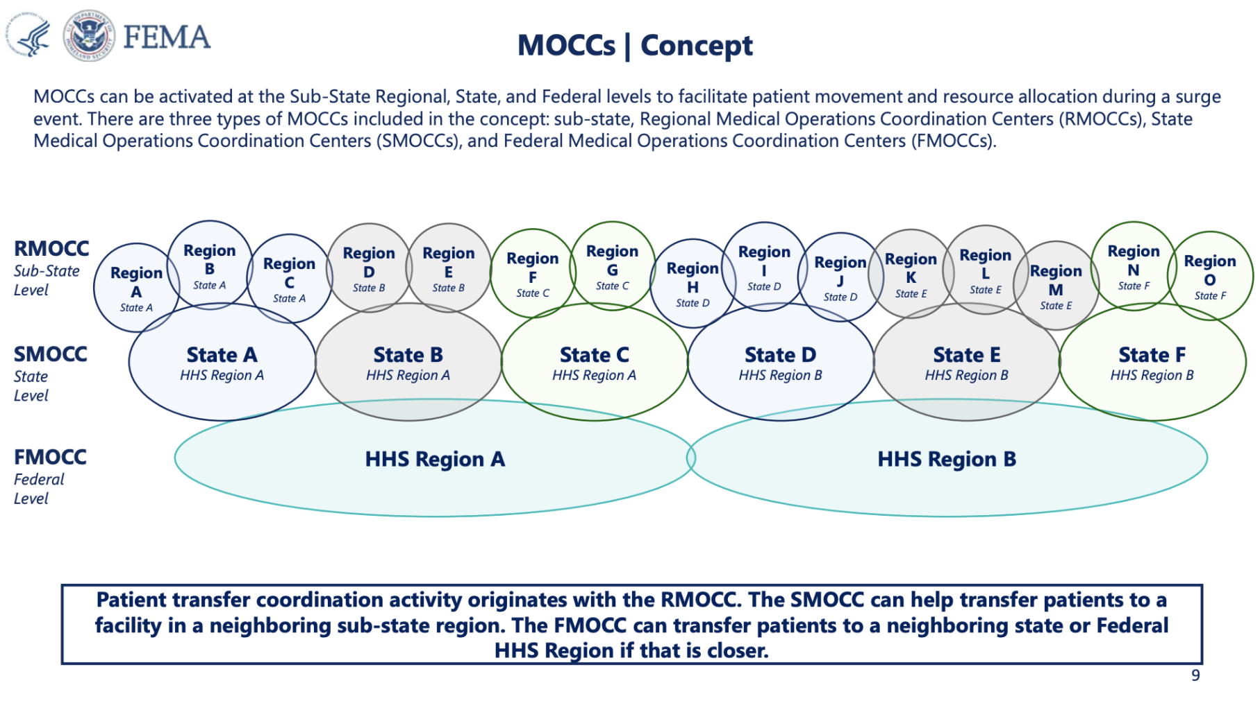
Integration of RMOCCs into a National System
©ACS
Notes:
The idea is to build a network of regional coverage that covers the entire country. Allows regions to coordinate with neighboring regions or when needed at the state level or even for a national or pandemic event at the Federal level.
HHS= Health and Human Services; 10 regions of the states (1-10)

Slide 19
Why the push now?
How RMOCCs would support a National Trauma System
Improve access to higher level and specialty trauma care across rural regions
Coordinate regional/national mass disaster surge response
Patient load balance in the event of a Large-Scale Combat Operation (LSCO)
©ACS
Notes:
Why the push now?
1. It’s the right thing and Improves care
2. Provides a surge capability for the nation
AND 3. Will support the return of casualties should we be in a large scale combat operation on a global scale…Something that the Dept of War is anticipating may occur by mid 2027.
(A large load of military casualties will require the support of military civilian partnerships at our civilian trauma centers and will prove their worth by making this centers “ready:”)

Slide 20
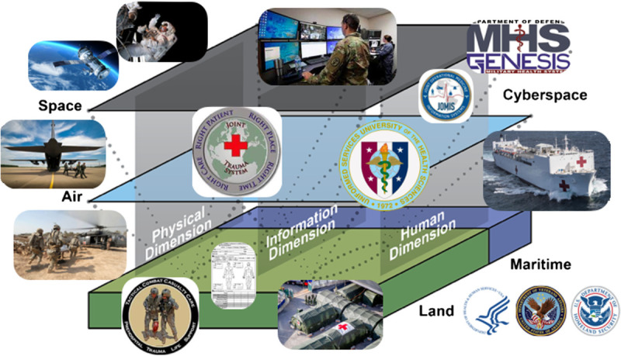
Large Scale Combat Operation
Multi-Domain Threat
©ACS
Notes:
What is a modern Large Scale Combat Operations?
Widespread, intense and destructive conflict that span multiple domains. Tend to involve major powers and result in high casualty rates.
Historically WWI, WWII, Korean War all meet this definition.
The current Russo-Ukraine war is a more modern example of LSCO.
These are multi domain involvement occurring across the entire spectrum. Satellite communications are at risk. Cyber attacks are already weakening infrastructure

Slide 21
Large Scale Combat Operations
Peer-Near Peer Conflict
Massive casualties anticipated
Imminent threat to North America
Sustained offensive action
  Military capability overwhelmed
  Repatriation to North American civilian trauma centers
  While maintaining ongoing civilian trauma needs
©ACS
Notes:
Massive casualties anticipated (current modeling is 1000 casualties per day for 30 days)
Imminent threat to North America if the shift is made towards total war- win at all costs
Sustained offensive action anticipated
Military capability would be quickly overwhelmed (perhaps by day 1-2)
Repatriation to North American civilian trauma centers for most of these casualties
While STILL TRYING to maintain ongoing civilian trauma needs

Slide 22
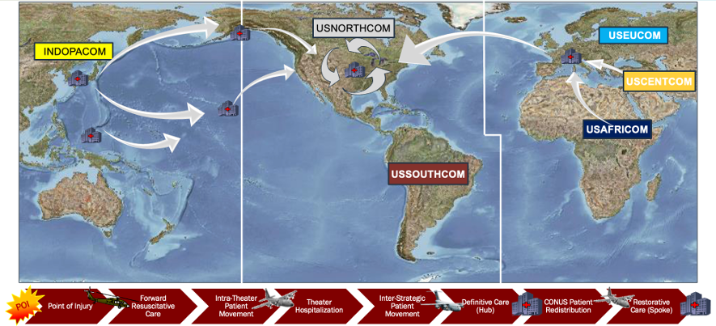
Macro View of Global Casualty Care
©ACS
Notes:
This is a more global map to perhaps outline how this casualty flow would look

Slide 23
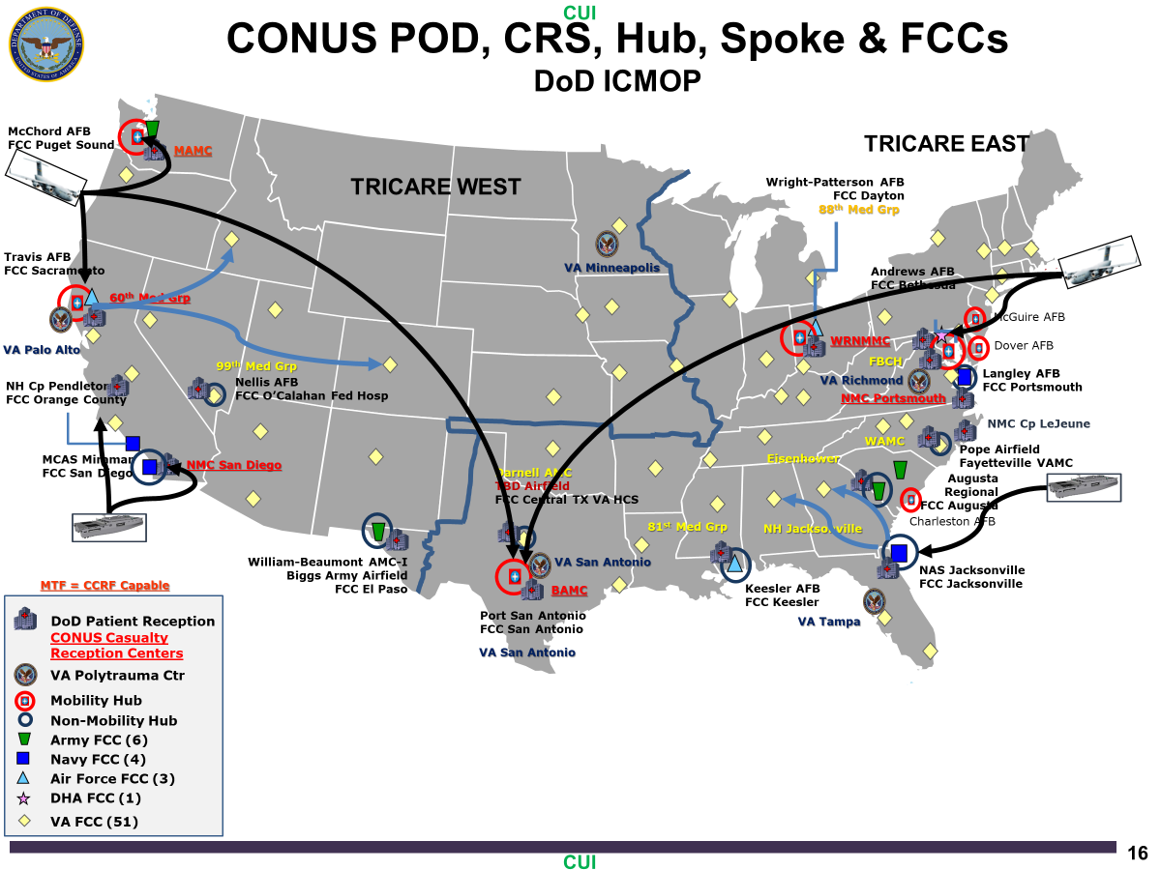
Integrated Continental U.S. Medical Operations Plan (ICMOP)
©ACS
Notes:
NOTE: extra materials- use as needed depending on your audience
This is the military plan for casualties to return to Casualty Reception centers before being moved to regional trauma centers.
In this model- VA would be for post acute care (not as primary receiving centers as some first thought)

Slide 24
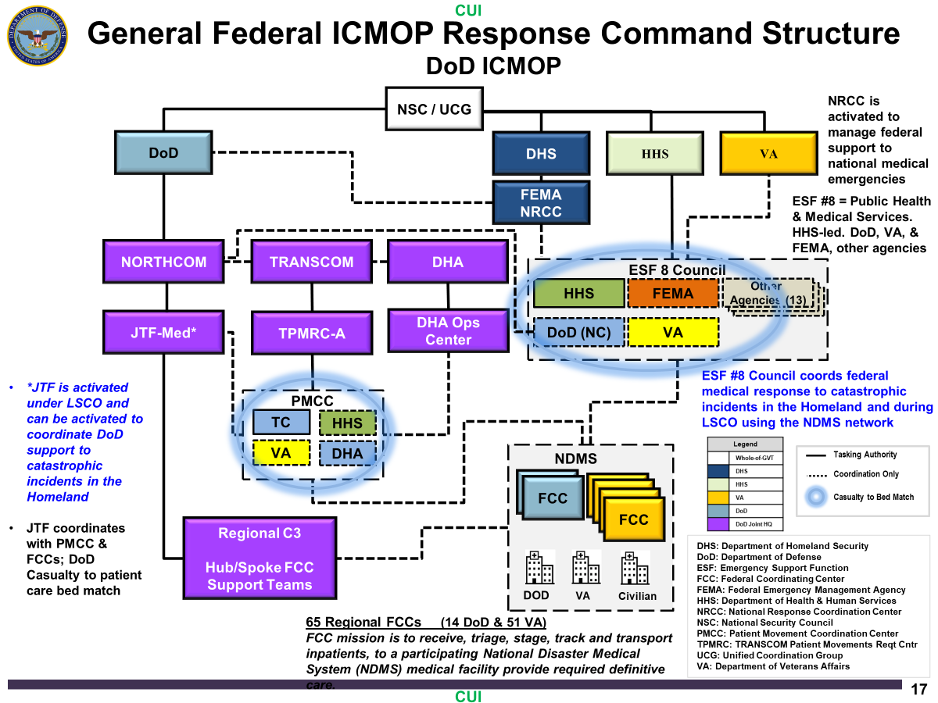
©ACS
Notes:
NOTE: extra materials- use as needed depending on your audience
Outline of the military and federal command structure needed to move these casualties

Slide 25
LSCO: Stateside Response
Questions to Address
How many beds?
What about post-acute care?
Who will be here to take care of the patients?
What are the training needs?
How will this be financed?
How do we make sure quality care has primacy?
How will military – civilian trauma needs be coordinated?
©ACS
Notes:
Here are just a few questions that we will have to address.
How many beds are available now and will be needed within the region?
What about post-acute care? Will this be with local VA or with civilian sites near the trauma center
Who will be here to take care of the patients? A major LSCO may result in a medical draft and many of the staff may be pulled and deployed forward (example Army surgeons need by be 10 x the current numbers on active duty/Reserve/Guard)
What are the training needs? For both the trauma center ALL staff as well as those who are drafted
How will this be financed? Medical Care, additional supplies or equipment, additional bed expansion, training, etc
How do we make sure quality care has primacy? And will this be linked to the Joint Trauma System for capture and generation of a TQIP like report
How will military – civilian trauma needs be coordinated?

Slide 26

National Disaster Medical System (NDMS) Pilot Program
Potential Scenario: Overseas military contingency resulting in 1,000 combat casualties returning daily to the United States for 100 days or longer.
Pilot sites (current):
  Capital Region
  San Antonio, TX
  Denver, CO
  Omaha, NE
  Sacramento, CA
  Puget Sound, WA
  Shreveport, LA
  Oahu, HI
©ACS
Notes:
To prepare for the LSCO event, The National Disaster Medical System has been tasked with Trying to prepare the nation for this potential event.
1,000 casualties per day for 100 days is the pilot project for the NDMS planned response exercise.
Currently 8 areas have been identified as pilot sites and there may be an additional 7 that get identified.

Slide 27
National Disaster Medical System (NDMS) Established 1984
Federal Agency Partnership
  Health and Human Services (HHS)
  Department of War (DoW)
  Homeland Security (DHS)
  Veterans Affairs (VA)
Areas of Focus
  NDMS Response Teams
  Patient Movement
  NDMS Definitive Care Hospitals
Federal Coordinating Centers
  Hub and Spoke Model
©ACS
Notes:
What is NDMS? It is part of The Department of Health and Human Services, and part of Administration for Strategic Preparedness and Response (ASPR), in its role as Coordinator of Emergency Support Function#8 (ESF-8), Public Health and Medical Services, of the National Response Framework (NRF), employs the NDMS to provide patient care, patient movement, and definitive care, as well as veterinary services, and fatality management support when requested by authorities from States, localities, Tribes and Territories, or other federal departments. Some common missions for NDMS include: augmenting a hospital in a disaster area to decompress the overtaxed emergency department; providing veterinary services to federal working animals during National Security Special Events, such as the Presidential Inauguration; and, supporting the National Transportation Safety Board and affected localities with fatality management services following major transportation disasters. Although NDMS is primarily a domestic disaster response capability, NDMS teams and personnel have also been deployed to disasters internationally, such as in Iran and Haiti following devastating earthquakes.
NDMS has three major components:^{[1]}
Emergency medical response by medical teams made up by Federal Intermittent Employees (IFEs) (civilians who are federalized when activated), equipment, and supplies deployed to a disaster area when requested by State or local authorities
Movement of ill and injured patients from a disaster area to areas unaffected by the disaster
Definitive care of patients at hospitals in areas unaffected by the disaster.
Over 5,000 NDMS civilian medical personnel (IFEs) are organized into a number of types of teams, designed to provide medical services supporting the Federal Public Health and Medical Services (Emergency Support Function - 8) mission

Slide 28
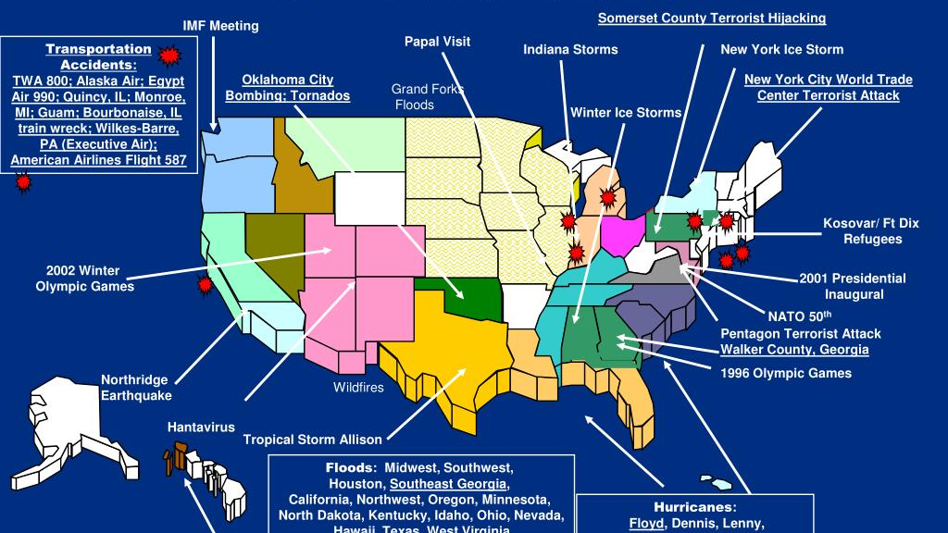
NDMS Activations
©ACS
Notes:
NOTE: extra materials- use as needed depending on your audience
Activities that NDMS has participated in since inception

Slide 29
NDMS Pilot Project
Aim: Increase surge capacity, capability, and interoperability across the NDMS in support of a large-scale combat operation requiring definitive care for large numbers of DoW casualties repatriated to the US over the course of a protracted conflict.
©ACS
Notes:
Again, the Aim of NDMS pilot project is to:
Increase surge capacity, capability, and interoperability across the NDMS in support of a large-scale combat operation requiring definitive care for large numbers of DoD casualties repatriated to the US over the course of a protracted conflict

Slide 30

NDMS Pilot Project
Authorized under the first Trump Administration to assess
and strengthen the NDMS
Address requirements of a LSCO or catastrophic event
Establish partnerships with public and private healthcare organizations
Implement NORTHCOM Integrated Continental US Medical Operations Plan
©ACS
Notes:
A few more details of the pilot project:
READ
Collaboration between DoW, VA, HHS, DHS and DoT

Slide 31
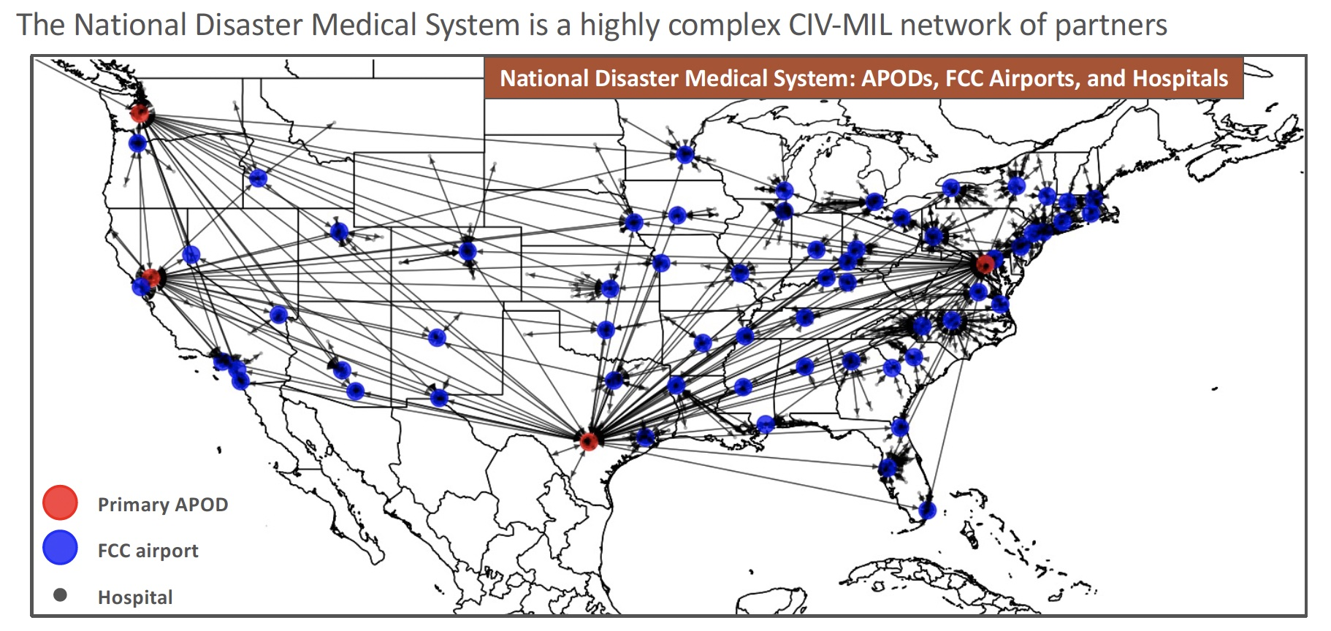
NDMS Pilot Project
©ACS
Notes:
NOTE: extra materials- use as needed depending on your audience

Slide 32
How do we do this?
Build a National Trauma and Emergency Preparedness System (NTEPS) plan and link existing efforts
National Disaster Medical Systems (NDMS) Pilot
NASEM Action Collaborative
Military- Civilian Partnerships
Regional Disaster Health Response System (RDHRS)
Hospital Preparedness Program (HPP) Healthcare Coalitions
Build a Network of RMOCCs
©ACS
Notes:
NOTE: extra materials- use as needed depending on your audience

Slide 33
We need a National Trauma System
Military Health System
Health Care System
Public Health
Emergency Management
©ACS
Notes:
NOTE: extra materials- use as needed depending on your audience
One that would integrate all of these together nationally

Slide 34
National Trauma System
Civilian Trauma System
Military Trauma System
Shared aims, infrastructure, system design, data, best practices, and personnel
©ACS
Notes:
NOTE: extra materials- use as needed depending on your audience
A National trauma System would have Shared aims, infrastructure, system design, data, best practices, and personnel and merge the Military Health Systema dn the Civilioan Health systems togther

Slide 35
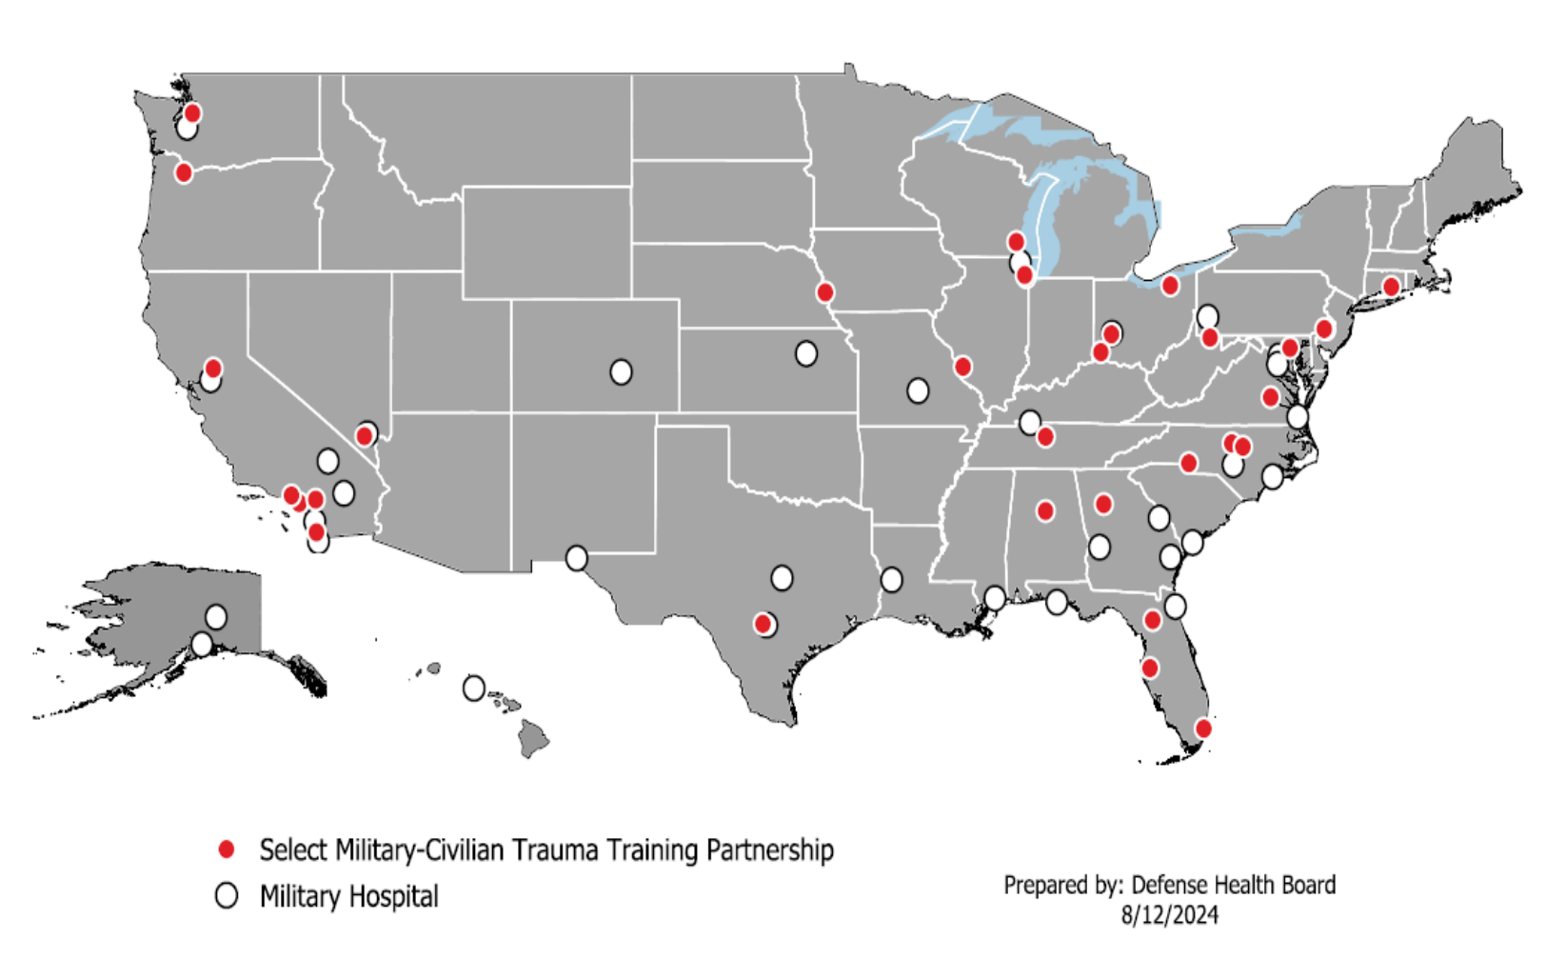
Existing Military Civilian Partnerships 2024
©ACS
Notes:
NOTE: extra materials- use as needed depending on your audience

Slide 36
Military-Civilian Partnerships
National Defense Authorization Act
Coordinated partnerships with civilian trauma centers
Augment and sustain readiness skills for combat casualty care
Mitigate the “Walker dip”
Model | Description | Duration | Example
Short-Term Rotational | Personnel rotate through civilian trauma centers | < 1 month | C-STARS SMART HMTT
Part-time Embedded | Personnel stationed at military treatment facility and work part-time at civilian trauma center | 2-4 years | U of Nevada MCP
Full-time Embedded | Personnel are stationed at a civilian trauma center full-time | 2-4 years | AMCT3 UAB MCP
©ACS
Notes:
NOTE: extra materials- use as needed depending on your audience

Slide 37
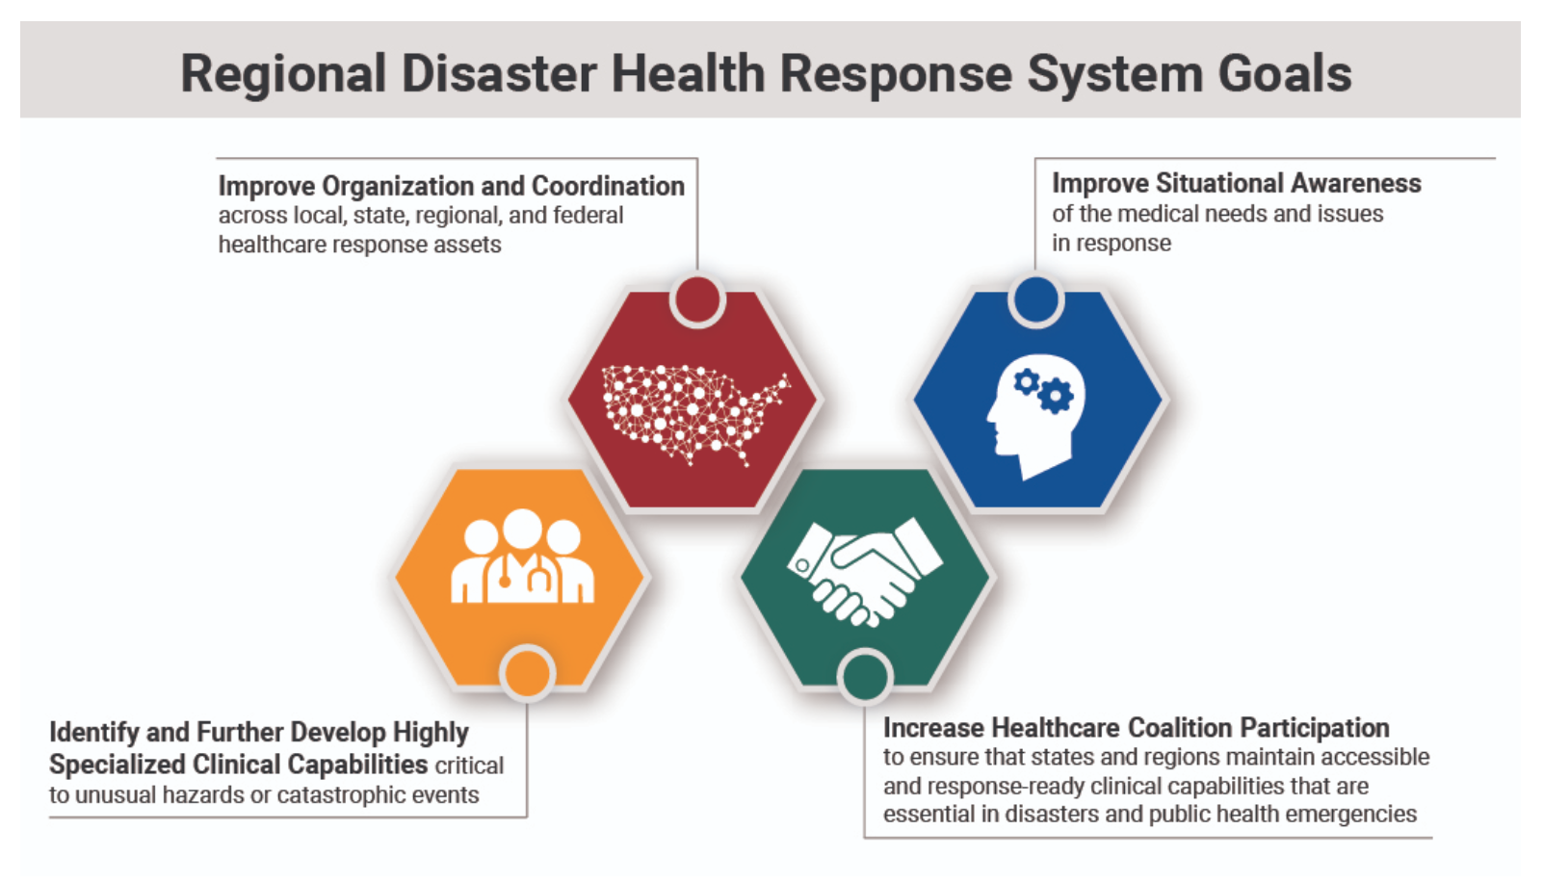
Regional Disaster Health Response System (RDHRS)
Administration for Strategic Preparedness & Response (ASPR)
©ACS
Notes:
NOTE: extra materials- use as needed depending on your audience

Slide 38
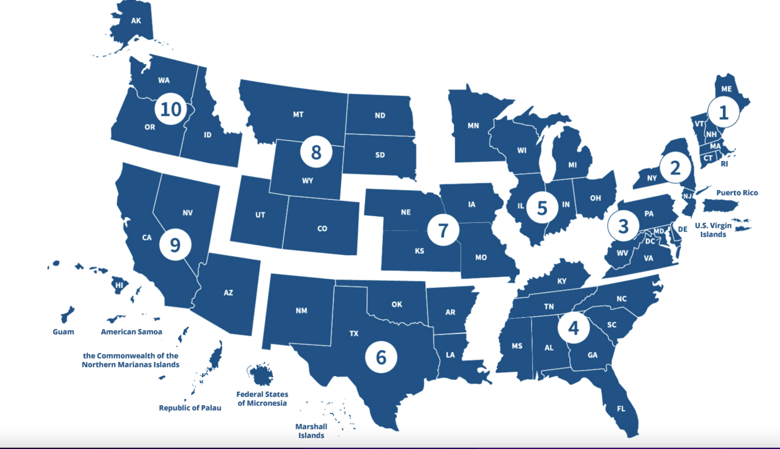
Administration for Strategic Preparedness & Response (ASPR) Regions
©ACS
Notes:
NOTE: extra materials- use as needed depending on your audience

Slide 39
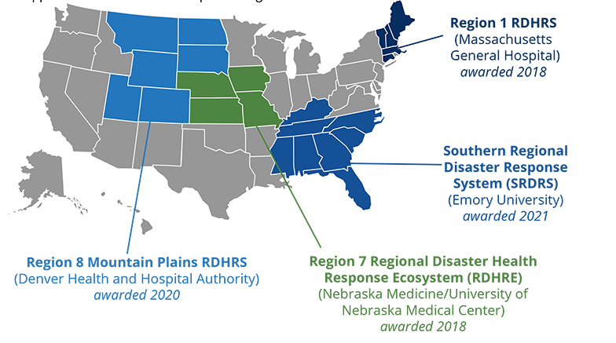
Regional Disaster Health Response System (RDHRS)
©ACS
Notes:
NOTE: extra materials- use as needed depending on your audience

Slide 40
Hospital Preparedness Program (HPP)
Healthcare Coalitions (HCC)
Foundation for healthcare and medical readiness
Healthcare and medical response coordination
Continuity of healthcare service delivery
Surge capacity and resource sharing
Communication and coordination
©ACS
Notes:
NOTE: extra materials- use as needed depending on your audience

Slide 41
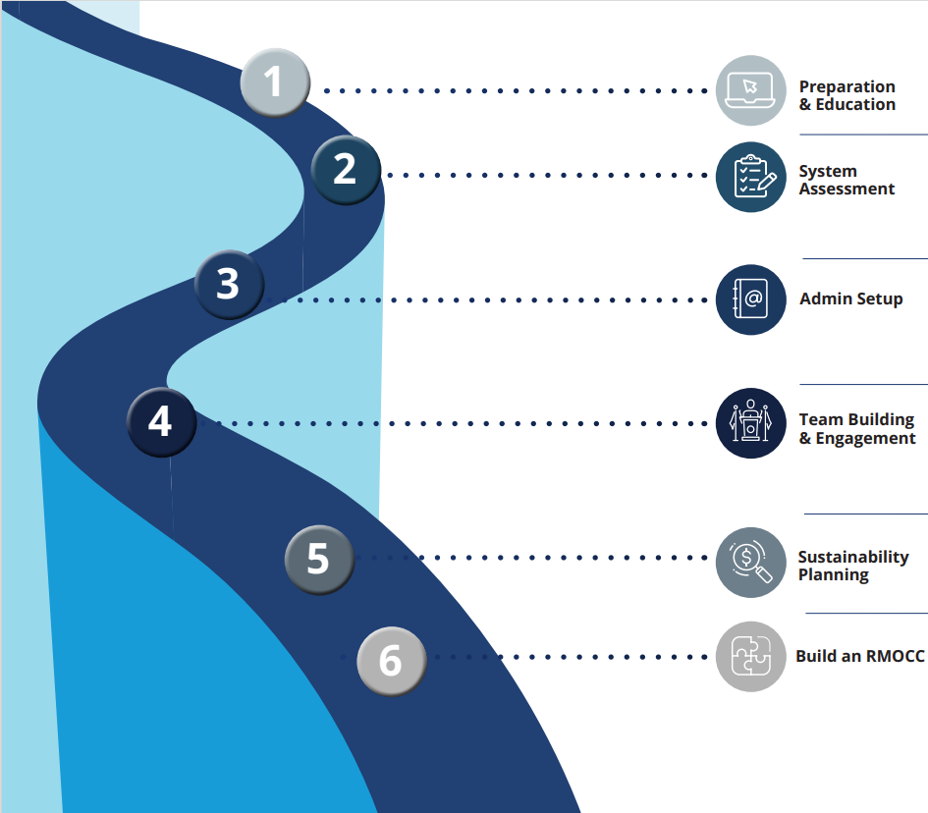
Getting Started
©ACS
Notes:
The COT has put together a roadmap of how to build the RMOCC building block which is critical piece of the NTEPS and for LSCO preparation

Slide 42
Getting Started
Coordinate with State COT Chair
RMOCC COT Checklist
MOC Toolkit 3rd Ed (ASPR TRACIE)
Regional COT RMOCC Website
www.facs.org/rmoccs
©ACS
Notes:
How to get started:
Coordinate with your STATE COT chair
Obtain and follow the COT RMOCC checklist
Use the ASPR TRACIE toolkit and other tools that are available on the RCOT RMOCC specific webpage

Slide 43
Principles Behind RMOCCs
Guiding Standard Development
Structured Cooperation
Maximal Inclusiveness
Timely Scalability
Bias for Action
Decisions by Consensus
©ACS
Notes:
What are the principles behind the development of an RMOCC?
Structured
Cooperation with all and with consensus decision making
Maximal inclusiveness
Daily use but timely scalable
Bias for action- lets get this done!

Slide 44
RMOCC Standards
Standards provide a clear framework for delivering high-quality, consistent care across diverse settings.
They serve as a foundation for evaluation, improvement, and accountability, ensuring patients receive safe, effective, and coordinated treatment.
©ACS
Notes:
Why have standards in your RMOCC development?
Standards provide a clear framework for delivering high-quality, consistent care across diverse settings.
They also serve as a foundation for evaluation, improvement, and accountability, ensuring patients receive safe, effective, and coordinated treatment.

Slide 45
Goals in Establishing an RMOCC
RMOCC Standards
Ensure Consistency Across Regions
Define a common framework so RMOCCs function reliably regardless of geography or organizational structure.
Support Scalable Disaster Response
Enable rapid expansion from daily coordination to mass casualty incident management without building from scratch.
Facilitate Interoperability and Cross-State Coordination
Align protocols and data systems to support coordination across jurisdictions, especially during large-scale events.
©ACS
Notes:
Read the next three slides: What are the goals for establishing an RMOCC?

Slide 46
Goals in Establishing an RMOCC
RMOCC Standards
Guide Implementation and Maturity
Provide a roadmap for developing and evolving RMOCC capabilities, from basic coordination to fully integrated operations.
Build Trust Through Transparency and Governance
Set clear expectations around authority, data use, and decision-making to encourage hospital participation and collaboration.
Enable Data-Driven Performance Improvement
Standardize what data is collected and how it’s used to improve transfer efficiency, patient outcomes, and system learning.
©ACS

Slide 47
Goals in Establishing an RMOCC
RMOCC Standards
Justify and Align Funding
Allow state, federal, and local funders to allocate resources based on demonstrable capacity, performance, and need.
Protect Legal and Ethical Integrity
Ensure triage and transfer decisions made during crisis conditions are supported by clear, defensible, and ethical guidelines.
Institutionalize the RMOCC Function
Shift coordination from a temporary workaround to a permanent system function that strengthens routine and emergency care alike.
©ACS

Slide 48
Basic Structural Components to be Addressed by RMOCC Standards
Category | Key Needs
Authority | Legal/contractual authority to access data, compel transfers
Trust | Transparent governance, equitable policies
Infrastructure | Data platform, comms systems, call center setup
Staffing | Medical director, transfer coordinators, specialty consultants
Funding | Sustainable model
Integration | Ties with EMS, public health, trauma, and emergency management, others
Capabilities | Attributes outlined by ASPR
©ACS
Notes:
NOTE: extra materials- use as needed depending on your audience
Basic Structural Components to be Addressed by RMOCC Standards
READ: category and the Key needs

Slide 49
Building an RMOCC Network
Supporting a National Trauma System
A National Trauma and Emergency Preparedness System is critical for the optimal care of patients and ongoing advancement of the US healthcare system
Federal support is needed for full integration; however, the building blocks of the national system must address the day-to-day needs of the individual regions
The basic building block to accomplish this is the RMOCC
Creating this system will require regional coordination and leadership
©ACS
Notes:
Summary slide:

Slide 50

Thank You.
©ACS

