Slide 1
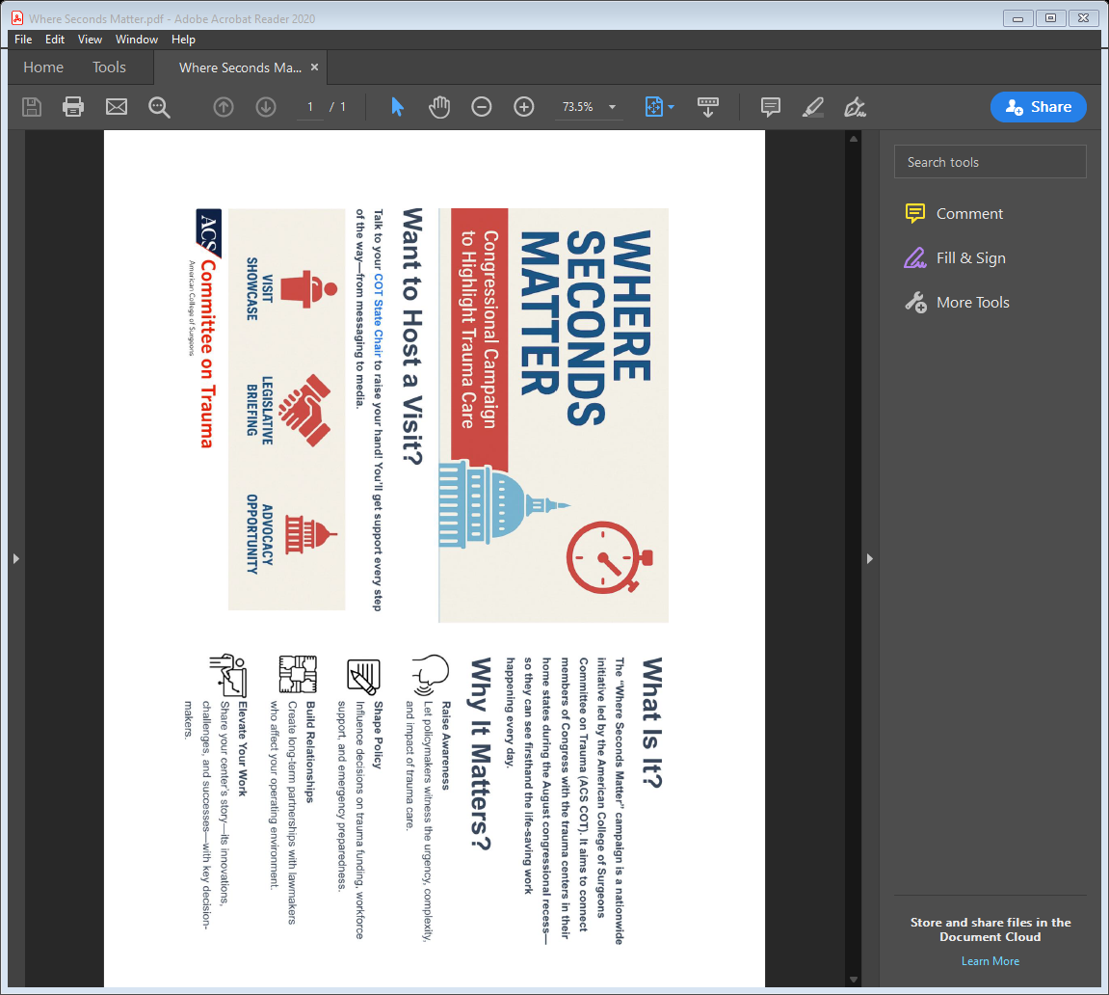


REGIONAL
Committees on Trauma
Advocacy Webinar
May 27, 2026
Copyright ©2025 American College of Surgeons. 633 N Saint Clair St, Chicago, IL 60611-3295

Slide 2

You can adjust the horizontal length of the light blue and dark blue triangles to fit whatever you need.
Overview – Where Seconds Matter
ACS–COT Annual National Campaign
Build stronger relationships with members of Congress
Invitation to Trauma Centers during August Recess
Aim:
Ensure at least one member of Congress (House or Senate) visits a trauma center in 2026, targeting August Recess as a prime window.
©ACS

Slide 3
Objectives – Where Seconds Matter
1. Strengthen Relationships – Establish long-term connections between trauma surgeons and Congressional representatives.
2. Educate Policymakers – Provide members of Congress firsthand exposure to trauma care challenges and opportunities.
3. Promote Public Awareness – Leverage media and social platforms to highlight the importance of trauma systems and advocacy efforts.
©ACS

Slide 4
Where Seconds Matter Roles
1. Surgeon- Become a WSM Champion!
Any COT member can be a Where Seconds Matter Champion. WSM Champions are responsible for coordinating a trauma center visit with at least one Congressional representative.
This includes:
  Identifying trauma centers willing to host visits.
  Contacting Congressional district offices to schedule meetings.
  Organizing visit logistics and ensuring hospital leadership participation.
  Communicating with ACS staff on preparation.
  Preparing trauma teams to provide a compelling and educational experience.
©ACS

Slide 5
Where Seconds Matter- Roles
2. ACS-COT and DC Office Staff Support
Staff will provide oversight, monitor progress, centralized resources and support to ensure consistency and effectiveness.
Their responsibilities include:
  Tracking outreach efforts and scheduled trauma center visits.
  Providing resources including, checklist for WSM champions, media & communication toolkit, talking points, and personalized congressional information.
  Assisting WSM Champions with scheduling challenges.
  Ensuring follow-up by collecting feedback from WSM Champions and compiling a report on participation and key takeaways.
©ACS

Slide 6
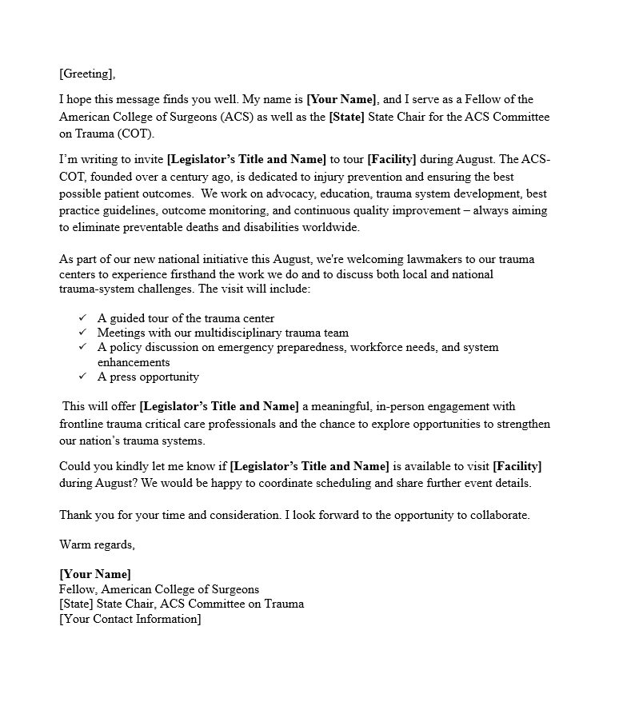
Template Email
More Headers
Text text text text text text text
Text text text text text text text
Text text text text text
text text
©ACS

Slide 7
Structure of Trauma Center Visits
Each visit should include:
  A Guided Tour – Walkthrough of trauma bays, ICUs, and operating rooms (when feasible).
  Meet-and-Greet with Trauma Teams – Opportunities for physicians, nurses, and administrators to share their experiences.
  Case Studies and Patient Impact Stories – Real-life examples showcasing trauma care challenges and successes.
  Discussion – Opportunity for advocacy based on ACS COT’s priority issues or regional/local specific legislative priorities.
  Press Conference – Include Hospital Leadership, Trauma Team, and Congressional member
©ACS

Slide 8
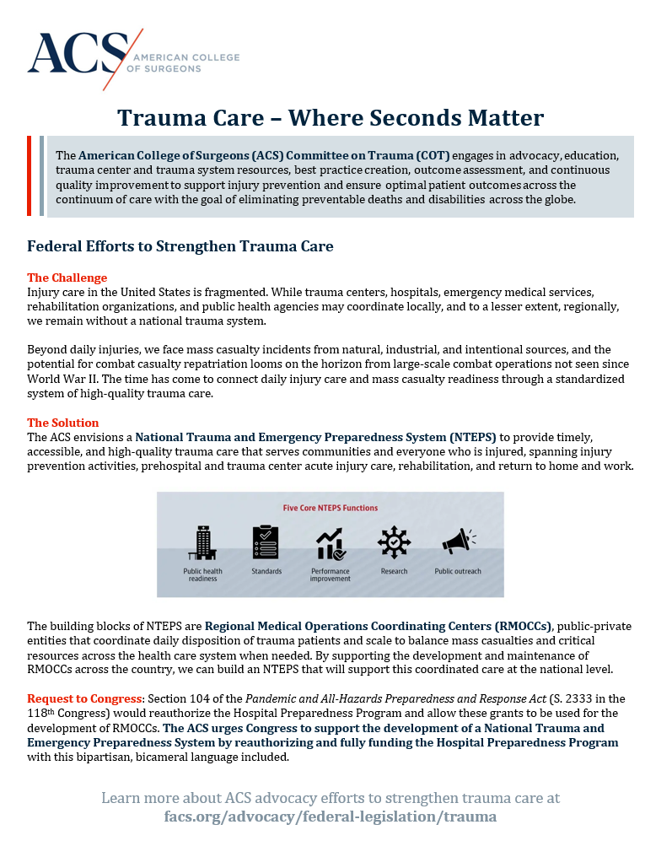
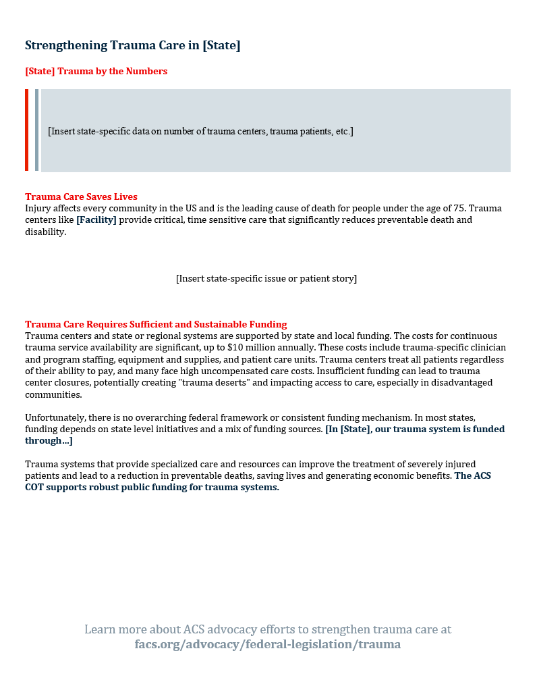
One-Pager
More Headers
Text text text text text text text
Text text text text text text text
Text text text text text
text text
©ACS

Slide 9
Promotion & Media Engagement
Encourage local press coverage to highlight the importance of trauma systems.
Please make sure to work with and communicate to hospital and health system media team.
Leverage social media using ACS and trauma center platforms with hashtags like #TraumaCareMatters and #SecondsMatter.
Recognize participating members of Congress through follow-up engagement and public acknowledgment.
©ACS

Slide 10
Metrics for Success
Goal: At least one member of Congress visits a trauma center in every state.
Engagement: Number of trauma centers and Congressional offices participating.
Media Impact: Press coverage, social media engagement, and public awareness reach.
Strengthened Relationships: Post-visit discussions leading to legislative action or increased support for trauma-related issues.
©ACS

Slide 11
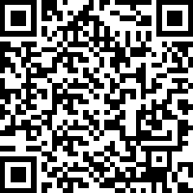

Want to Host a Visit?
Please scan this QR Code to Sign Up as a Where Seconds Matter Champion
Once signing up, ACS staff will email you through wsmtrauma@facs.org with follow up questions to tailor support.
©ACS

Slide 12

Questions – wsmtrauma@facs.org
©ACS

