Slide 1
TQIP Enrollment
Program and Application Process Overview

Slide 2
What is TQIP?
The ACS TQIP works to elevate the quality of care for trauma patients. Currently, more than 950 trauma centers across the US and the world participate in TQIP.
TQIP collects data from your trauma center, provides feedback about your center’s performance, and identifies institutional characteristics that your trauma center staff can implement to improve patient outcomes. The program uses risk-adjusted benchmarking to provide your hospital with accurate national comparisons.

Slide 3
TQIP Eligibility
To be eligible to join TQIP, one of the following criteria must be met:
Adult Level I, II, III or Pediatric Level I or II state-designated trauma center
Adult Level I, II, III or Pediatric Level I or II ACS-Verified trauma center
Undesignated trauma center who has submitted an ACS Adult Level I, II, III or Pediatric Level I or II Consultation or Verification site visit application
Undesignated trauma center who has applied for Adult Level I, II, III or Pediatric Level I or II designation at the state level
Center is provisionally designated as an Adult Level I, II, III or Pediatric Level I or II trauma center by their state
Note: International trauma centers must complete a brief eligibility assessment to determine their US-equivalent trauma center level

Slide 4
TQIP Levels of Participation
There are three levels of TQIP participation:
Adult Level I and II TQIP (Adult Level I and II trauma centers)
Pediatric TQIP (Pediatric Level I and II trauma centers)
Level III TQIP (Level III trauma centers)
A hospital with both Adult and Pediatric trauma centers may enroll in both Adult and Pediatric TQIP.
A hospital with an Adult trauma center that also treats pediatric patients may also enroll in both Adult and Pediatric TQIP.

Slide 5
TQIP Program Deliverables
Program Deliverables
Standardized data
Semi-annual risk-adjusted benchmark reports
Data drill-down tools
Education
  Data abstractors and trauma registrars
  Whole trauma team
Networking opportunities
Clinical Best Practices Guidelines
Access to TQP Participant Use File

Slide 6

TQIP Reporting
Program Design
TQIP reports utilize both core NTDS data elements and TQIP Processes of Care Measures*
  *Level III TQIP participants have no additional data collection requirements (no Processes of Care Measures)
  All data elements are defined in the NTDS Data Dictionary
Two reports per year – Spring and Fall
12 months of data during a rolling window
  E.g., for Fall 2025, we used the most recently submitted 12 months of data between 1/1/2024 and 3/31/2025

Slide 7
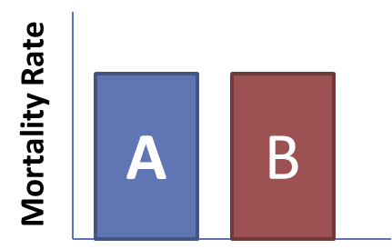
TQIP Reporting
Why risk-adjustment?
You each treat different types of patients
  Differing by demographics, injury patterns, volumes, etc.
Comparing raw rates wouldn't be a fair assessment
Risk-adjustment uses patient-level data to predict performance based on your center's patient mix
Models are updated every 6 months to reflect the most current standards of care

Slide 8

TQIP Education
Continuous Quality Improvement, Continuous Learning
TQIP Online Courses
  Annual NTDS course
  TQIP Basics Courses
  “Top 5” courses
  Data Quality courses
Monthly educational experiences
Access to the TQIP Education Portal
Participation in the TQIP Google Group
Access to TQIP Best Practice Guidelines
TQIP Annual Conference

Slide 9
Enrollment Process Overview
Execute Participation Agreement
Submit Application
Sign BA/DUA
(if not already on file)
Pay Participation Fee
Complete Site Profile on QPort

Slide 10
Before Submitting Your Application
Confirm registry compliance with the current ACS NTDS Data Dictionary
Discuss TQIP participation with your registry vendor

Slide 11
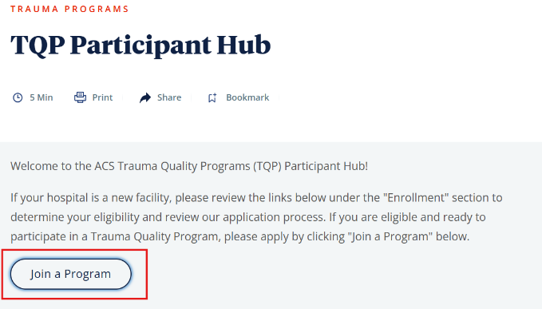
Submit Application (as a brand-new center)
To apply for TQIP, complete the following steps:
Go the TQP Participant Hub
Select ‘Join a Program’
Fill in hospital information and select program participation type
Click ‘Submit’

Slide 12
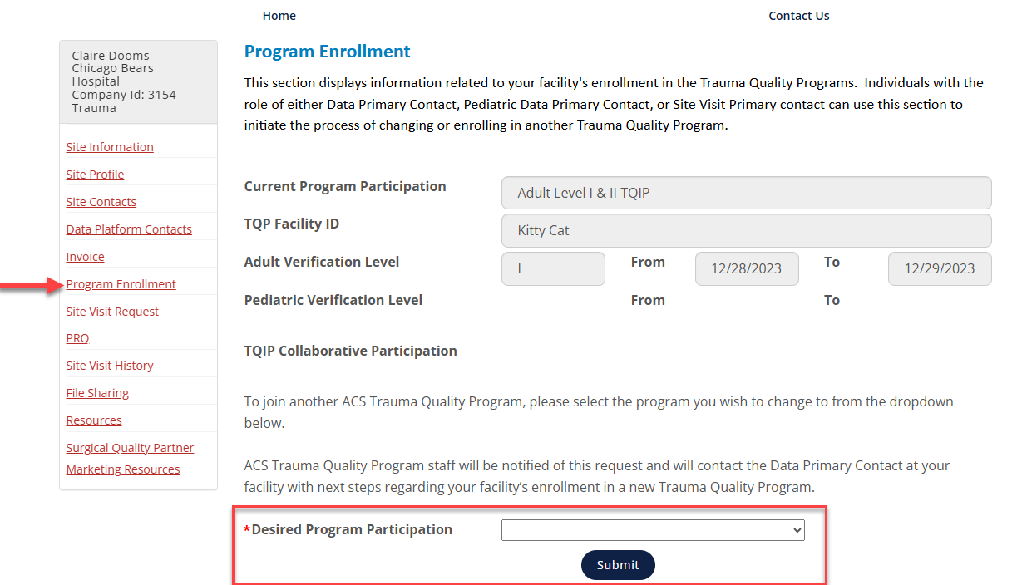
Submit Application (as a past participant in the Annual Call for Data)
To apply for TQIP, complete the following steps:
Log in to QPort
Navigate to Program Enrollment section
Enter desired program participation type
Click ‘Submit’

Slide 13
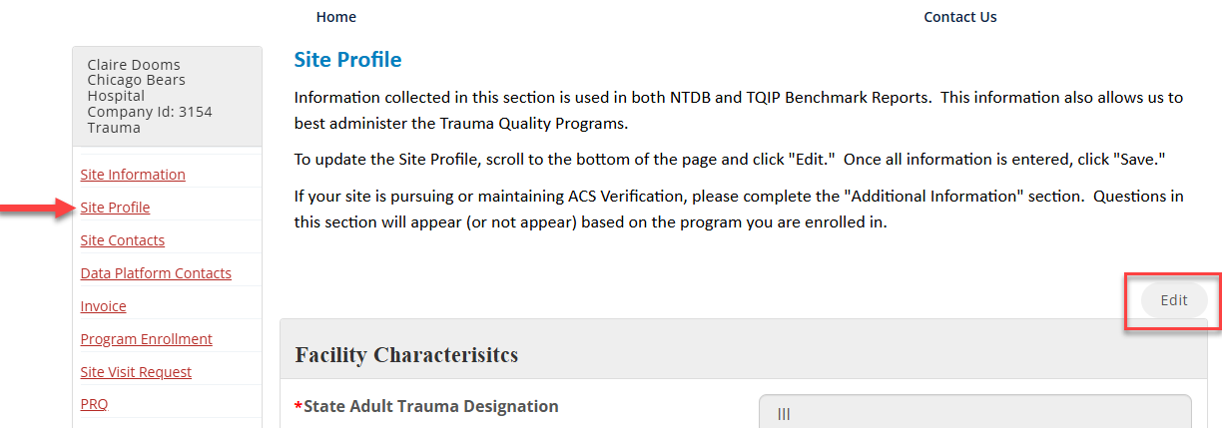
Enrollment Process Step – Site Profile
Execute Participation Agreement
Submit Application
Sign BA/DUA
(if not already on file)
Pay Participation Fee
Complete Site Profile on QPort
After reviewing your application, TQIP staff will contact you via email with next steps. After completing the site profile, steps can be completed in any order but are outlined one by one here.
All centers are encouraged to review and update their Site Profile, even if it was previously completed

Slide 14
Enrollment Process Step – Sign BA/DUA
Execute Participation Agreement
Submit Application
Sign BA/DUA
(if not already on file)
Pay Participation Fee
Complete Site Profile on QPort
If you have recently participated in the Annual Call for Data or another ACS Quality Program, staff will confirm that you have a current BA/DUA on file
If a BA/DUA is needed, ACS will initiate that process through our Contract Management System Ironclad
  The email will come from our contract team via our contract management software and will appear like this: American College of Surgeons via Ironclad <(workflow-ID)@mg.ironcladapp.com>

Slide 15
Enrollment Process Step – Execute HPA
Execute Participation Agreement
Submit Application
Sign BA/DUA
(if not already on file)
Pay Participation Fee
Complete Site Profile on QPort
All centers must sign the TQIP Hospital Participation Agreement (HPA)
The TQIP HPA outlines participation requirements and program deliverables
ACS will initiate this process through our Contract Management System Ironclad
  The email will come from our contract team via our contract management software and will appear like this: American College of Surgeons via Ironclad <workflow-ID@mg.ironcladapp.com>

Slide 16
Enrollment Process Step – Pay Annual Fee
Execute Participation Agreement
Submit Application
Sign BA/DUA
(if not already on file)
Pay Participation Fee
Complete Site Profile on QPort
TQIP staff will provide an invoice for 12 months of participation
Check payments must be submitted to the address noted on the invoice. Please include a copy of the invoice.
Credit card payments can be made over the phone (312-202-5797). Please have the invoice number available to reference.

Slide 17
Completing Enrollment
Execute Participation Agreement
Submit Application
Sign BA/DUA
(if not already on file)
Pay Participation Fee
Complete Site Profile on QPort
After all enrollment steps are complete, TQIP staff will email you with:
  Your TQIP Report ID
  Instructions for accessing TQIP Education
  Instructions for accessing the TQP Data Center (to submit data and access TQIP reports and drill down tools
In QPort, you will have access to additional sections to help manage your ongoing participation:
  Invoice
  Resources

Slide 18
Eligible trauma centers interested in joining TQIP may start the application process at any time
TQIP follows a quarterly enrollment schedule to standardize participation across all centers with a unified billing cycle beginning each July 1
Enrollment deadlines and TQIP start dates will occur on July 1, October 1, January 1, and April 1 each year
Depending on your start date, any excess payment from your initial 12-month invoice will be applied towards your second invoice
A Note About Quarterly Enrollment

Slide 19
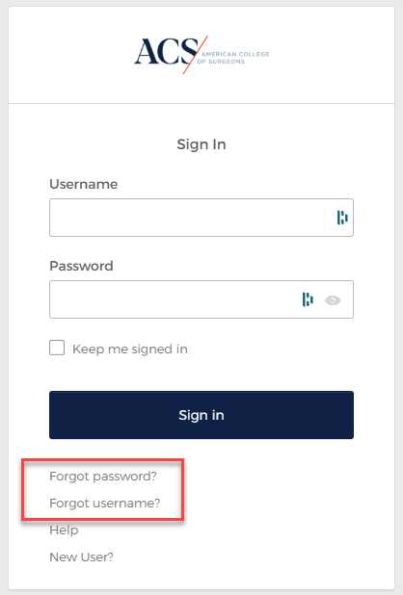
General QPort Tips
To retrieve or reset your QPort username and password please click these links on the QPort login page
Note: For security purposes, your QPort and Data Center login credentials will be different
Only the individual designated as the Primary Contact can edit contact information in QPort
The "Guide to Trauma Quality Programs QPort Roles" outlines the various permissions of each role within QPort and the Data Center

Slide 20
Important 2026 TQIP Dates
March 2: Quarterly submission deadline
April 1: Quarterly enrollment deadline
June 1: Quarterly submission deadline, Enrollment deadline for inclusion in Fall 2026 Benchmark Report
July 1: Quarterly enrollment deadline
September 1: Quarterly submission deadline
October 1: Quarterly enrollment deadline
November 13-15: TQIP Annual Conference (Anaheim, CA)
December 1: Quarterly submission deadline, Enrollment deadline for inclusion in Spring 2027 Benchmark Report

Slide 21
We’re Here to Help!
Email: TraumaQuality@facs.org
Phone: 312-202-5680

Slide 22
Thank you!

