Slide 2
Read this slide first!
Purpose
Functionality of Slide Deck
This PowerPoint is intended for use as a guide to help medical students learn the people and equipment commonly found in operating rooms.
Please feel free to use these slides as the basis of a meeting with your school’s Surgery Interest Group.
If you haven’t already, please put your PowerPoint into Slide Show mode.
Blue buttons that look like this are hyperlinks that will take you to a more detailed description of the equipment in question. You will then have the option of going back to your original slide by hitting the “Back” button.
1

Slide 3
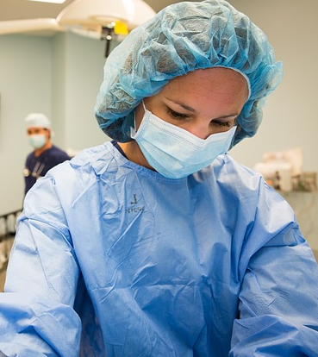
Preparing for Operating Room
Know the case
  Review pathophysiology and basics of procedure
  Review possible complications of procedure
Put on shoe covers, surgical cap, and mask at entrance to perioperative area
Be cordial to the OR front desk staff so that you are alerted when the patient is sent for, or if there are schedule changes your team needs to know about!
Review the Student Resource Task Force module titled Shadowing in the OR for helpful tips about good OR behavior!

Slide 4
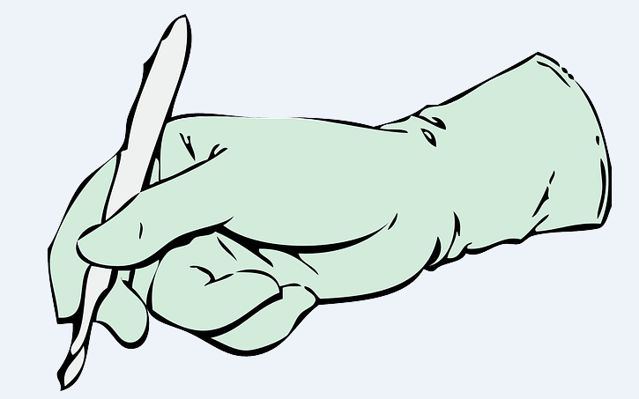
In the Operating Room
Introduce yourself to the circulating nurse and scrub tech as soon as you help bring the patient back in
Know and remember your glove size
  After introducing yourself to the scrub tech, inform them of your glove size before scrubbing in
Write your name on a white board
  A nurse will need to add your name as a member in the room
Help tie gowns

Slide 5
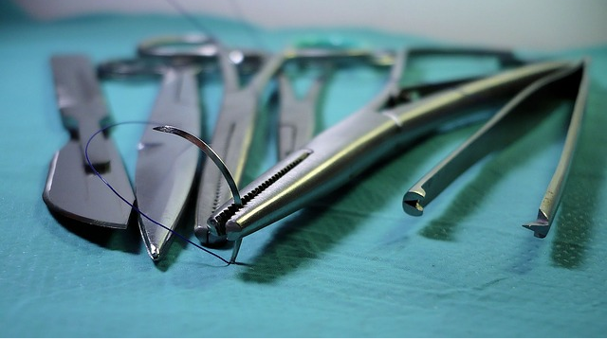
In the Operating Room
Do not pick up any item from a table with blue drapes unless asked directly
Try to time scrubbing as soon as you are unable to contribute to the room, and before the attending/resident scrubs
Ask and confirm with the attending/resident where to stand
As the case is wrapping up, double check with either RN/Anesthesia to bring the bed back in
You can bring new blankets from the warmer and bring the positioner at the end

Slide 6
Equipment
Navigate through the following slides sequentially. Or you may click on the blue circles to be taken to more detailed information. Click the “back” button to be taken to your original slide.
1
Sterile Back Table
Anesthesia Machine
Anesthesia Cart
Mayo Stand
Operating Table
  Positioners
  Gel Pads
  Towels
  Drapes
  Patient Warmer
6
Surgical Lights
Medical Receptacle (“Kick Bucket”)
Electrocauterizing Equipment
Scrub Sink and Sterile Gown/Gloves
Suctioning Equipment
Lines and Outlets
Imaging
2
7
3
8
4
9
5

Slide 7
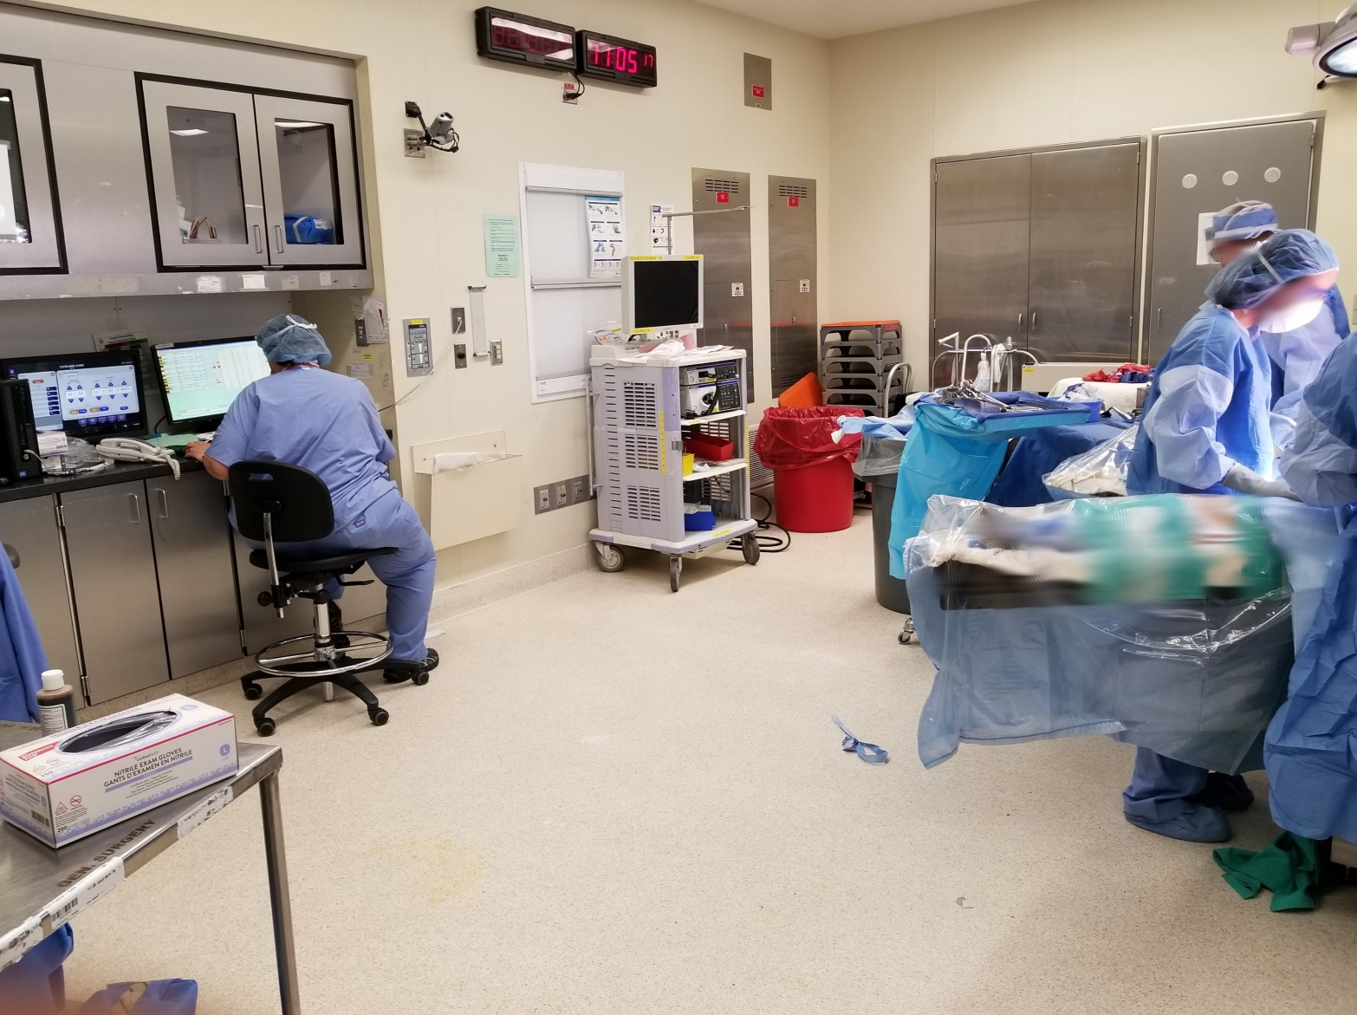
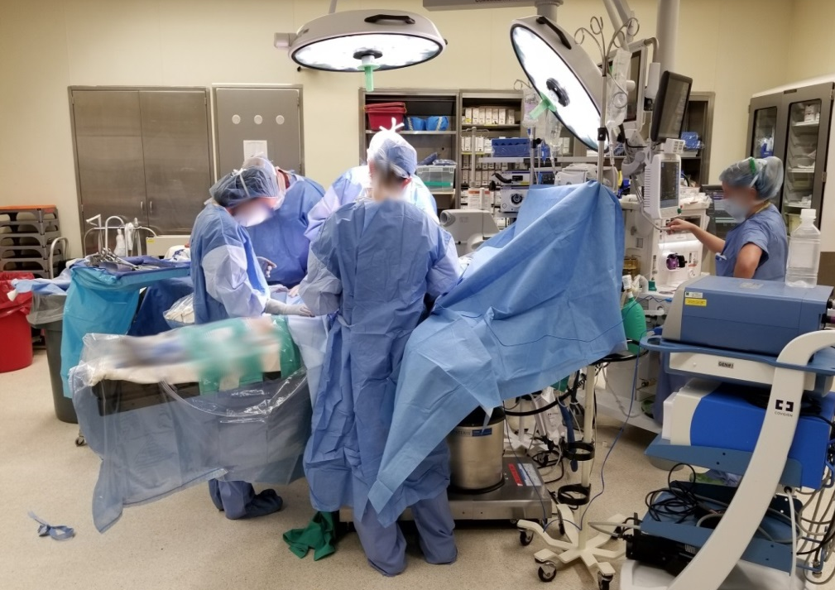
Personnel
D
D
A
Surgeon +/- Resident/Medical Student (All Sterile Team)
Anesthesiologist (Unsterile Team)
Circulating Nurse/Circulator (Unsterile Team)
Opens non-sterile instruments, retrieves supplies
Ties surgical gowns for others
Ensures OR is prepared before surgery
“Time-out" procedure
Paperwork and coordination
Scrub Technician or Nurse (Sterile Team)
In charge of instruments/Mayo stand
Maintains sterile field – if they say you are not sterile, DO NOT question! Scrub out!
Keeps accurate count of all instruments/gauze used
Organizes tissues for biopsy
B
A
C
C
D
A
D
A
B
A

Slide 8
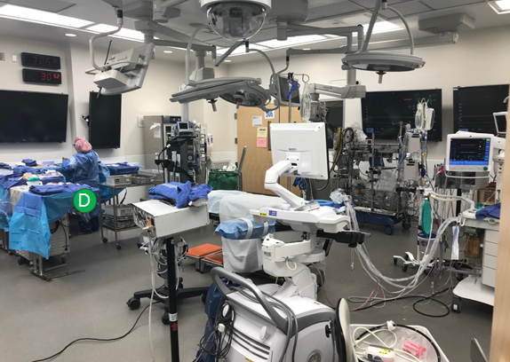
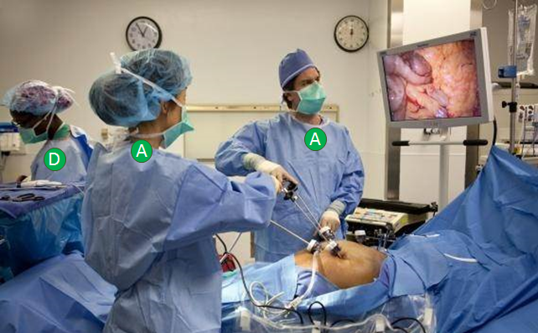
Operating Room Set-Ups
Thoracic Suite with Intraoperative Imaging
Laparoscopic Surgery
A
A
D
D
D
Scrub Technician or Nurse
A
Surgeon +/- Resident/Medical Student (All Sterile Team)

Slide 9
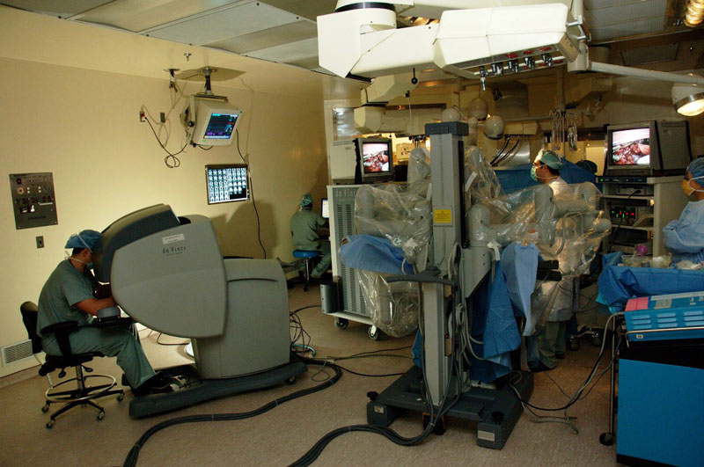
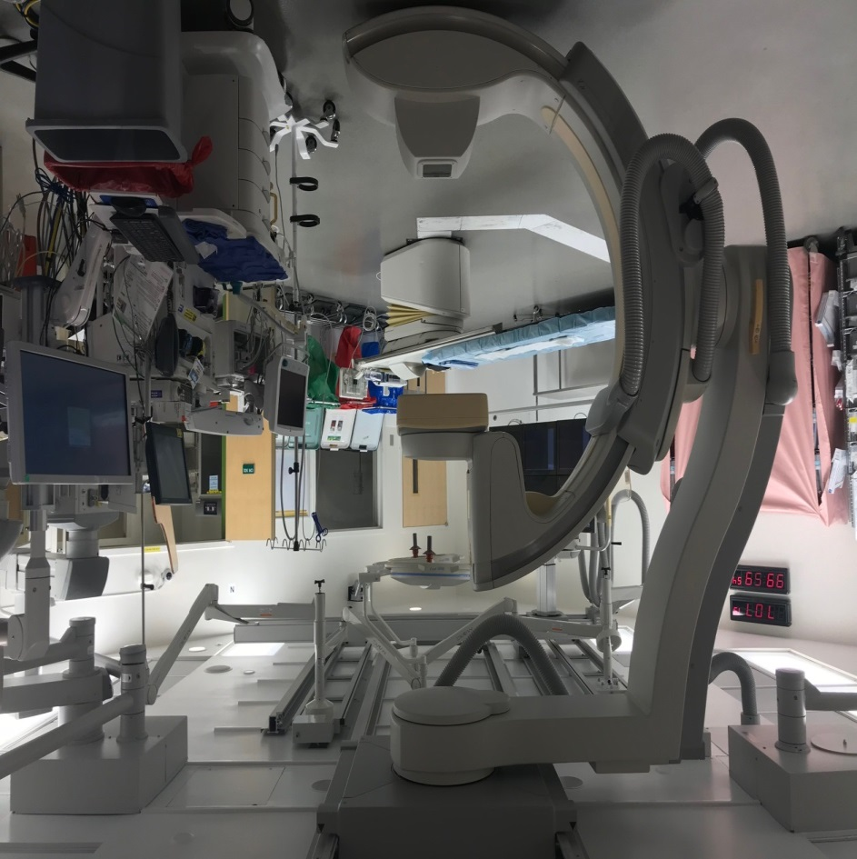
Operating Room Set-Ups
Robotic Surgery
Vascular Combined Suite
C
A
A
A
Circulating Nurse/Circulator (Unsterile Team)
C
Surgeon +/- Resident/Medical Student
(All Sterile Team)

Slide 10
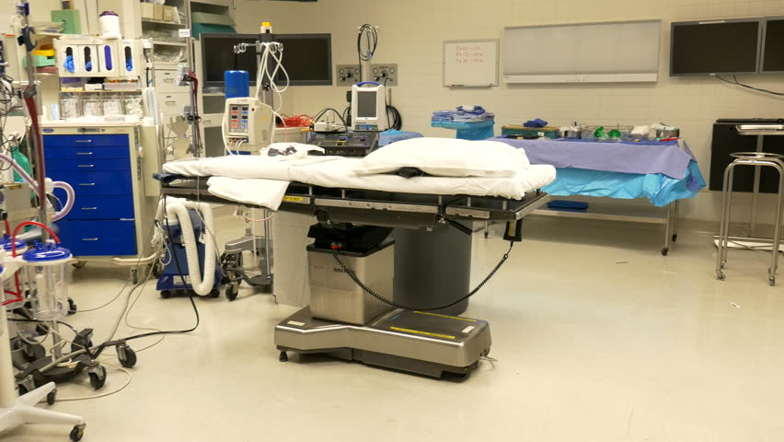
Name That Equipment!
(click on the space bar to see the answer)
3
2
1
Sterile Back Table
4
1
5
2
Anesthesia Machine
3
Anesthesia Cart
4
Mayo Stand
Operating Table
5

Slide 11
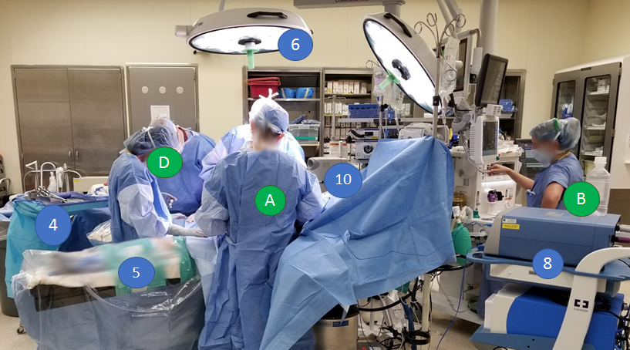
Name That Person/Equipment!
(click on the space bar to see the answer)
6
Name That Equipment!
D
A
B
4
Mayo Stand
4
8
5
Operating Table and Positioners
5
6
Surgical Lights
8
Electrocauterizing Equipment
Name That Person!
Suction Equipment
A
Surgeon/Resident
B
Anesthesiologist (Unsterile Team)
D
Scrub technician

Slide 12
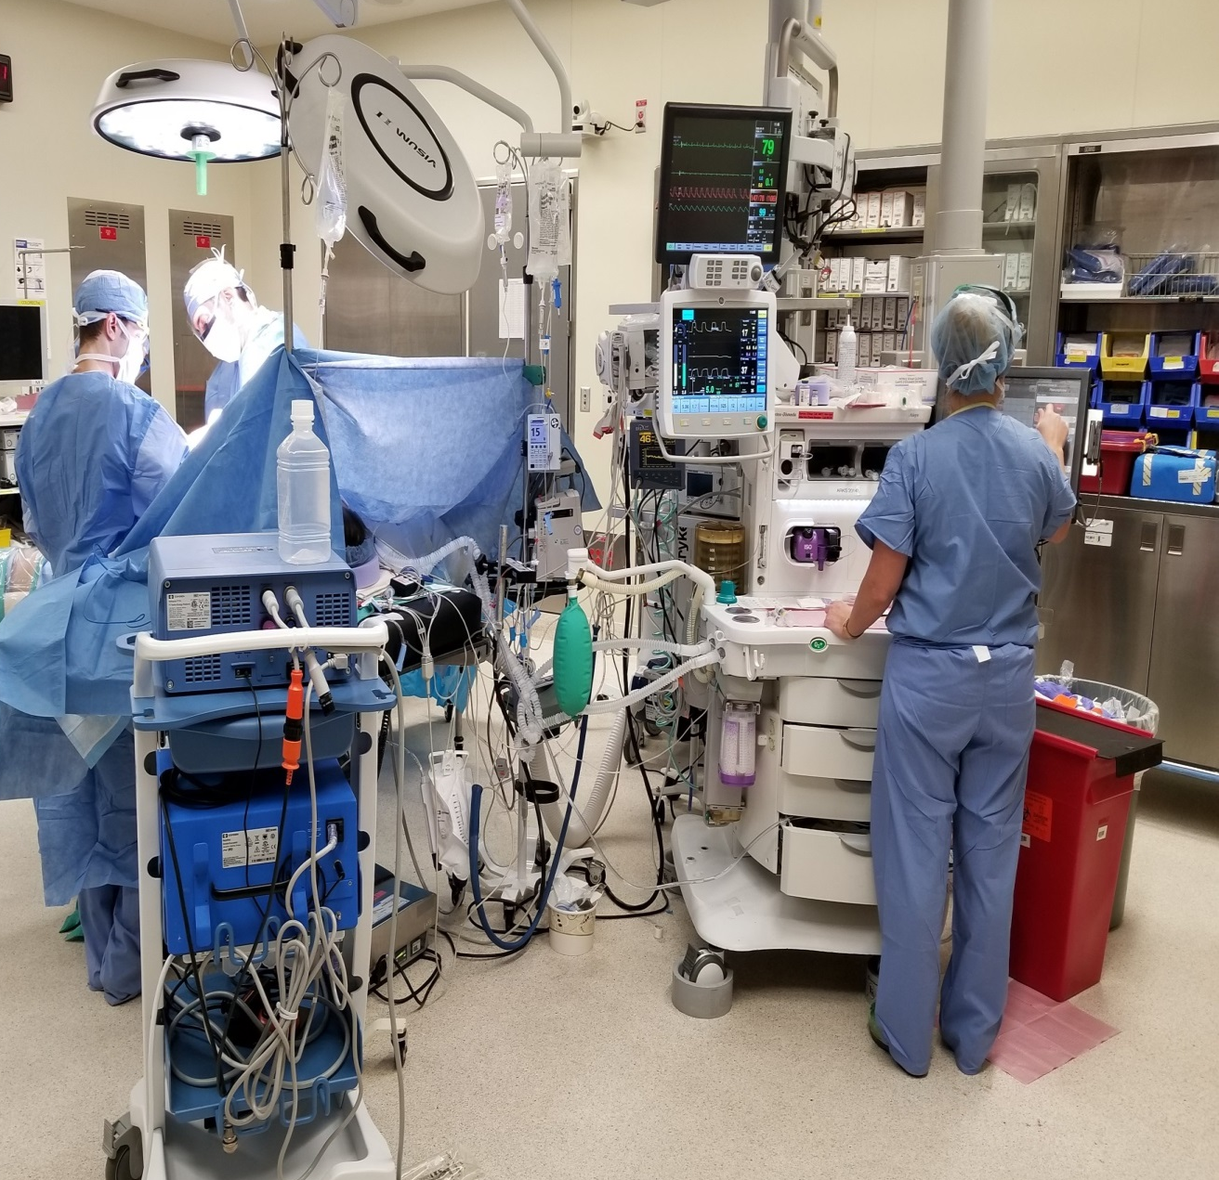
Name That
Person/Equipment!
(Click on the space bar to see the answer)
6
A
A
Surgeon/Resident
A
B
Anesthesiologist
(Unsterile Team)
B
2
2
Anesthesia Machine
8
6
Surgical Lights
8
Electrocauterizing Equipment

Slide 13

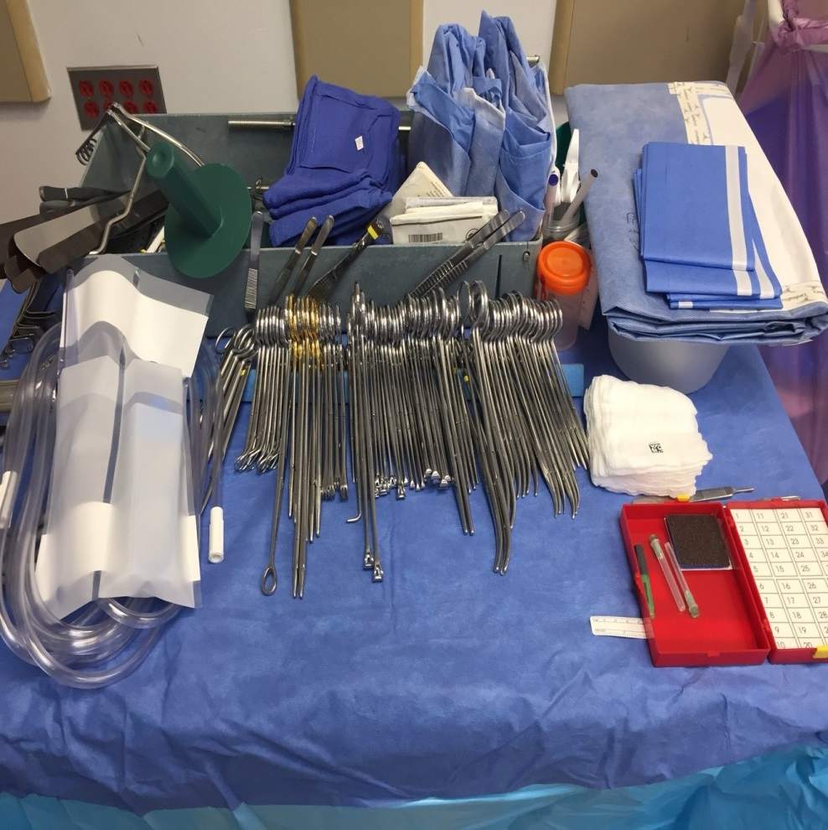
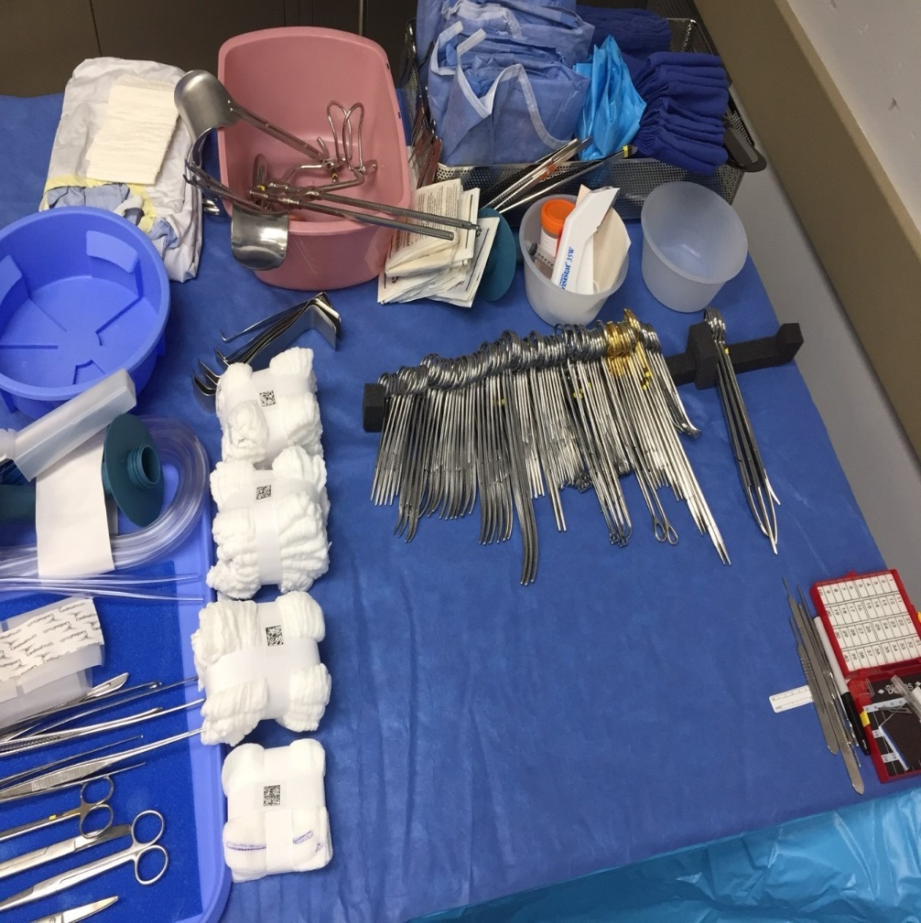
1
Sterile Back Table
Role: Scrub technician or scrub nurse
This is used prior to a procedure to arrange, count, and prepare instruments.

Slide 14
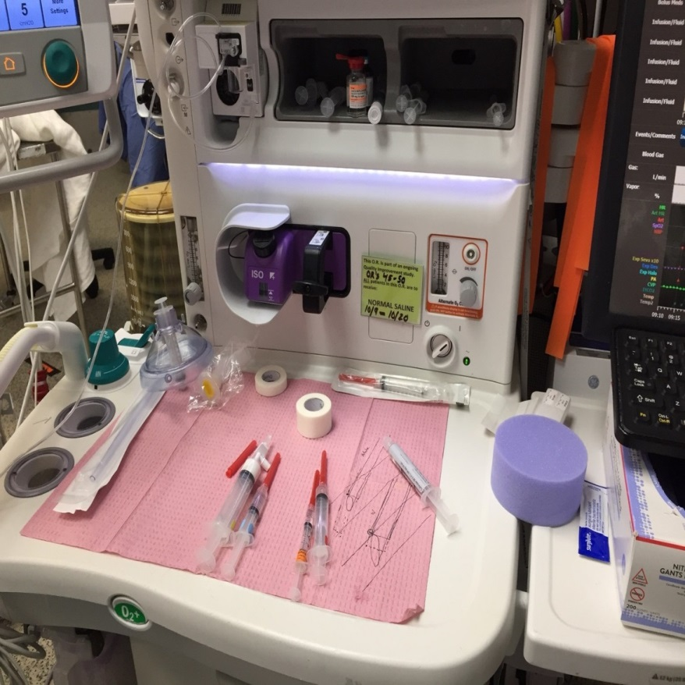
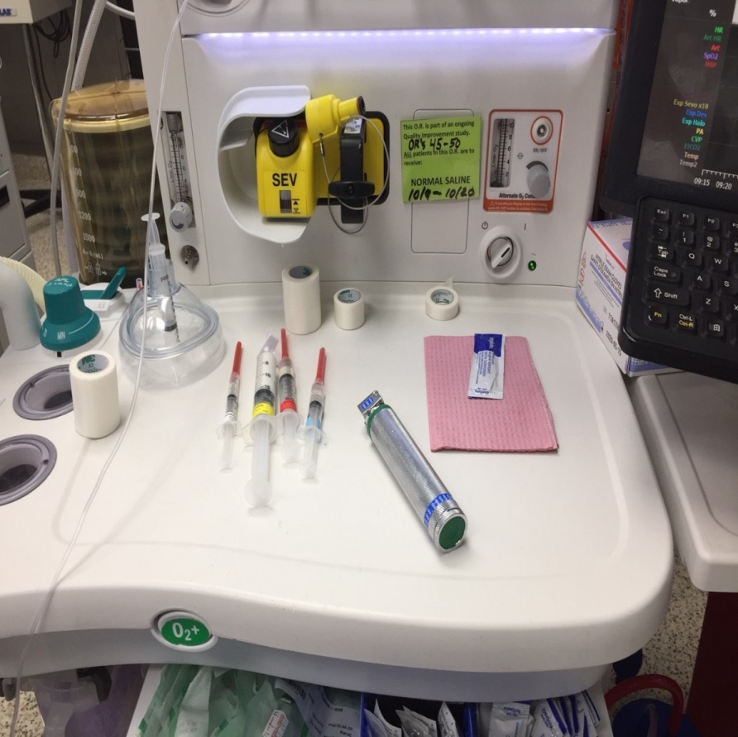
2
3
Anesthesia Machine and Cart
Role: Anesthesiologist/Nurse anesthetist
An anesthesia machine delivers a mixture of oxygen and anesthetic gas to a breathing system. An anesthesia cart holds equipment and medications for anesthesia, sedation, and reversal. It also contains equipment for respiratory support and resuscitation.

Slide 15

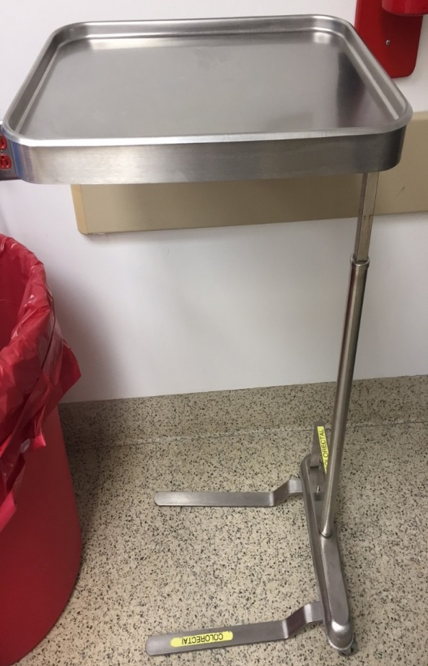
Mayo Stand
4
Role: Scrub technician or scrub nurse
The Mayo stand is used to arrange appropriate instruments prior to the procedure. During the procedure, the scrub technician/nurse will use the Mayo stand to remove or add instruments requested by the surgeon.

Slide 16
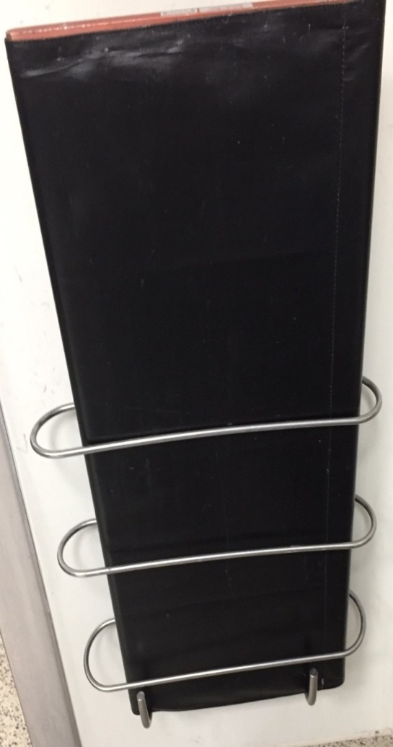
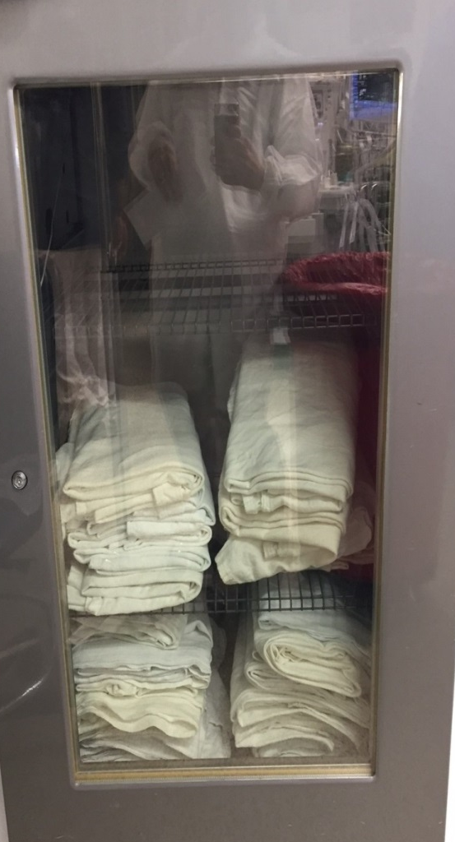
5
Operating Table and Patient Equipment
The patient is positioned on the operating table during the procedure. This can be adjusted using levers on the table, gel pads, and other positioners.
Positioner (a.k.a. “roller board”):
After placing a sheet around it, use this to place under the patient for transfer to OR bed or off. Pull the sheet to roll the patient. A team effort!
It’s usually against a wall in the OR.
Patient Positioner / Roller Board
Blanket Warmer

Slide 17
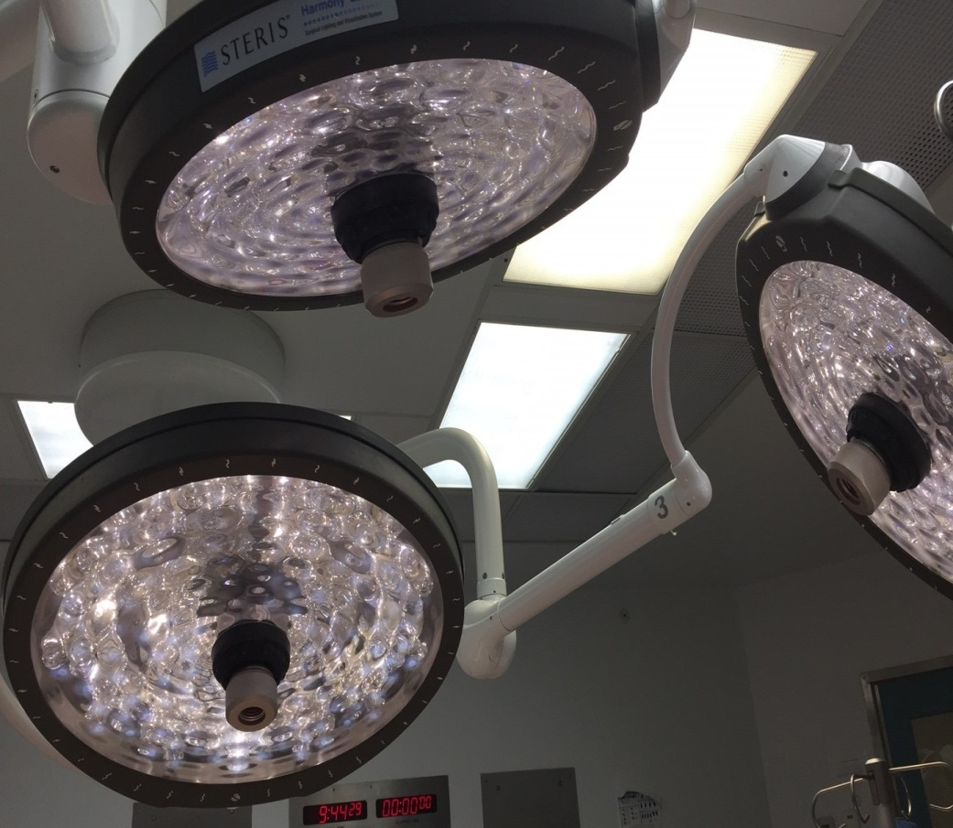
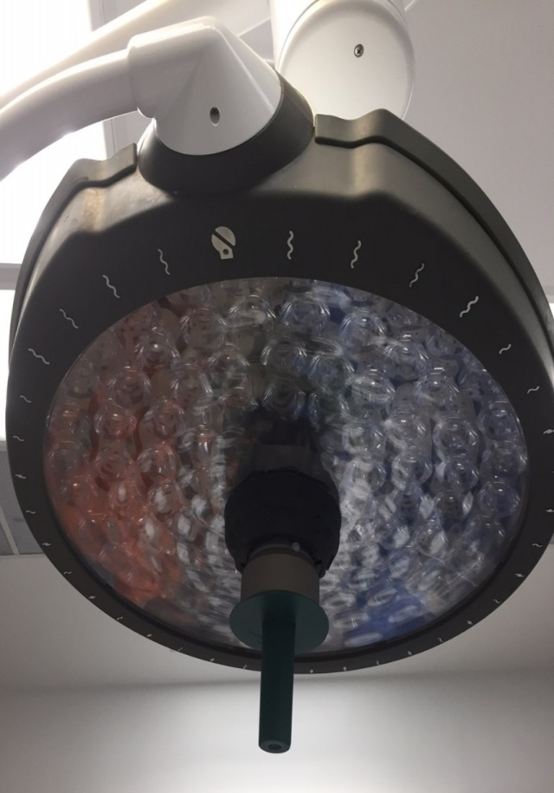
6
Surgical Lights
Role: Surgeon
The handles at the center of light are given sterile covers to use to position the light as needed. Because it is sterile, the cover must be replaced if anything unsterile (including your head) touches it. Surgeons can adjust the overhead surgical lights to provide desired lighting for the surgical field. Covers are disposed of following a procedure.

Slide 18
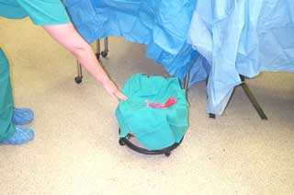
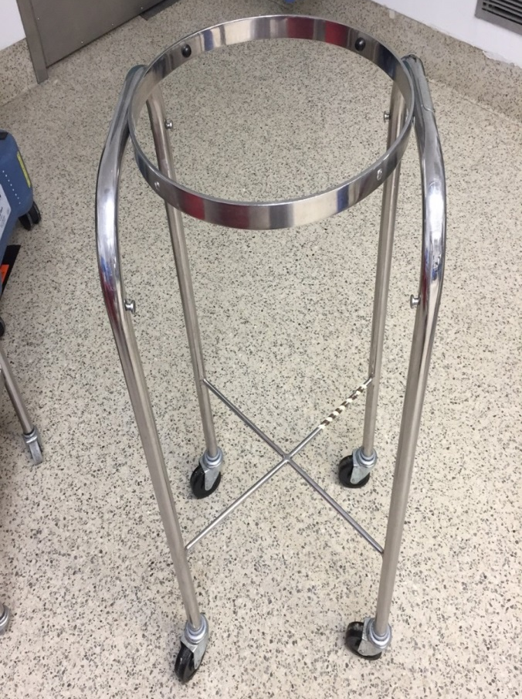
7
Medical Receptacle
Role: Scrub technician or nurse (perioperative), circulating nurse (postoperative)
The receptacle is used by operating room personnel to collect disposable items such as sponges during the procedure. An OR nurse or technician can use the bucket items in the final count to ensure all items are accounted for. Below, a ring stand used for keeping bowls or basins is also pictured.

Slide 19
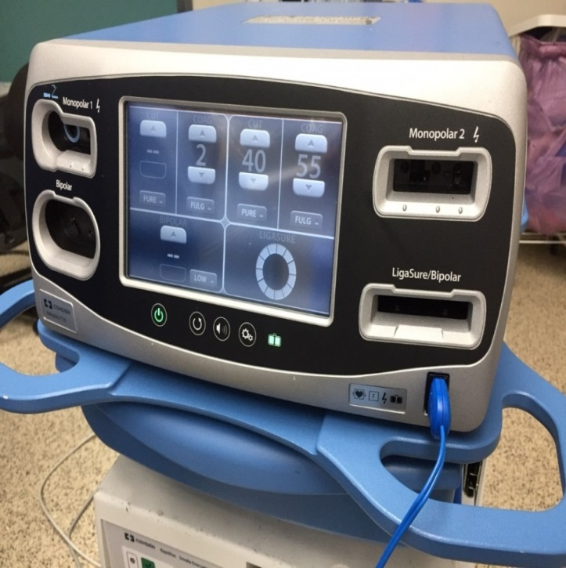
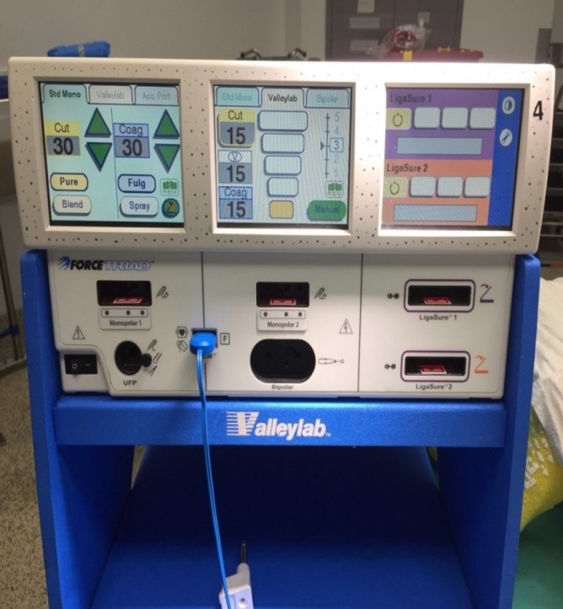

8
Electrocauterizing Equipment
Role: Surgeons use the cauterizer, but a scrub nurse or circulating nurse
may change settings as requested
Electrocauterizing equipment is used to cut, coagulate, and desiccate tissue with limited blood loss.

Slide 20
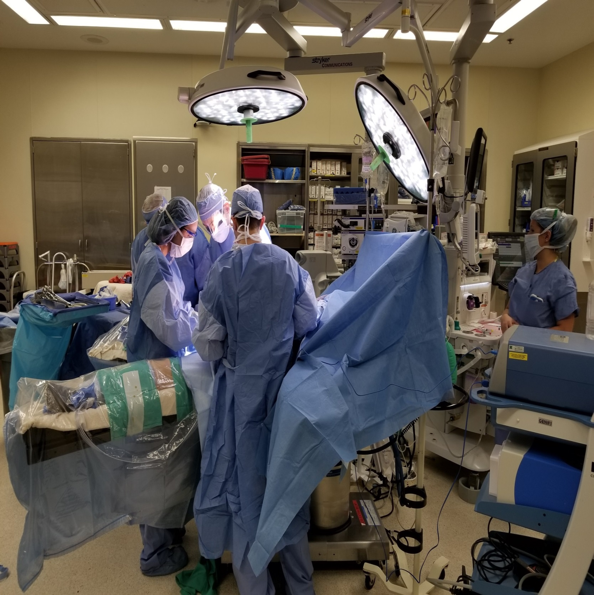
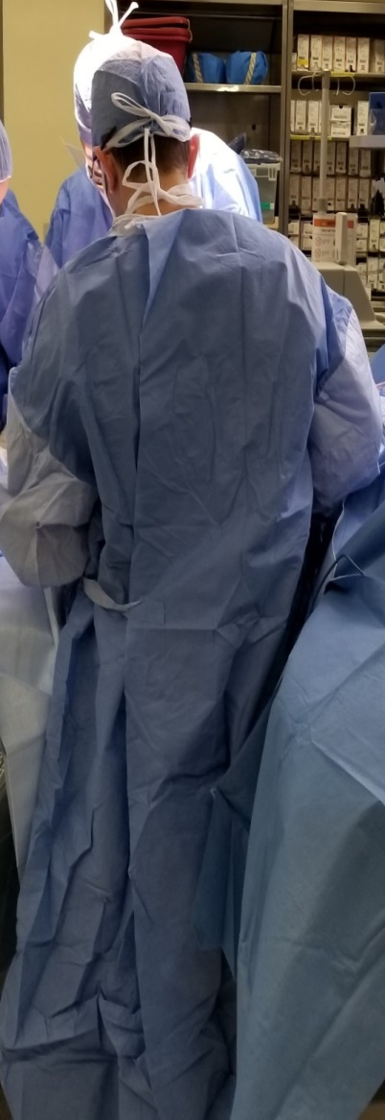
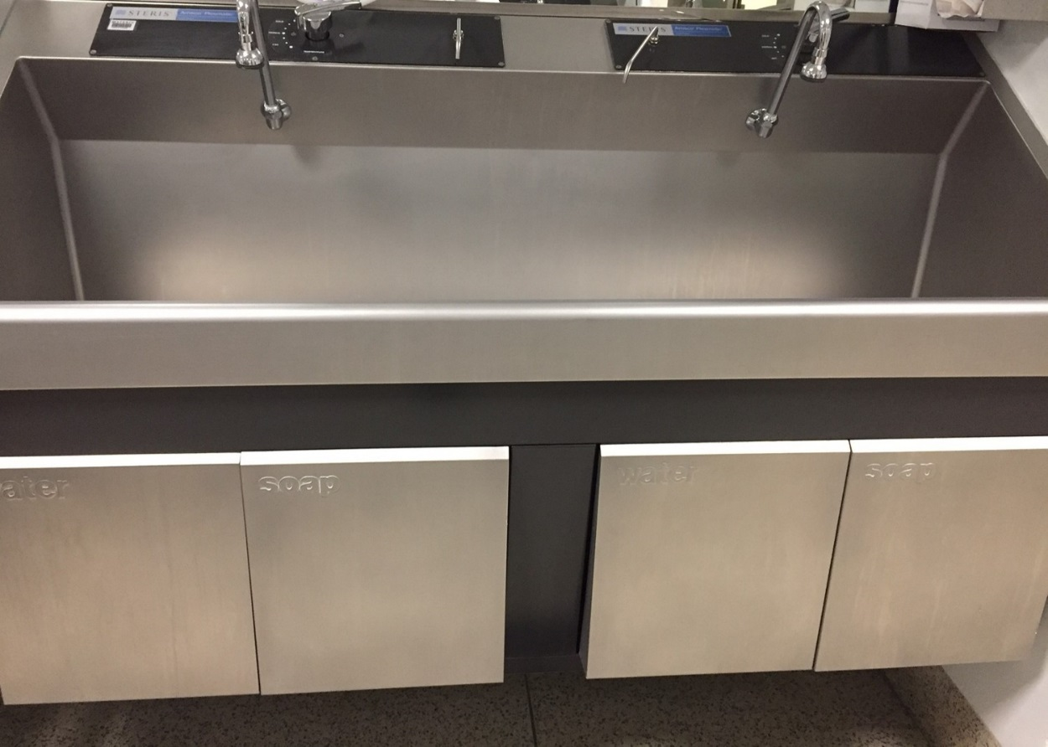
9
Scrub Sink and Sterile Gown/Gloves

Slide 21
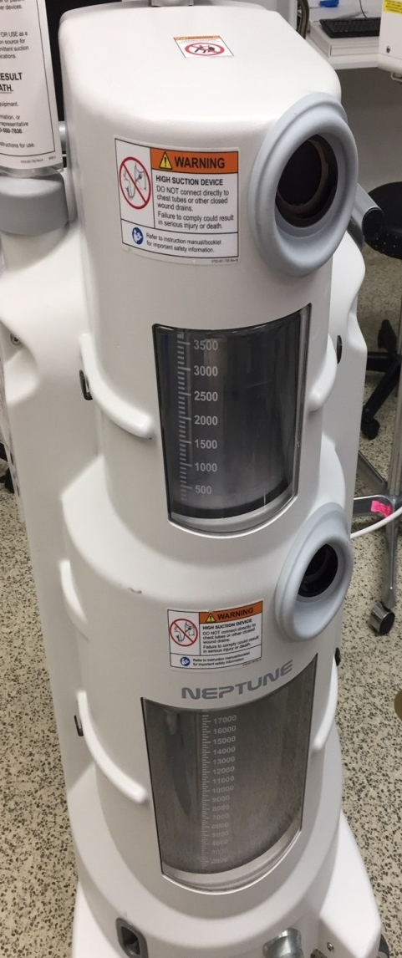
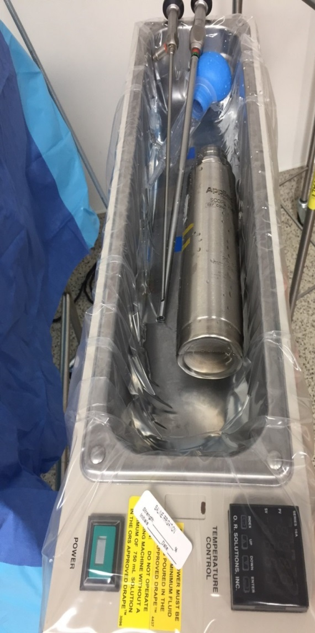
Suction Equipment
The purpose of the suction set-up is to remove fluids (both irrigating and body), tissue and gases from the surgical field. The equipment is set up in a manner in which containers stay in sight but out of the way. Fluid will automatically flow into subsequent containers as they fill. All fluid is measured and recorded at the end of the procedure.
The force of suction can be controlled from mild to heavy with the regulator. Tubing goes from the regulator to the canister and then to the surgical field.

Slide 22
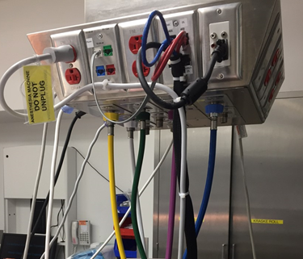
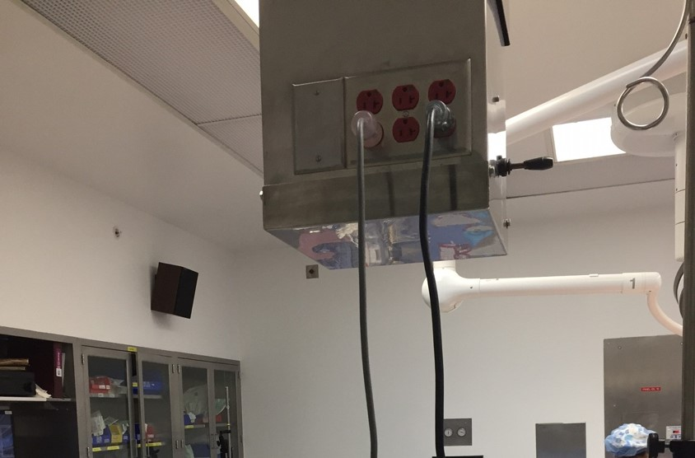
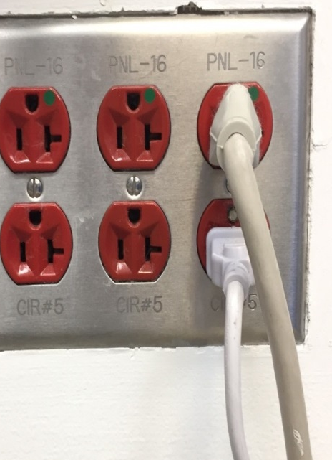
Lines and Outlets
Red Outlets:
Power failure outlets, powered by generators. Critical equipment connected such as anesthesia machine.
High power needs supplied by outlets everywhere including those on the floor.
Premium gases:
Air is YELLOW
Oxygen is GREEN

Slide 23
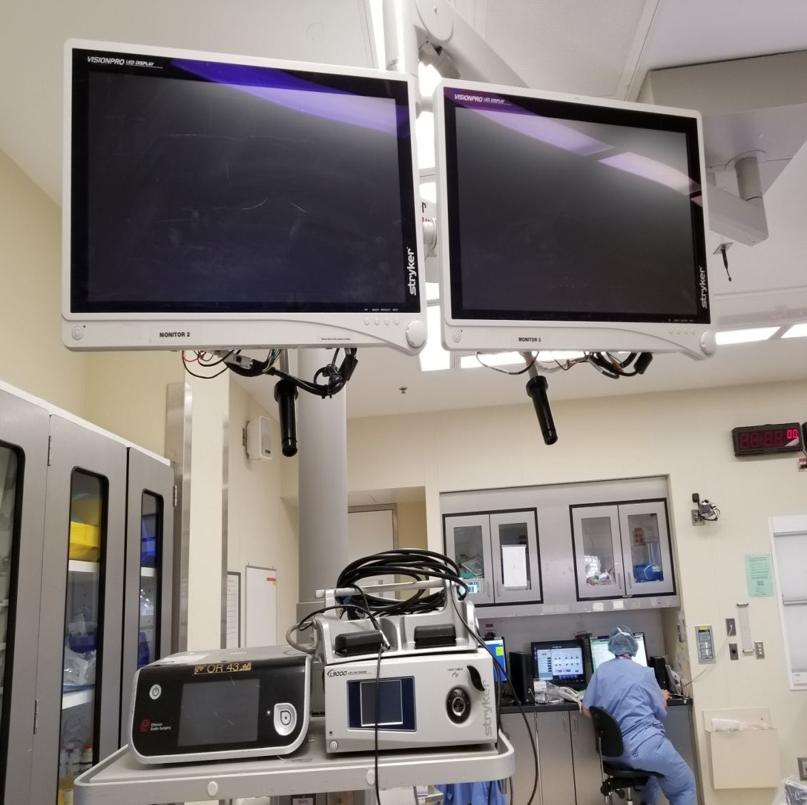
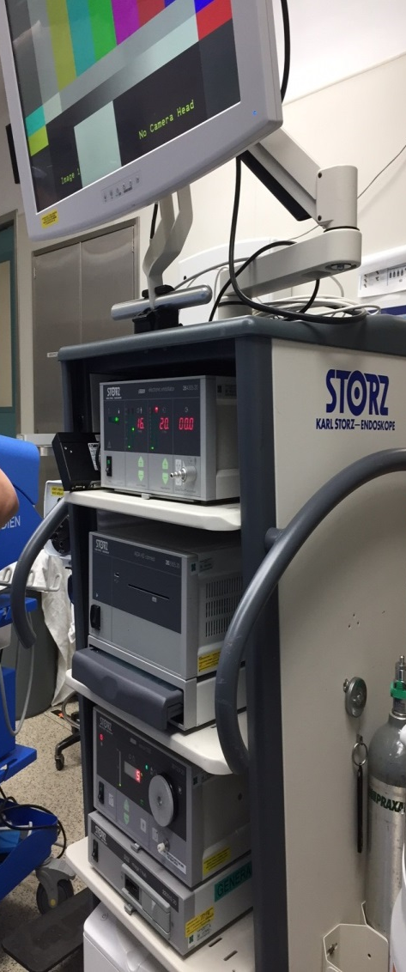
Imaging

