Slide 1


REGIONAL
Committees on Trauma
RCOT Field Program Webinar Series
Copyright ©2025 American College of Surgeons. 633 N Saint Clair St, Chicago, IL 60611-3295

Slide 2

REGIONAL
Committees on Trauma
Introduction to Pediatric Readiness &
the RCOT Field Program
Aaron R. Jensen, MD, MEd, MS, FACS, FAAP
Vice-Chair, Quality Pillar, ACS COT
Co-Lead, Trauma Domain, EMSC Innovation and Improvement Center
July 23, 2025
Copyright ©2025 American College of Surgeons. 633 N Saint Clair St, Chicago, IL 60611-3295

Slide 3



You can adjust the horizontal length of the light blue and dark blue triangles to fit whatever you need.
Disclosures
I have no personal of financial disclosures
Funding Sources:
  Health Resources and Services Administration – Emergency Medical Services for Children
  Health Resources and Services Administration – Pediatric Pandemic Network
©ACS

Slide 4
Objectives for Today
Introduce the RCOT Field Program structure and establish the foundation for understanding Pediatric Readiness as a national priority in trauma care
Describe current access to Pediatric Ready trauma centers for US Children
Describe the current state of Pediatric Readiness at US Trauma Centers
Discuss the mortality benefit of optimizing Pediatric Readiness at US Trauma Centers
Call to action for Pediatric Readiness Champions
©ACS

Slide 5
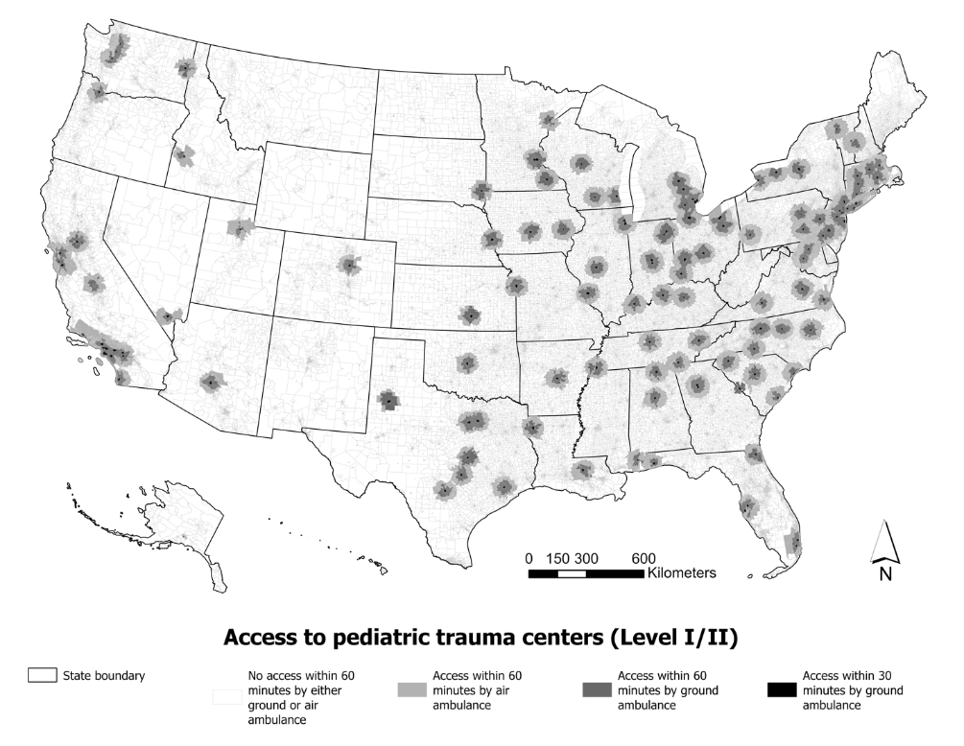
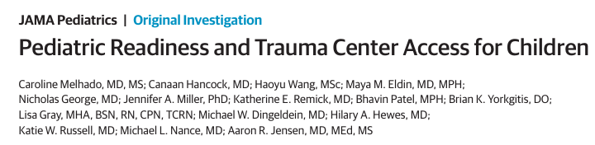
Kids Don’t have Access to Pediatric Centers
Pediatric Trauma Center 60-minute access
Ground 51% / Air 65%
©ACS

Slide 6
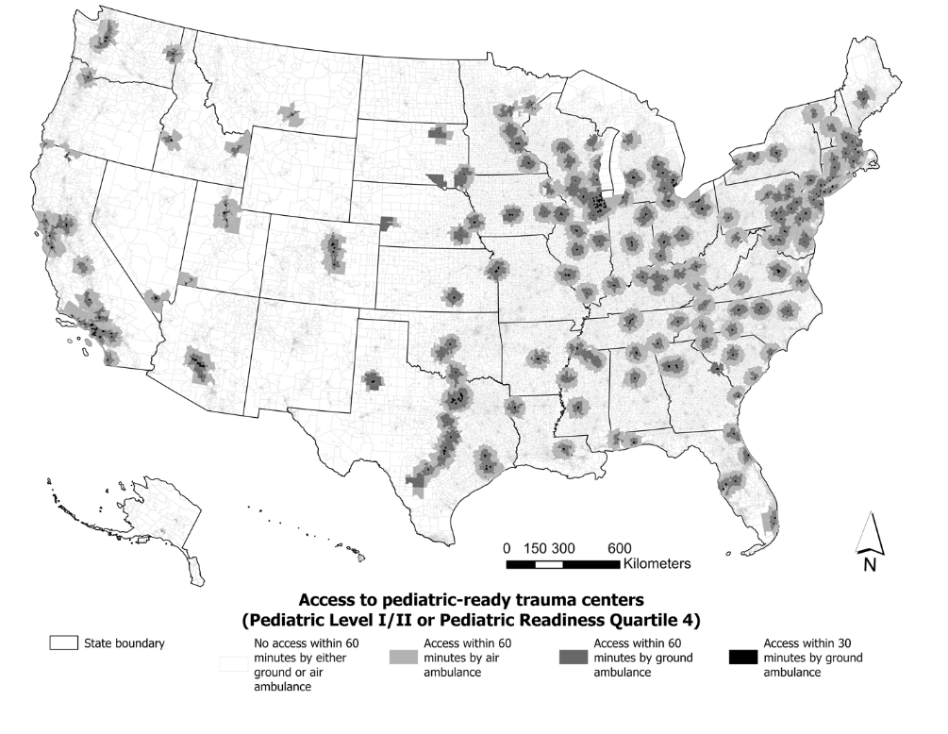
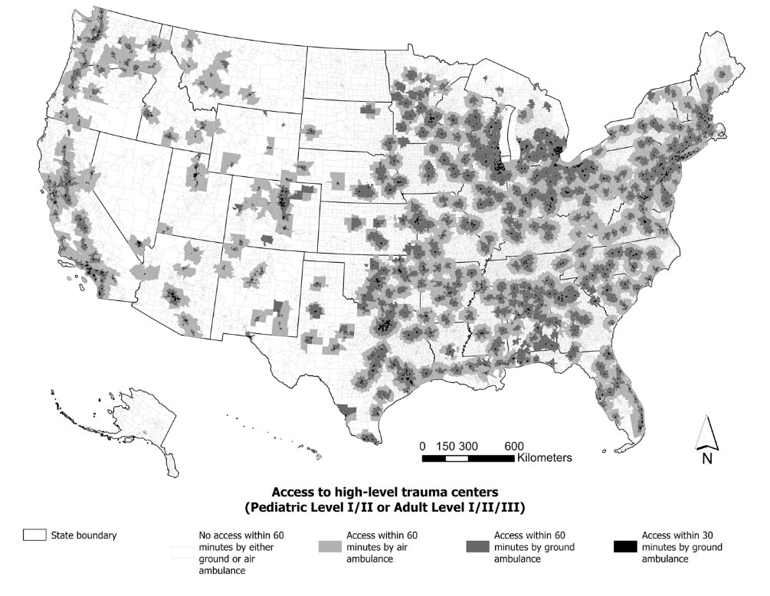
60-Minute Access to Trauma Centers
Pediatric Trauma Center
Ground 51% / Air 65%
‘Peds Ready’ Trauma Center
61% Ground / 73% Air
Any L1-L3 Trauma Center
81 % Ground / 92% Air
What if our Trauma System was optimized for kids?
©ACS

Slide 7


Case Illustration of a Pediatric Ready Trauma Center
Contributers:
Regional Children’s Hospital / Level 1 PTC
  Inclusive collaboration promoting early transfer activation
  Collaborative pediatric PI / case review
  Shared trauma resuscitation protocols (TBI, Shock, Imaging, Triage)
Suburban Level 2 Trauma Center (Adult Only)
  Facility Recognition for Pediatric Readiness (EDAP)
©ACS

Slide 8

Illustrative Case
7yo boy flew off carnival ride across the street from L2
Obvious head trauma
  Open skull fracture
  Bleeding scalp lac
  BP 105/79 HR 121 GCS 3
EMS transport to L2 trauma center
  BP now 67/45
    10mcg epi and 20cc/kg NS bolus
©ACS

Slide 9
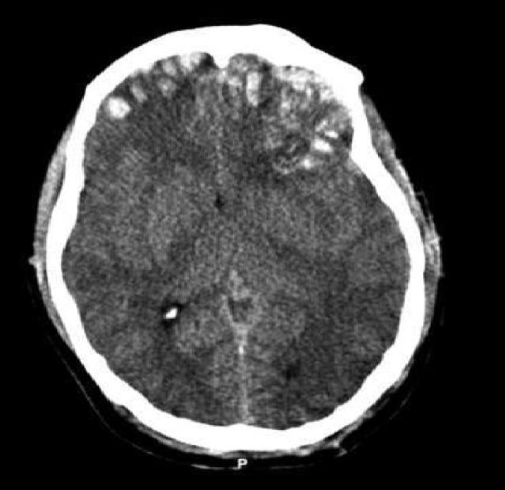
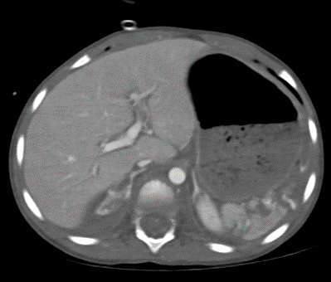
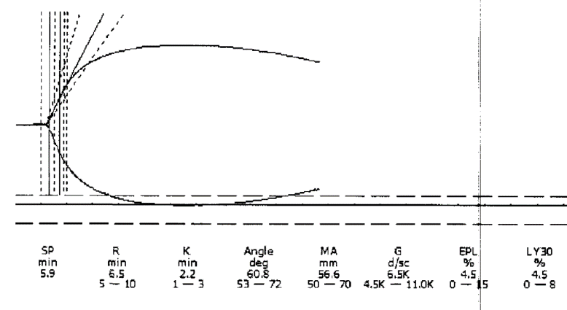
Illustrative Case
Trauma Team Activation
Notification of PTC, Aircraft mobilized
BP 121/81 HR 146 GCS 3
  Intubated, bleeding scalp lac sutured
  Transfused (peds) 10cc/kg RBC + Plasma
Trauma bay ancillary studies
  CXR – rib fractures, no hemothorax
  7.0 / 68 / 41 / 16 -15 Lactate 7
Responded – Shared Decision to Image
9.1
290
INR 2.2
29
©ACS

Slide 10
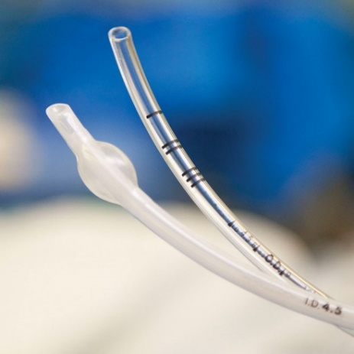
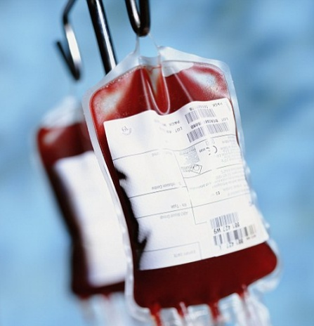

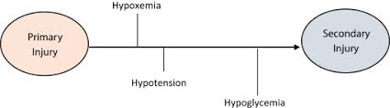
Regional Pediatric Trauma Quality
Aircraft arrived in 30min
Wheels out of ED under 60 minutes
Coagulopathy corrected, no further hypotension
Nonoperatively managed at PTC
Discharged to Rehab with remarkable outcome
©ACS

Slide 11
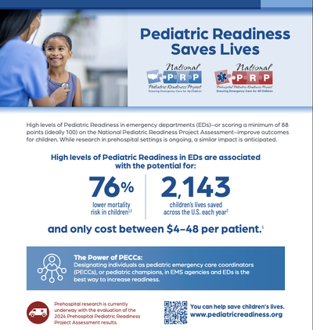
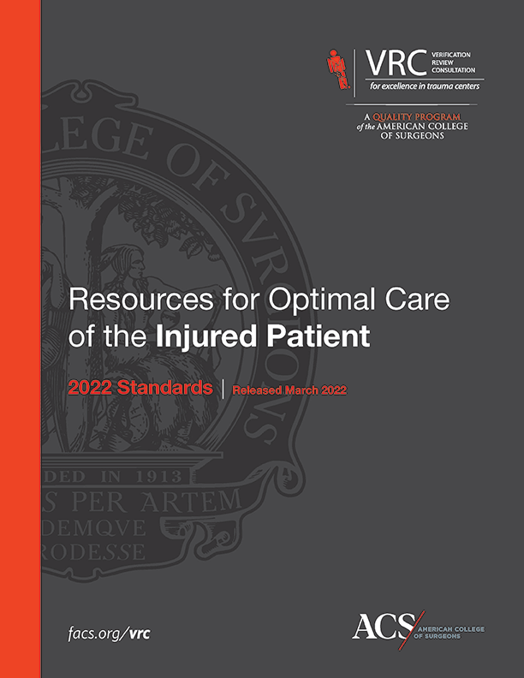

Assess PR
Address Gaps in PR
©ACS

Slide 12

What is Pediatric Readiness?
Covered in More Detail in Next 8 Webinars
Dates back to 1993 IOM Report on Emergency Medical Services for Children
Refers to the level of preparedness of an emergency department (ED) or EMS agency to provide optimal care for children with medical emergencies
Not just trauma – partner with your ED!
Can be assessed (NPRP Assessment)
Can be improved (NPRQI)
©ACS

Slide 13
ED Pediatric Readiness
Equipment and Supplies
Staffing
(Competencies)
Coordination of Care
Quality Improvement
Policies / Procedures
Patient Safety
©ACS

Slide 14

REGIONAL
Committees on Trauma
Webinar 2: History of Pediatric Readiness and NPRP Surveys
Pediatric Readiness can be Measured
Weighted Pediatric Readiness Score (wPRS) 0-100
©ACS

Slide 15
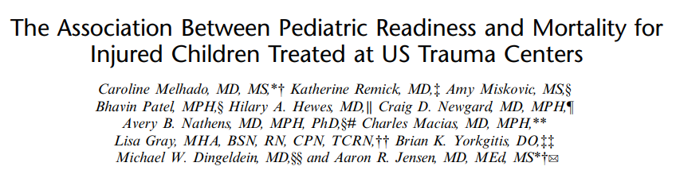
wPRS Matters! Pediatric Readiness and Mortality for Injured Kids
NPRP 2021 assessment / NTDB data (2019-2021).
66,588 children (0-15y) meeting TQIP inclusion criteria from 630 trauma centers
  Center-specific mortality (O:E odds ratios) by wPRS
Adjusted mortality in top quartile centers (wPRS>93) significantly (17-27%) better that Q1, Q2, or Q3
LOESS plots suggest improved mortality above wPRS ~88
Presence of pediatric-specific quality improvement plan is independent driver of mortality benefit
©ACS

Slide 16
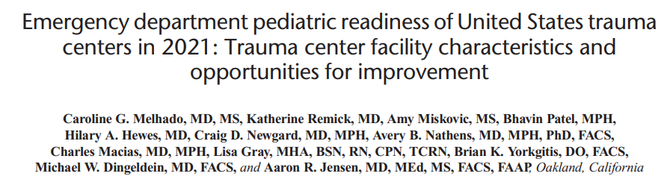
Current State of Trauma Center Pediatric Readiness
Median Trauma Center wPRS 79
  Mortality improves wPRS 88
  Significantly better above wPRS 93
Over 25% of adult only centers have wPRS >90
It can be done!
©ACS

Slide 17
So How do We Optimize
Pediatric Readiness at Trauma Centers?
Pediatric Trauma Center
Ground 51% / Air 65%
‘Peds Ready’ Trauma Center
61% Ground / 73% Air
Any L1-L3 Trauma Center
81 % Ground / 92% Air
©ACS

Slide 18
RCOT Field Program
8 Webinars - Two Overarching Goals by March 2026
Ensure that every trauma center in the United States completes the next National Pediatric Readiness Project (NPRP) assessment during the 2026 cycle (March 2026).
Advance Pediatric Readiness involvement and improve readiness scores among U.S. trauma centers through the structured RCOT Field Program, which convenes regional leaders regularly through March 2026.
©ACS

Slide 19
RCOT Field Program
Objectives
Identify a Pediatric Readiness Champion in each State / Province
Establish multidisciplinary State and Provincial Pediatric Readiness teams
  Include Trauma, EMSC managers, stakeholders (ACEP, AAP)
Create a Trauma Center Inventory
Track NPRP National Assessment participation for all TC’s in your State/Province
Implement Pediatric Trauma Protocols (TBI, MTP, Imaging) in each State/Province
©ACS

Slide 20
RCOT Field Program
Pediatric Readiness Webinar List
Intro to Pediatric Readiness
Pediatric Readiness Checklist
QI Plans and Use of NPRP Resources
Protocols, Telehealth, and Transfer Guidelines
Engagement Strategies
History of Pediatric Readiness and NPRP Assessments
Equipment
ED Walkthroughs
Tools
Simulation
Recognition Programs
Education
Long-Term Sustainability
Legislative Policy
Simulation Mandates
Metrics & Standards
2026 NPRP Review
Lessons Learned
©ACS

Slide 21
Call to Action – Today!
State Champions for Pediatric Readiness:
Commit to the PR Champion role
Collaborate with your own ED Manager that coordinates PR
Review your own center’s PR score and gap report (get from your ED Manager)
Familiarize yourself with your State/Province’s PR Landscape (Facility Recognition Programs?)
©ACS

Slide 22

Thank You.
©ACS

