Slide 1
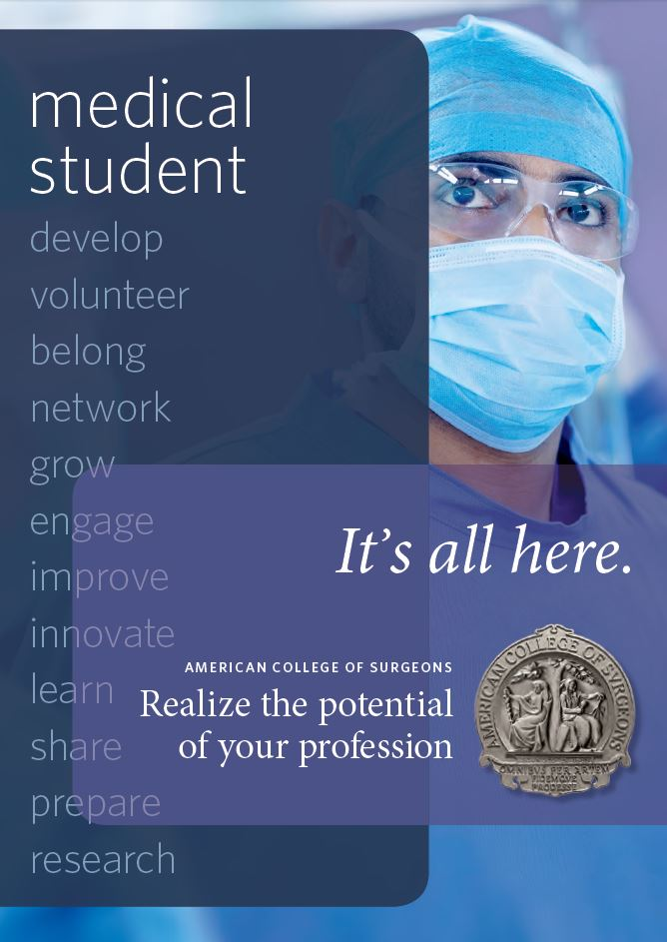

ACS MEDICAL STUDENT TOOLKIT
BENEFITS OF MEDICAL STUDENT MEMBERSHIP

Slide 2
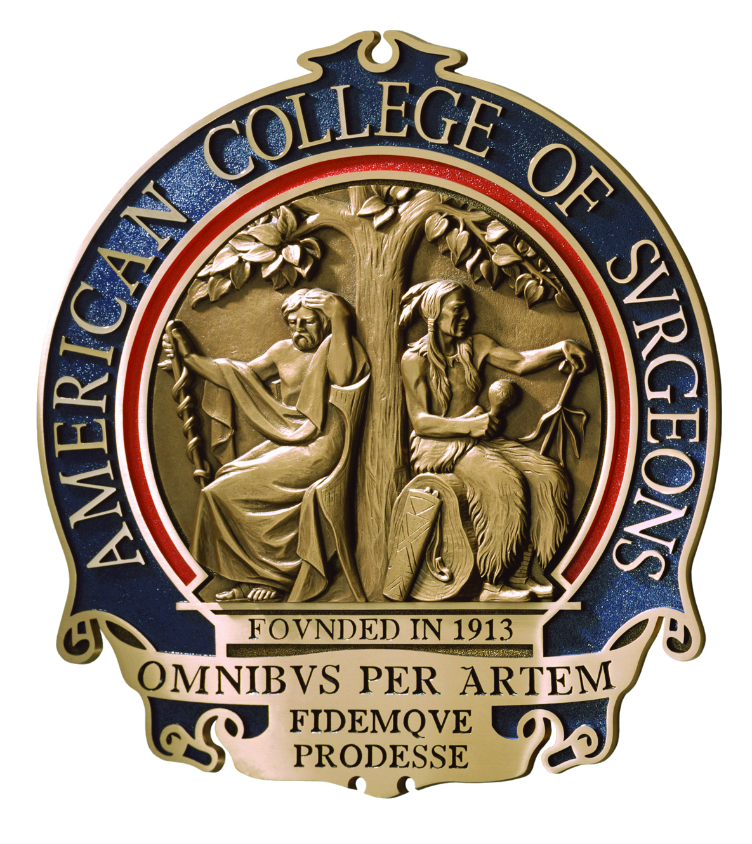
What is the American College of Surgeons?
The largest organization of surgeons in the world
Founded in 1913
Develops education and training programs
Improves care for surgical patients
Provides scholarships and fellowships for the next generation of surgeons
Conducts research to provide best practices in patient care
Gives surgeons throughout the world opportunities for networking
Promotes the image of the surgical profession

Slide 3


More than 80,000 Members Worldwide
ACS

Slide 4
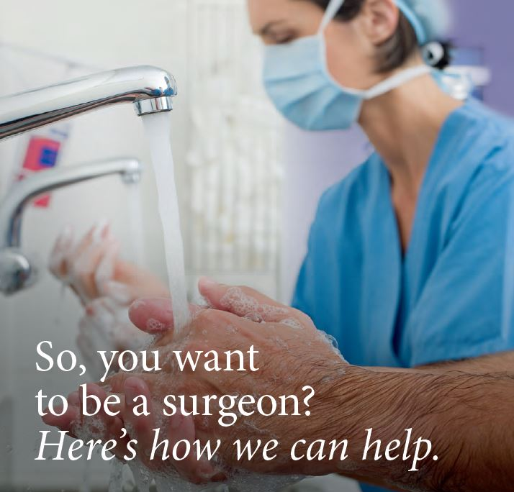
Join the more than 3,000 medical student members across the country who have turned to the American College of Surgeons (ACS) to learn more about how to prepare for a career in surgery.
As a Medical Student Member, you will receive access to a wide variety of benefits to enhance your professional experience and assist you on your path to becoming a surgeon.

Slide 5

EDUCATIONAL RESOURCES
Planned presentations and activities include:
Lifestyle Issues in Surgery
Mastering the Surgical Residency Interview
Skills Workshops
Mock Interview Practice
Networking with Specialty Surgeons, Program Directors, and Surgical Residents
ACS Clinical Congress
Medical Student Program

Slide 6


EDUCATIONAL RESOURCES
The American College of Surgeons created an online version of the popular book, "So you want to be a surgeon,” that contains expanded content, including information about all the surgical specialties that admit PGY 1 residents.
"So You Want to Be A Surgeon: An Online Guide to Selecting and Matching with the Best Surgery Residency” is updated on a continuous basis.

Slide 7


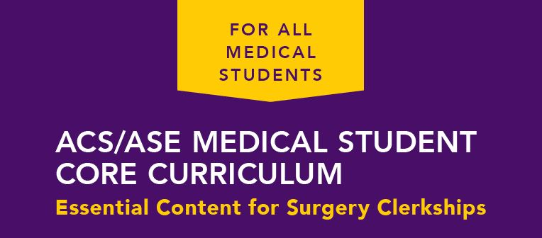
EDUCATIONAL RESOURCES
Ensures that fourth-year students have the solid basic surgical skills necessary to step into their new roles as surgery residents
Offers medical students structured, uniform, and consistent learning experiences related to the essential surgical skills needed by all physicians
Addresses the competency-based surgical cognitive skills needed by all medical students prior to graduation

Slide 8
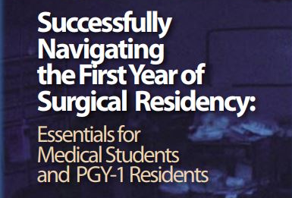

EDUCATIONAL RESOURCES
  Addresses the essential areas of knowledge and skills that medical students should possess before beginning surgical residency training
  Provides a standardized introductory course in the evaluation and management of trauma for medical students

Slide 9


Engagement Opportunities
GO GLOBAL
STOP THE BLEED

Slide 10
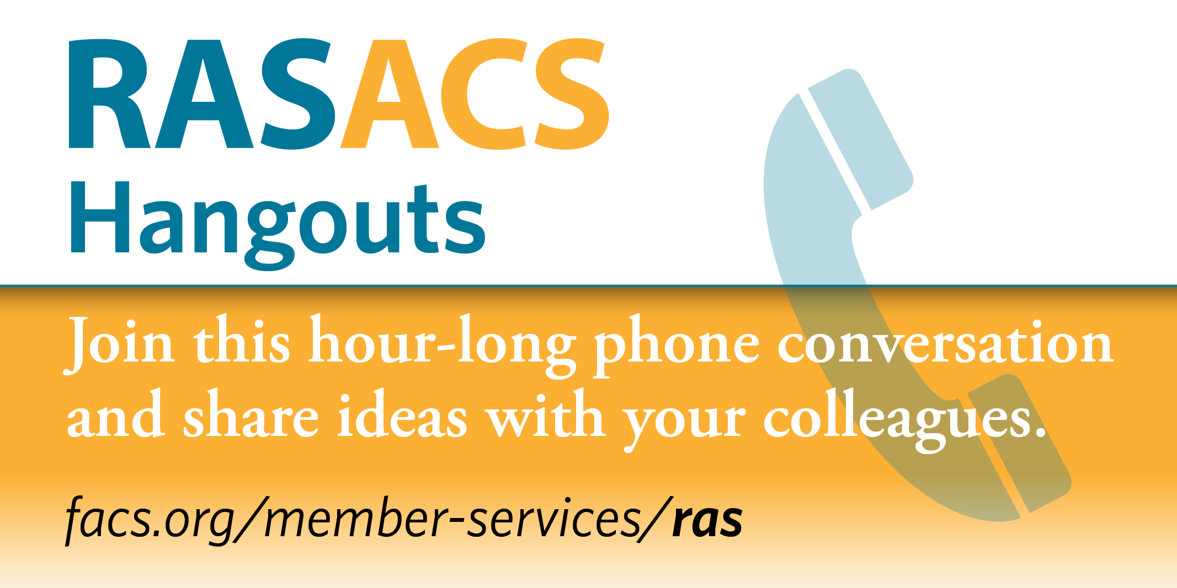
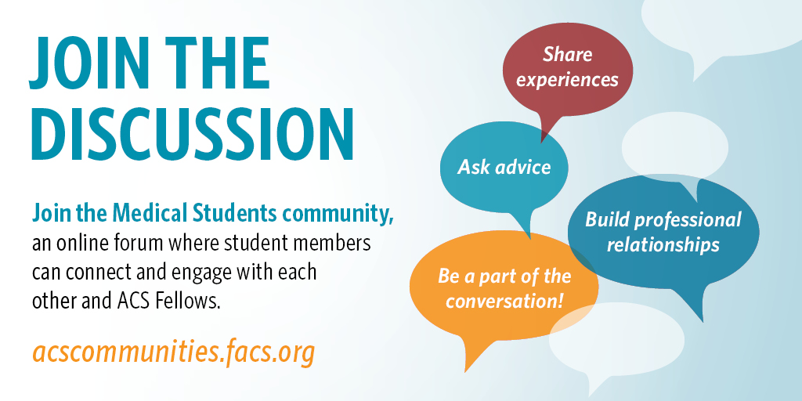
Engagement Opportunities
HANGOUT WITH RAS-ACS
START A CONVERSATION

Slide 11
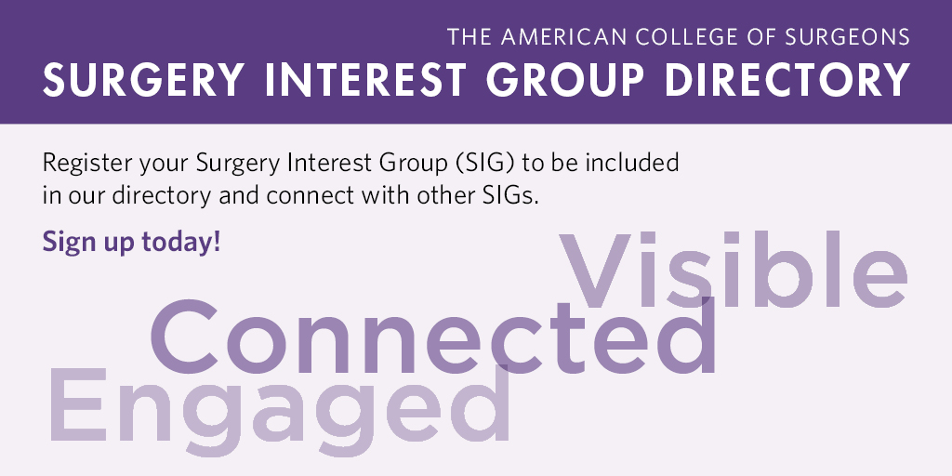
Engagement Opportunities
BUILD CONNECTIONS
LISTEN AND LEARN
Student Podcast Series
RAS-ACS has developed a podcast series designed to improve future experiences for medical students who enter the surgical field by providing guidance on common topics related to research, interviews, matching, and more.

Slide 12
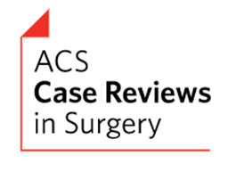
Engagement Opportunities
GET PUBLISHED
SHARE YOUR STORY
Medical students are encouraged to submit to ACS Case Reviews in Surgery; however, in order to do so, an ACS fellow must be included as one of the case report authors.
Contact: casereviews@facs.org
Share your SIG success story about a program, new initiative, event, or volunteer project and you may be featured on our website and in an issue of ACS Medical Student News.
Contact: hlakew@facs.org

Slide 13
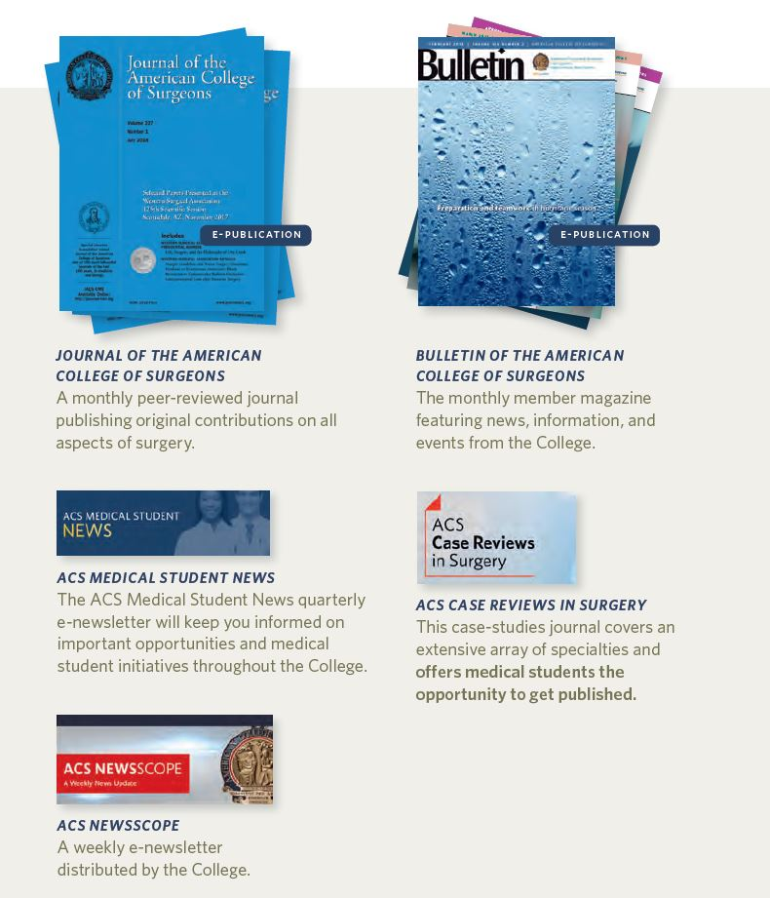
PUBLICATIONS
Complimentary access to ALL
ACS publications!

Slide 14

ADVOCACY
The ACS is the largest and most comprehensive voice for all surgeons.
Advocacy is an important part of your future career.
It’s important to advocate for your profession and future patients.
Find your voice!

Slide 15

LEADERSHIP & ADVOCACY SUMMIT
“Through my participation at the ACS Leadership Summit, I have become more knowledgeable about the various ways that surgeons across the country are serving as leaders and making a significant impact within the medical community.”
Adam Miles Berenson
Texas A&M College of Medicine
MD Candidate, Class of 2019
Access the ACS Medical Student’s Guide to Advocacy to learn more about getting involved in advocacy!

Slide 16

Did you know…
…that the #1 way to get a job
(or a recommendation) is to network?

Slide 17
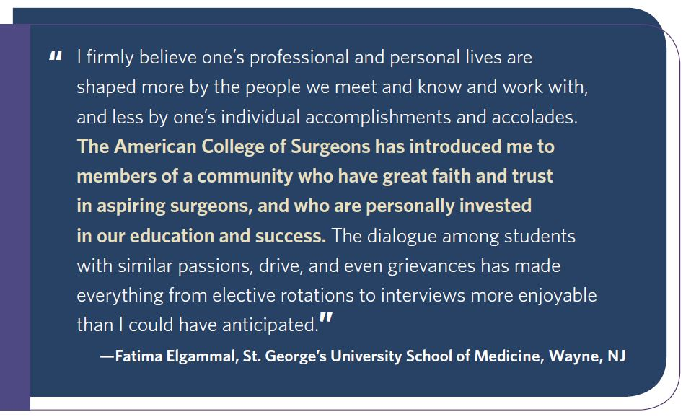
NETWORKING
Join:
Local ACS Chapter
Surgery Interest Group Directory
Medical Student Community
RAS-ACS Hangouts
ACS Committees
Attend:
Clinical Congress
Leadership & Advocacy Summit
Local ACS Chapter Meetings

Slide 18
HOW TO APPLY
Medical Student Membership
What you’ll need to apply
Your current contact information
Information about your medical education
Verification that you are currently attending medical school
Information about your graduate degree
Information about your military service, if applicable
Easy online application
Only $20 to apply
Access to ACS communities & publications
Unique educational and networking opportunities
Your Membership Matters!
If you have any questions about applying contact enroll@facs.org

Slide 19






STAY CONNECTED!
STAY CONNECTED!
Connect with us to make sure you don’t miss out on any ACS news or opportunities!
www.facs.org
facebook.com/AmCollSurgeons
@AmCollSurgeons
youtube.com/AmCollegeofSurgeons

