Slide 1
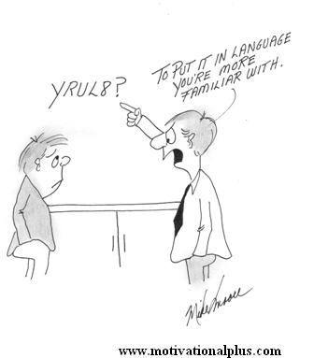

Teaching in the Clinic
Board of Governors
Education Pillar
Surgical Training Workgroup
Notes:
Teaching surgery outside of the operating room can be a significant challenge for many practitioners. The talk on teaching millenials highlights the learning styles of this new generation of others. While the socratic method is useful at times this style can be perceived as abusive and demeaning. Teachers therefore, need to adopt techniques they may not be familiar with to effectively interact with modern medical learners. In this talk we will highlight the challenges facing the surgeon trying to teach outside the operating room and provide some simple tools that can be used in an attempt to be successful.

Slide 2
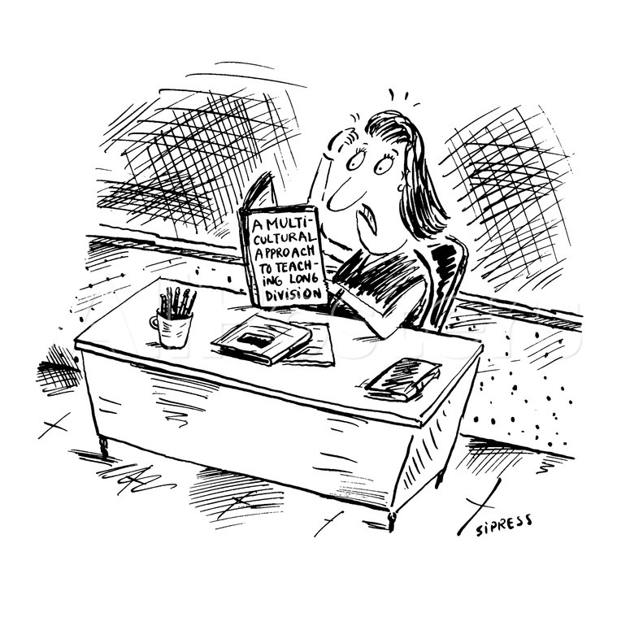
Notes:
Teaching for most clinicians is an acquired, not innate, skill. We are teaching learners that are very different from us and we need to be clinically and emotionally competent, while being skilled educators.

Slide 3
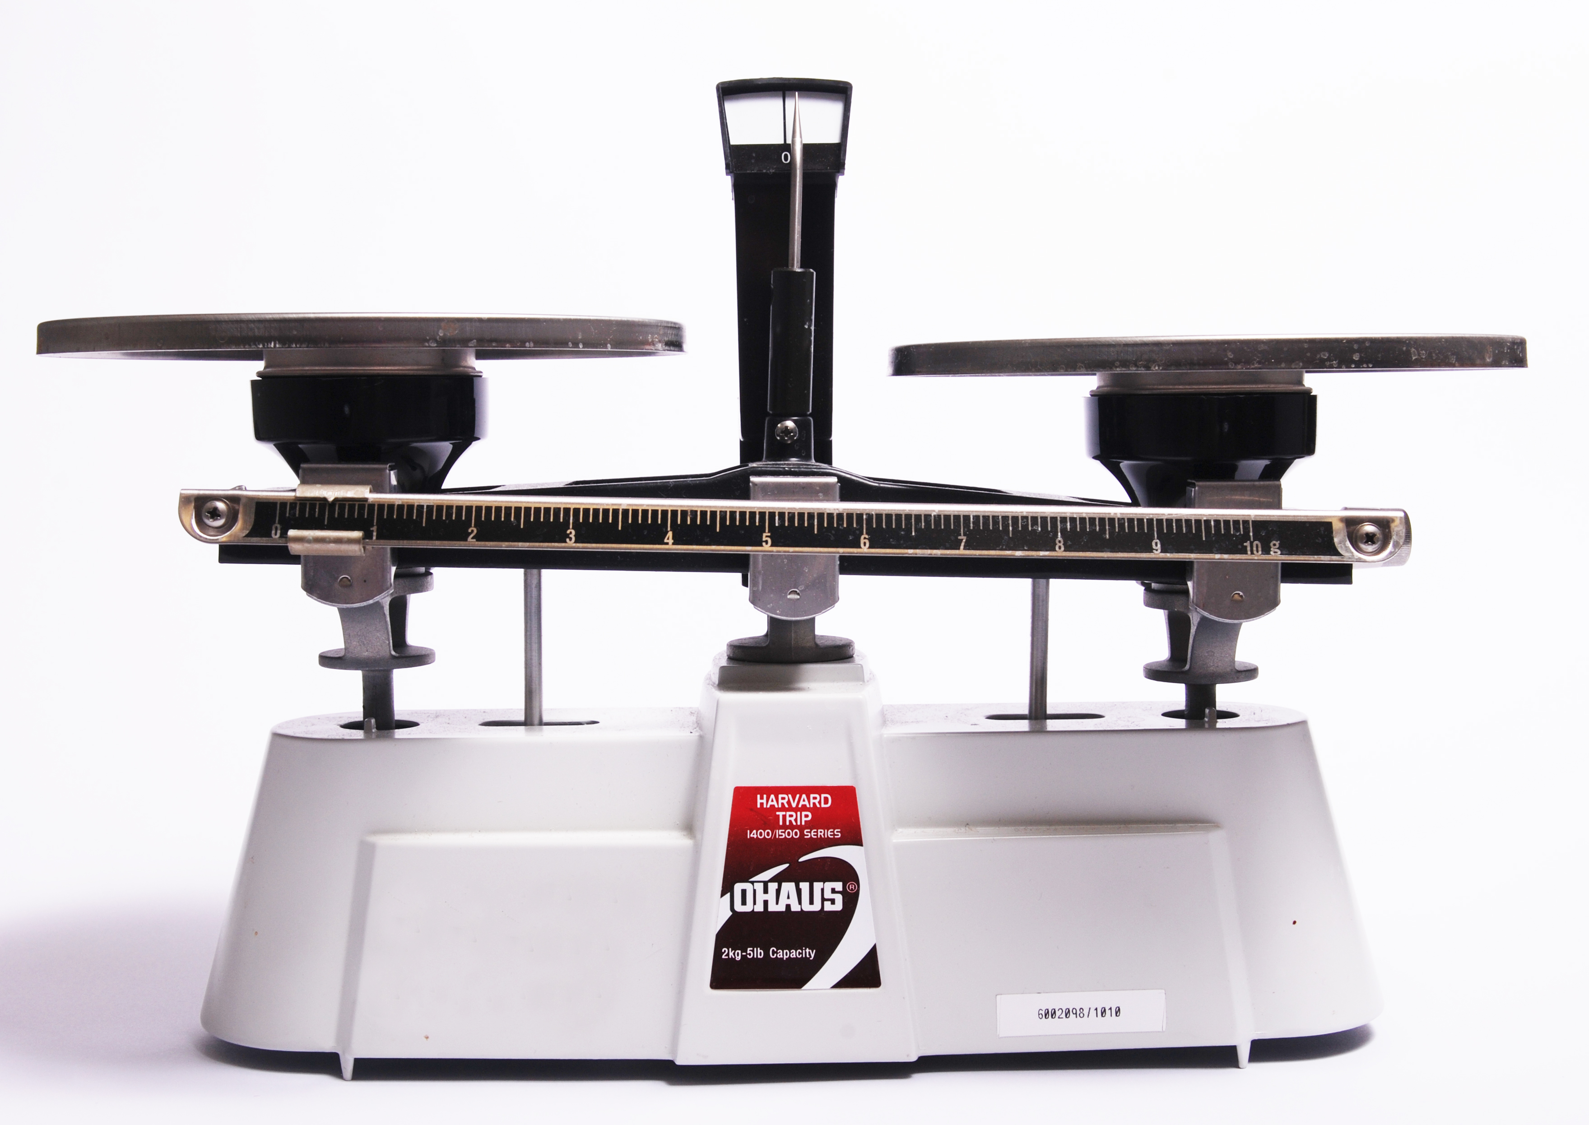
Educational Challenges
Provide quality medical care
Maintain clinical efficiency
Provide meaningful education
Time constraints.
Lack of remuneration.
Lack of skills.
  Experience
  Institutional resources
Notes:
The surgeon is faced with multiple challenges in an attempt to become an effective educator. On one side is the need to provide meaningful education while providing efficient, high quality medical care. On the other side are time constraints, lack of remuneration for teaching, and a lack of knowledge concerning effective teaching. In other words, how can you effectively educate students and residents, at times an unfunded mandate, while still achieving work RVU targets. Fortunately most medical schools are beginning to recognize this challenge. Local resources are available to help clinicians become more effective educators. Several surgical societies including the ACS have “Surgeons as Educator” courses. Additionally, some medical schools are providing credit in the form of either decreased wRVU targets or educator tracks for promotion to encourage high quality teaching by faculty.

Slide 4
“I desire no other epitaph… than the statement that I taught medical students in the wards, as I regard this as by far the most useful and important work I have been called upon to do.”
Sir William Osler, M.D.
The Fixed Period, in Aequanimitas.
Notes:
Regardless of how busy we believe we are as faculty members and as preceptors for students and residents we have an obligation to society to teach the next generation of providers.

Slide 5
Key Cognitive Attributes of
Effective Clinical Teachers
Demonstrates clinical skills
Well organized
Excellent communication skills
Knowledgeable
Notes:
It is important to understand what are the attributes that make a clinician an effective educator. I think this can be broken down into two main categories cognitive and noncognitive attributes. The cognitive attributes include being an excellent clinician with an appropriate fund of knowledge who is organized and able to communicate.

Slide 6
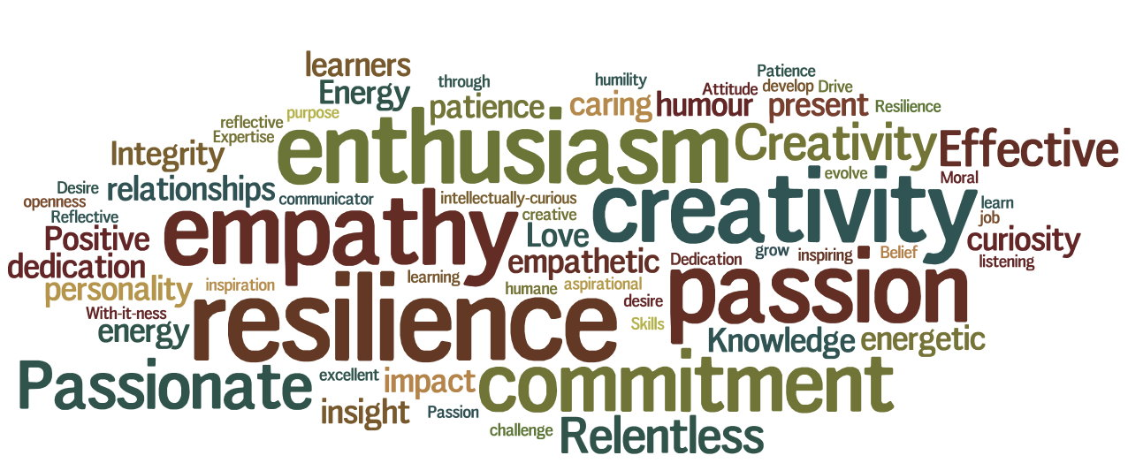
Key Non-Cognitive Attributes of
Clinical Teachers
Notes:
While the cognitive attributes are important the most crucial attributes are non-cognitive. This is a mind-map of the attributes of effective teaches as described by a group of learners. From this mind-map we can see that the most important attributes include enthusiasm, passion, resilience, empathy, and creativitiy. It appears the key to being an effective educator is having passion for the role.

Slide 7
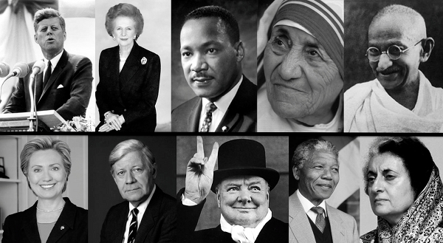
You are a Role Model
Notes:
Whether you like it or not as a clinician you are a role model. Learners will look at your behavior and will listen to your words as representative of your profession. Your goal should be to inspire them to become outstanding physicians and hopefully surgeons.

Slide 8

Notes:
This quote from William Ward sums it up. The great teacher inspires. I wouldn’t be here today if it weren’t for the great teachers I had (give a personal example or two)

Slide 9
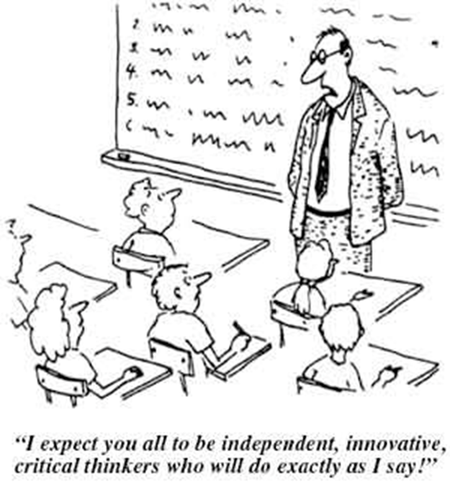
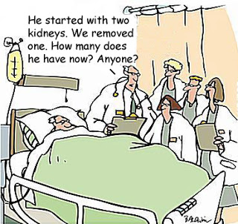
Notes:
As I mentioned earlier teaching clinical surgery to students and residents is not an easy task. Not all of us are natural born educators. So what are some simple things we can all do to become more effective?

Slide 10
Incorporate teaching into your “every day” activities. Teaching should be inextricably integrated with your patient care activities.
Notes:
The first thing is to adopt the mindset that part of my daily standard work is teaching.

Slide 11
Practical tips for Teaching in the Clinic
Prepare for the visit
Teach during the visit
Teach after the visit
Notes:
McGee and Irby describe three practical tips for efficient teaching in the outpatient clinic. The first is to make sure you prepare the learners for the experience. Learners should be thoroughly oriented to clinic personnel and management including the number of patients to be seen, time to be spent with each patient and how to present patients succinctly. Patient Specific Orientation should also be considered.
Orienting the student to each patient to be interviewed can significantly enhance the effectiveness of
both the learning process and the clinic. This orientation might include reviewing the patient’s medical
background, directing the trainee which complaint to focus on, setting guideline for physical exam., and
setting a time limit for the initial encounter.
The second tip is to teach during the visit. Ask questions to diagnose the
learner’s knowledge and clinical reasoning, select a specific teaching point in each case, model good
physician-patient interactions, observe at least in part learner-patient interactions and provide timely and
specific feedback. The third tip is to teach after the visit. This means answering questions that arise from
specific patient problems, clarify what learners did not understand, refer to literature and create reading
assignments.

Slide 12

One Minute Preceptor
Notes:
The ‘Microskills’ of teaching, also called the one minute preceptor because of the short time available for teaching in
the clinical environment, provides a simple framework for daily teaching during patient care (Neher et al. 1992). These steps can be used to
structure effective short clinical teaching encounters that last five minutes or less as well as to address problems that arise.

Slide 13
One Minute Preceptor
Getting a commitment
Probing for supporting evidence
Teaching general rules
Reinforcing what was done well
Correcting mistakes
Notes:
The original microskills model uses a five-step approach. 1. Getting a commitment: The teacher encourages
learners to articulate their opinions on the differential diagnosis and management rather than giving their own
conclusions and plans. The teacher must create a safe learning environment so that learners feel safe enough to risk
a commitment – even if it is wrong.
Step 2. Probing for supporting evidence: The teacher should encourage learners to ‘think out loud’ and give their
rationale for the commitment they have just made to diagnosis, treatment, or other aspects of the patient’s problem. Teachers
should either validate learners’ commitments or reject them gently if flawed.
Step 3. Teaching general rules: Teachers can guide learners to understand how the learning from one patient can be
applied to other situations. The learner is primed for new information they can apply to a given patient as well as future
patients. If the learner has performed well and the teacher has nothing to add, this microskill can be skipped.
Step 4. Reinforcing what was done well: It is appropriate to use this microskill every time the trainee has handled a patient
care situation well. Effective reinforcement should be specific and behaviour based and not vague. Positive feedback also
builds the trainee’s self-esteem.
Step 5. Correcting mistakes: Negative or constructive feedback is often avoided by clinical teachers, but this is vital to ensure good patient care. Encouraging self-assessment is a good way to have the learners realize their mistakes themselves and if they have identified their errors, they can be given positive feedback on their self-reflective capabilities. If the teacher has to point out mistakes, this must be specific,
timely and based entirely behavior based.

Slide 14
You have a new third year medical student on your service who has just seen a patient referred for right upper quadrant abdominal pain.
Student: Hi, I just saw Mrs. Smith. She is a 45-year old female who complains of intermittent right upper quadrant abdominal pain. She has a history of hypertension. The pain began four months ago. The pain is described as colicky in nature and comes on 20-30 minutes after a meal. The patient states that they believe fried food makes it worse. The patient does not report nausea or vomiting. She does not drink or smoke and her only medication is HCTZ. On physical exam she has minor tenderness to deep palpation in the right upper quadrant of her abdomen. The patient has had an ultrasound that is reported to show stones in the gallbladder. (The student pauses here waiting for a response).
Notes:
I would like to present an example of the one minute preceptor technique in action using a common general surgical case.

Slide 15
Get a Commitment
What do you think is going on with this patient?
Are there any other possible diagnoses?
What other tests, if any, would you order?
What treatment would you recommend for this patient?
Notes:
Notice that questions used in getting a commitment do not simply gather further data about the case. The goal is to gain insight into the learner's reasoning. Questioning by the preceptor for specific data reveals the preceptor's thought process – not the learner's. The learner in the example above needs the opportunity to tell you their assessment of the patient data they have collected.

Slide 16
Probe for Supporting Evidence
What factors in the history or physical support your diagnosis?
Why would you recommend the treatment you did?
Would you treat this patient any differently if they had asymptomatic gallstones?
Would it make any difference if this patient had a fever or had jaundice?
Notes:
Now that you have a commitment from the learner, it is important to explore what the basis for their opinion was. The educational setting often rewards a lucky guess to the same degree as a well-reasoned, logical answer. In the clinical setting, it is important to determine that there is an adequate basis for the answer and to encourage an appropriate reasoning process. By the same token it is important to identify the “lucky guess” and to demonstrate the use of appropriate supporting evidence.
Once the learner has made their commitment and looks to you for confirmation, you should resist the urge to pass immediate judgement on their response. Instead, ask a question that seeks to understand the rationale for their answer. The question you ask will depend on how they have responded to your request for a commitment:

Slide 17
Teach a General Principal
With a similar history pain persisting more than 24 hours is likely to be acute cholecystitis not biliary colic.
It is important to look at both total and direct bilirubin when evaluating a patient. In the case of gallbladder disease it is the direct bilirubin that is diagnostic of biliary obstruction.
Gram negative organisms are most often associated with acute cholecystitis, although you can see enterococcus on occasion.
Notes:
One of the key but challenging tasks for the learner is to take information and data gained from an individual learning situation and to accurately and correctly generalize it to other situations. There may be a tendency to over generalize – to conclude that all patients in a similar clinical situation may behave in the same way or require the exact same treatment. On the other hand, the learner may be unable to identify an important general principle that can be applied effectively in the future. Brief teaching specifically focused to the encounter can be very effective. Even if you do not have a specific medical fact to share, information on strategies for searching for additional information or facilitating admission to the hospital can be very useful to the learner.

Slide 18
Reinforce What was Done Well
It was important that you tried to establish a relationship to meals.
You did a good job describing the patient’s past medical history.
Your presentation was very concise.
I liked that you mentioned the nature of the pain.
Notes:
In order for the learner to improve they must be made aware of what they did well. The simple statement “That was a good presentation” is not sufficient. The learner is not sure if their presentation is “good” because they included current medications or because they omitted the vital signs. Comments should include specific behaviors that demonstrated knowledge skills or attitudes valued by the preceptor

Slide 19
Give Guidance about
Errors and Omissions
When presenting a patient with possible gallbladder disease you should mention if the patient has a history of jaundice.
Even when the diagnosis is relatively simple the family history can be insightful.
Remember to include the past surgical history as part of your presentation.
Notes:
In framing comments it is helpful to avoid extreme terms such as `bad' or “poor”. Expression such as “not best” or “it is preferred” may carry less of a negative value judgement while getting the point across. Comments should also be as specific as possible to the situation identifying specific behaviors that could be improved upon in the future.
It is important to reflect here that a balance between positive and constructive criticism is important.

Slide 20
Getting Better as Educator
Identify opportunities (they’re everywhere) & take risks
Don’t be intimidated; extraordinary knowledge or talent not required!
Pay attention to others - why are/aren’t they effective?
Prepare when possible - decreases your stress level/anxiety of the unknown
When using “few minute preceptor” don’t get hung up on order or straying from script – It’s “a”way, not “the” way
Practice
  The more you teach, the better you’ll become

Slide 21
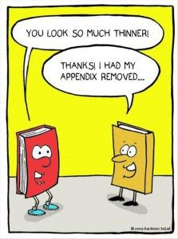
A Little Surgical Humor

