Slide 1
Hospital Based Violence Intervention Programs
Your Name
Your Institution
Date

Slide 2
Overview and Objectives
Violence is a public health issue
Meaningful statistics of violence in the U.S. and local city
Factors that lead to injury and criminal recidivism
Creation of a Hospital Based Violence Intervention Program (HVIP)
Target population of HVIP at Name of your Hospital
Importance of data collection, advocacy, and partnerships

Slide 3
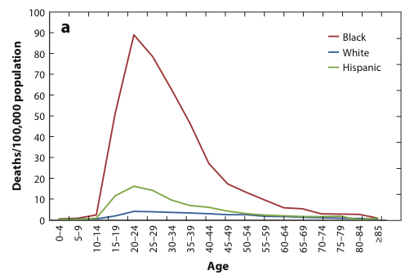
Burden of Firearm Deaths
Severity and Disparity of Homicide in Youth and Young Adults
33,000 annual firearm deaths
  35% homicide
  67,000 annual injuries
Homicide is the third leading cause of death among Americans 15-34 years old
Burden of homicides fall disproportionately on young, minority men
#1 cause of death in African Americans 15-34 years old
  53 per 100k African Americans
#2 cause of death in Latinos 15-34 years old
  20 per 100k Latinos
Firearm homicide mortality rates among males, 2012

Slide 4

Violence is a Public Health Issue
Public Health is Population-Based
Public Health Approach to Violence is rooted in:
  Risk Factors
  Protective Factors
Violence affects:
  Families
  Communities
  Populations
The Public Health Approach to Violence Focuses on Mitigating Modifiable Root Causes

Slide 5
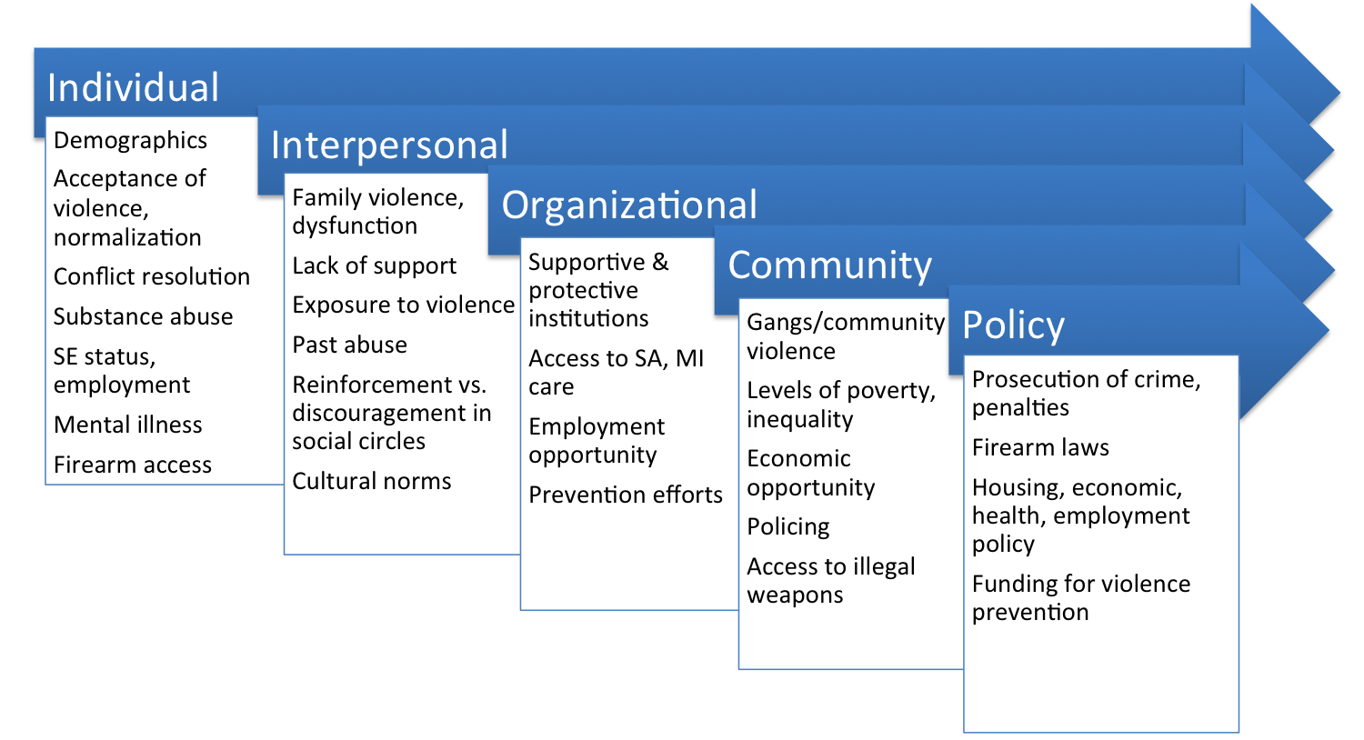
Multiple Contributors to Violence - Modifiable Risk Factors Exist

Slide 6
The Trauma Center’s Role in Public Health and Prevention
20-40% recidivism rate after being a victim of assault
20% of homicide victims are treated for a violent injury in the 5 years preceding their death
Risk Reduction strategies can be provided in trauma centers
  Utilize the “Teachable Moment”
  Culturally competent case management at bedside
  Community partnerships
Public Health
Injury Surveillance
Advocacy
Research
Services
Prevention & Control
Policy
Evaluation

Slide 7
Culturally Competent Case-Management Based Model
Case managers should be credible messengers
  Case managers should come from the community, understand urban violence and have knowledge of the community
Case managers go to bedside for “Teachable Moment”
  The “Teachable Moment” is a time after which a life-threatening event occurs when an individual is most open to risk factor reduction
Case Managers shepherd clients through mental health care and risk reduction resources offered through city and community
  Employment, tattoo removal, safe schools, vocational training..
  6 months to 2 years, dependent upon client needs and program capacity

Slide 8
Intervention Program Design
INJURY
Initial Trauma Care
HOSPITAL CARE
Teachable
Moment
Assessment by Case Managers at Bedside
Low Risk
High Risk
RECOVERY
Referral to Appropriate Resources
Intervention Program
Notes:
To talk about our intervention program a little…Specifically, after the patient receives initial trauma care for the injuries, one of our five culturally competent case managers meets the individual at the bedside during their initial hospitalization (taking advantage of the teachable moment). The case managers perform risk assessments and offers the highest risk individuals enrollment into the case management program. Enrolled client spends approximately six months to one year in the program.

Slide 9
Noteworthy Programs
Wraparound Project, San Francisco, CA
Prospective data, 2005 – 2011
Participants:
  10-30 yr-old “high risk” patients identified by social workers
Interventions:
  Case management, connection to community resources, follow-up
Outcomes:
  N=254
  Recidivism from violent injury significantly lower compared to historical controls (16 vs 4.5%)
Journal of Trauma and Acute Care Surgery
2013; 74:976-982

Slide 10
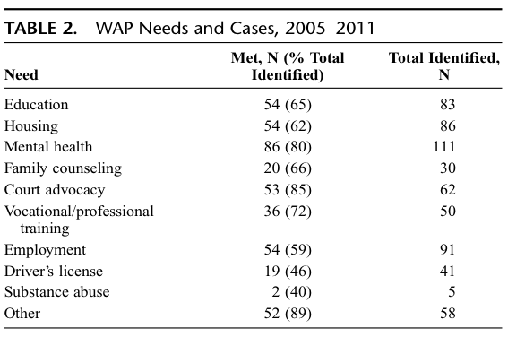
Noteworthy Programs
Wraparound Project, San Francisco, CA
Services most strongly associated with success: employment and mental health support
Journal of Trauma and Acute Care Surgery 2013; 74:976-982

Slide 11
Noteworthy Programs
Bridging the Gap, Richmond, VA
Brief in hospital violence intervention (BVI), with community case management (CCM) and follow up
Initiated as a prospective randomized study in in 2007
Currently a standard of care at VCU Level 1 Trauma Center
Program Participants: admitted patients with intentional injuries
  149 patients , age 10-24, (BVI plus CCM)
  272 Violence Consultation, age >24, (BVI and referral)
Process & Outcomes:
  Program growth from 0.5 FTE in 2007 to 4 FTE in 2015
  Hospital : Decrease Violence Recidivism from 15% to 3.6%; Improved ED resource utilization and clinic visits
  Community services : > 90% connected to community service programs, including mental health, employment internships.
Journal of Trauma and Acute Care Surgery, 2011 July;71(1):228-37;
Curr Trauma Rep (2017) 3:79–88

Slide 12
Noteworthy Programs that have Replicated
Boston’s Violence Intervention Advocacy Program (VIAP)
Drexel and CHOP’s Healing Hurt People
Oakland’s Youth Alive/Caught in the Crossfire
Baltimore’s Violence Intervention Program (VIP)
Milwaukee’s Project Ujima
Indianapolis’ Prescription for Hope

Slide 13
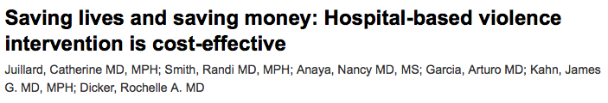
HVIPs are Cost-Effective for Hospitals
Prevention of 3.5 injury recidivists per year render program cost-neutral
Program overall saves hospital estimated $500,000 per year when recidivists are considered against the cost of the program
Journal of Trauma and Acute care surgery
Volume 78, Number 2

Slide 14
Surveillance: Local Burden of Violence
Use this slide to populate the local burden of violence – vital statistics

Slide 15
Trauma Center at Name of your hospital
Number of annual trauma admissions
Percent of penetrating trauma
Percent of interpersonal violence
Recidivism rate for interpersonal violence (usually calculated over 5 years)
Homicides in your city per year
Demographics of at-risk population (this will be your target population for the program)

Slide 16
Trauma Center at Name of your hospital
Insert any press about violence in your community here
Insert statement about the value in the hospital building partnerships with the communities it serves

Slide 17
General Steps for setup of HVIPs
Needs assessment-Surveillance
  Completed!
Resource building
  No need to reinvent the wheel: COT and NNHVIP guidelines and mentorship
  Grant funding
  Sustainability plan
  Develop Community Partnerships
Implementation
  Legal agreements and memoranda of understanding
  Hiring and Finance
  Training
  Hospital champion
  Case management at the core
Intervention
  HVIP provides interventions to patients
  Data collection
  Accountability and Evaluation

Slide 18
Timeline for setup of HVIP at Name of your Hospital
Month, Year: Needs assessment
Month, Year: Resource Building
Month, Year: Implementation
Month, Year: Intervention

Slide 19
Impact at Name of your Hospital
Anticipated length of grant funding: fill in
Anticipated sustainability funding: fill in
Anticipated number of patients enrolled in year 1: fill in

Slide 20
Snapshot of an Ideal Comprehensive Violence Prevention Program
Enough case managers to screen all victims of violence
Sustainable funding (line item in city budget or reimbursement through policy change)
In-house mental health services
Long-term follow-up
Expanding the Teachable Moment to the Community Setting
Mature quantitative and qualitative analysis expertise
Partnerships (formal, with MOU’s) with community and city resources
  Vocational training and Jobs
  GED/school
  Tattoo removal
  Victim of crime office
  Housing

Slide 21
Research and Evaluation Goals
•Cost-effectiveness
•Endpoints in the population at Name of your Hospital
Recidivism
Job placement
Stable housing
Connection with mental health services
Qualitative “value”
•Validation studies for assessment of “high-risk” patients
•Add data elements to National databanks run through the Committee on Trauma and the NNHVIP

Slide 22
National support for our initiatives
National Network of Hospital Based Violence Intervention Programs (NNHVIP)
  Provides Mentoring program for new Programs
    Now over 30 programs
  Annual Conference for Idea sharing
    Coordinated with Cure Violence
  Data sharing and National Databank
  Multiple Working Groups
  Publishes “Violence Is Preventable” guidebook to HVIP setup
    Best Practices and Curriculum Development
•American College of Surgeons Committee on Trauma
  Injury Prevention workgroup
  Provides a Primer to educate key stakeholders
Eastern Association for the Surgery of Trauma
American College of Emergency Physicians

